Slide 1

PGDF (24-26) Fundamental Analysis (FAL)
Session 1 (15-Nov-2025)

Slide 2
For Discussion in this Course
Introduction to Fundamental Analysis (FAL)
FSA Framework in FAL
F Score,M Score and Benford Analysis
Fundamentals determining PE ratio
Fundamentals determining PEG multiple and other variants of PE Ratio
PB Multiple and its fundamentals
PS Ratio and its fundamentals
EV/EBITDA and FAL
EV/EBIT & EV/IC and FAL
EV/ Sales multiple and FAL
Loose ends in Fundamental Analysis and concluding remarks

Slide 3
For Discussion in this Session
Introduction to FAL
Financial Statement Analysis Framework

Slide 4
What is Fundamental Analysis (FAL)???
Is the process of
Identifying
Analyzing and
Measuring
the fundamentals that determine the Value of a firm to its investors.

Slide 5
What are the Fundamentals that determine the value of a firm???
Revenue
Profitability
Cash flow
Cost of debt and cost of equity
Capital structure
Assets & Liabilities
Growth in fundamental
Liquidity
Managerial ability
Reinvestment rate → Most important

Slide 6
We need to look at below in FS and assess
Profitability
WC Efficiency
Liquidity
Solvency
Cash Flow Management
Degree of Leverage of Firm(s)

Slide 7
1. Profitability
ROE vs ROC
If we look at a return pyramid where bottom part is profit margin and if this pyramid is for equity investor then profit margin is basically net profit margin however if the pyramid is for entire firm then the bottom of the pyramid is EBIT margin (or operating profit margin) here we are looking at both debt and equity (because here we are looking at entire firm)
Profit for equity share holder = ROE, profit for debt+equity share holder = ROC
Middle of the pyramid is nothing but ROE and ROC.
Excess return is ROE – cost of equity OR ROC-Cost of capital

Slide 8
Dupont Framework – ROE ( with 4 components)
ROE = (PBT/ Total Revenue) * (Total Revenue/ Total Assets )* (1-t) * ( Total Assets/ Owners Equity) = PBT*(1-T)/OE = PAT/OE
(PBT/ Total Revenue) = value component
(Total Revenue/ Total Assets ) = Volume component OR Asset turnover
(1-t) = Tax component
( Total Assets/ Owners Equity) = equity multiplier OR Debt component or Financial leverage
ROE = PBT Margin * Asset Turn * Tax Retention Rate * Equity Multiplier
Dupont 4 component can be expanded to many more like 7 components

Slide 9
Dupont Framework – ROE ( with 7 components)
= GPBDA/ Net Op.Rev
*EBITDA/GPBDA
* EBIT/EBITDA
* PBT/EBIT
* PAT/PBT
* Net OP.REV/TA
*TA/OE
GPBDA (gross profit before depr and amortization)/ Net Operating Revenue =
EBITDA/GPBDA =
EBIT/EBITDA =
PBT/EBIT =
PAT/PBT =
Net OP.REV/TA =
TA/OE =

Slide 10
Dupont Framework – ROE ( with 7 components)
Key points
We look at Net Operating revenue and ignore other income and total revenue
Expense = Cost of material consumed, change in inventory of finished good+WIP, purchase of STOCK IN TRADE, direct and operating expense, employee benefit expenses
For us to arrive at COGS excluding D&A we need to take all above items.
GPBDA = Net Operating Rev – Cost of good sold excluded D&A
Cost of good sold excluding D&A can be arrived from above expense items.
OE = total shareholders fund + minority interest. If we take standalone statement, then we only use total shareholder fund. If we take consolidated statement, then we need to include minority interest.

Slide 11
Modified P&L Stat. from the data given in Annual Report
Particulars | Amount ( in INR crores)
Operating Revenue (Net) | ***
Less: CGS (excluding D&A)= Cost of Materials Consumed +Purchase of Stock in Trade + Operating and Direct expenses + or - Changes in inventories of FG,WIP & stock in trade + Employee Benefit Expenses | ***
Gross Profit (before D&A)= GPBDA | ***
- Other Expenses (=SGA) | ***
EBITDA | ***
Less : D&A | **
EBIT or Operating Income | ***
Less: Finance Costs ( Other Income is Ignored) | **
Adjusted PBT | ***
Less: Tax expenses ( Adjusted PBT * Effective Tax Rate)
Adjusted PAT or Net Income | ***

Slide 12
Dupont Framework ( ROE)
Sub-Parameters Considered ( Higher the Better)
Gross Profit Before D&A Margin
SGA Advantage
D&A Advantage
Interest Advantage
Tax Advantage
Asset Turn
Equity Multiplier

Slide 13

FAL PGDF (24-26)
Session2 (16-Nov-2025)

Slide 14
GP Before D&A Margin of HUL-Last Five Fys
Particulars | March 2025 | 2024 | 2023 | 2022 | 2021 | 2020
Net Operating Revenue (INR Cr) | 62288 | 60966 | 59549 | 51548 | 46321 | 39238
(-) CGS exclude.D&A ( =Total exp – D&A-fin costs- other exp) | 33655 | 32769 | 34570 | 28280 | 24506 | 20079
GP Before D&A | 28633 | 28197 | 24979 | 23268 | 21815 | 19159
GP Before D&A Margin in % | 45.97 | 46.25 | 41.95 | 45.14 | 47.10 | 48.83
5 year Average | 45.28%

Slide 15
SGA Advantage of HUL- Last Five Fys
Particulars | March 2025 | 2024 | 2023 | 2022 | 2021 | 2020
GPBDA | 28633 | 28197 | 24979 | 23268 | 21815 | 19159
- Other Expenses | -14615 | -14464 | - 11,861 | -11309 | -10896 | -9843
EBITDA | 14018 | 13733 | 13118 | 11959 | 10919 | 9316
EBITDA/GPBDA | 0.490 | 0.487 | 0.525 | 0.514 | 0.501 | 0.486
5 year average | 0.503

Slide 16
D&A Advantage of HUL - Last Five Fys
Particulars | March 2025 | 2024 | 2023 | 2022 | 2021 | 2020
EBITDA | 14018 | 13733 | 13118 | 11959 | 10919 | 9316
- D& A | -1355 | -1216 | - 1137 | -1091 | -1074 | -1002
EBIT | 12663 | 12517 | 11981 | 10868 | 9845 | 8314
EBIT/EBITDA | 0.903 | 0.911 | 0.913 | 0.909 | 0.902 | 0.892
5 Year Average | 0.908

Slide 17
Interest Advantage of HUL- Last Five Fys
Particulars | March 2025 | 2024 | 2023 | 2022 | 2021 | 2020
EBIT | 12663 | 12517 | 11981 | 10868 | 9845 | 8314
Interest + Other Income ignored | -395 | -334 | -114 | -106 | -117 | -118
EBT | 12268 | 12183 | 11867 | 10762 | 9728 | 8196
EBT/EBIT | 0.969 | 0.973 | 0.990 | 0.990 | 0.988 | 0.986
5 year average | 0.982

Slide 18
Tax Advantage of HUL- Last Five Fys ( not considering other income )
Particulars | March 2025 | 2024 | 2023 | 2022 | 2021 | 2020
EBT | 12268 | 12183 | 11867 | 10762 | 9728 | 8196
- Tax =( Actual Tax/Actual PBT)*Derived EBT | ( 3744/ 14423) * 12268 = 3185 | (3644/ 13930 )* 12183 = 3187 | (3201/ 13346)* 11867 = 2846 | (2987/11874) *10762 =2708 | (2606/10606) *9728 = 2390 | (2409/9173) *8196 = 2152
PAT or EAT | 9083 | 8996 | 9021 | 8054 | 7338 | 6044
PAT/EBT | 0.740 | 0.738 | 0.760 | 0.748 | 0.754 | 0.737
5 year average | 0.748

Slide 19
Asset Turn of HUL- Last Five Fys
Particulars | March 2025 | 2024 | 2023 | 2022 | 2021 | 2020
Net Op Revenue in INR Cr | 62288 | 60966 | 59549 | 51548 | 46321 | 39238
Total Assets | 79880 | 78499 | 73087 | 70517 | 68757 | 20153
Asset Turn | 0.780 | 0.777 | 0.815 | 0.731 | 0.674 | 1.947
5 year average | 0.755
Here asset changed a lot in 2021 due to acquisition. Here every 100 rs of asset is giving 78 rs of revenue.

Slide 20
Equity Multiplier of HUL - Last Five Fys
Particulars | March 2025 | 2024 | 2023 | 2022 | 2021 | 2020
Total Assets | 79880 | 78499 | 73087 | 70517 | 68757 | 20153
Owners’ Equity | 49609 | 51423 | 50522 | 49087 | 47694 | 8246
EM | 1.610 | 1.527 | 1.447 | 1.437 | 1.442 | 2.444
5 year average | 1.493
Higher the financial leverage, higher the ROE

Slide 21
Dupont ROE of HUL - Last Five Fys
Particulars | March 2025 | 2024 | 2023 | 2022 | 2021 | 2020 | 5 year Average
GPBDA Margin in % | 45.97 | 46.25 | 41.95 | 45.14 | 47.10 | 48.83
SGA Adv | 0.490 | 0.487 | 0.525 | 0.514 | 0.501 | 0.486
D&A Adv | 0.903 | 0.911 | 0.913 | 0.909 | 0.902 | 0.892
Interest Adv | 0.969 | 0.973 | 0.990 | 0.990 | 0.988 | 0.986
Tax Adv | 0.740 | 0.738 | 0.760 | 0.748 | 0.754 | 0.737
Asset Turn | 0.780 | 0.777 | 0.815 | 0.731 | 0.674 | 1.947
EM | 1.610 | 1.527 | 1.447 | 1.437 | 1.442 | 2.444
Dupont ROE in % | 18.32 | 17.48 | 17.84 | 16.41 | 15.41 | 73.20 | 17.09%
Some inferences
If Equity multiplier is increasing → company is taking advantage of borrowing
If asset turn over increasing → company is taking advantage of asset
Higher equity multiplier → lower the tax advantage

Slide 22
Dupont Framework – ROC ( with 3 components)
ROC = EBIT (1-Tax rate )/ Invested Capital = (EBIT/ Net Op.Revenue) (1- Tax rate) ( Net Op.Revenue/ Invested Capital)
Invested Capital (IC) = TL+OE – CL = Permanent capital or long term capital = OE+ LT Debt OR LT Borrowing
EBIT/ Net Op.Revenue is called pre-tax EBIT margin.
IC turn over = Net Op.Revenue/ Invested Capital

Slide 23
Modified Dupont Framework – ROC ( with five components)
ROC = GPBDA/ Net Op.Rev*EBITDA/GPBDA* EBIT/EBITDA* (1-T)* Net OP.REV/ IC
Gross Profit Before D&A Margin = GPBDA/ Net Op.Rev
SGA Advantage = EBITDA/GPBDA
D&A Advantage = EBIT/EBITDA
Tax Retention Rate =(1-T)
Invested Capital Turn over = Net OP.REV/ IC
All above are higher the better

Slide 24
GP Before D&A Margin of HUL-Last Five Fys
Particulars | March 2025 | 2024 | 2023 | 2022 | 2021 | 2020
Net Operating Revenue (INR Cr) | 62288 | 60966 | 59549 | 51548 | 46321 | 39238
(-) CGS exclude.D&A ( =Total exp – D&A-fin costs- other exp) | 33655 | 32769 | 34570 | 28280 | 24506 | 20079
GP Before D&A | 28633 | 28197 | 24979 | 23268 | 21815 | 19159
GP Before D&A Margin in % | 45.97 | 46.25 | 41.95 | 45.14 | 47.10 | 48.83
5 year Average | 45.28%

Slide 25
SGA Advantage of HUL- Last Five Fys
Particulars | March 2025 | 2024 | 2023 | 2022 | 2021 | 2020
GPBDA | 28633 | 28197 | 24979 | 23268 | 21815 | 19159
- Other Expenses | -14615 | -14464 | - 11,861 | -11309 | -10896 | -9843
EBITDA | 14018 | 13733 | 13118 | 11959 | 10919 | 9316
EBITDA/GPBDA | 0.490 | 0.487 | 0.525 | 0.514 | 0.501 | 0.486
5 year average | 0.503

Slide 26
D&A Advantage of HUL - Last Five Fys
Particulars | March 2025 | 2024 | 2023 | 2022 | 2021 | 2020
EBITDA | 14018 | 13733 | 13118 | 11959 | 10919 | 9316
- D& A | -1355 | -1216 | - 1137 | -1091 | -1074 | -1002
EBIT | 12663 | 12517 | 11981 | 10868 | 9845 | 8314
EBIT/EBITDA | 0.903 | 0.911 | 0.913 | 0.909 | 0.902 | 0.892
5 Year Average | 0.908

Slide 27
Tax Retention Rate of HUL- Last Five Fys
Particulars | March 2025 | 2024 | 2023 | 2022 | 2021 | 2020
Tax Rate =( Reported total Tax expenses / Reported PBT) | ( 3744/ 14423 ) | (3644/ 13930 ) | (3201/ 13346) | (2987/11874) | (2606/10606) | (2409/9173)
Tax Rate | 0.260 | 0.262 | 0.240 | 0.252 | 0.246 | 0.263
1- Tax Rate = Tax Retention Rate | 0.740 | 0.738 | 0.760 | 0.748 | 0.754 | 0.737
5 year average | 0.748

Slide 28
IC Turn of HUL- Last Five Fys
Particulars | March 2025 | 2024 | 2023 | 2022 | 2021 | 2020
Net Op.Revenue | 62288 | 60966 | 59549 | 51548 | 46321 | 39238
Owners’ Equity (including minority interest) | 49609 | 51423 | 50522 | 49087 | 47694 | 8246
Long Term Debt (LTB) | 0 | 0 | 0 | 0 | 0 | 0
IC=OE+LTD | 49609 | 51423 | 50522 | 49087 | 47694 | 8246
Op.Rev/IC | 1.256 | 1.186 | 1.179 | 1.050 | 0.971 | 4.758
5 year average | 1.128

Slide 29
Dupont ROC – HUL – Last 5 Fys
Particulars | March 2025 | 2024 | 2023 | 2022 | 2021 | 2020 | 5 year Average
GPBDAM in % | 45.97 | 46.25 | 41.95 | 45.14 | 47.10 | 48.83
SGA Adv | 0.490 | 0.487 | 0.525 | 0.514 | 0.501 | 0.486
D&A Adv | 0.903 | 0.911 | 0.913 | 0.909 | 0.902 | 0.892
Tax retention rate | 0.740 | 0.738 | 0.760 | 0.748 | 0.754 | 0.737
IC Turn | 1.256 | 1.186 | 1.179 | 1.050 | 0.971 | 4.758
Dupont ROC % | 18.91 | 17.96 | 18.02 | 16.56 | 15.58 | 74.23 | 17.41%

Slide 30
Common Size Income Statement Analysis
Expense line items as a % of Net Op.Rev

Slide 31
Common Size IS –HUL– Last 5 Fys
Particulars | March 2025 | 2024 | 2023 | 2022 | 2021 | 2020 | 5 yr Average
Net Op.Rev = 100% | 62288 | 60966 | 59549 | 51548 | 46321 | 39238
Cost of material % | 31.24 | 31.59 | 33.94 | 31.90 | 33.32 | 30.52 | 32.25
Purchase of stock in trade % | 18.10 | 17.25 | 19.44 | 18.06 | 15.37 | 16.29 | 17.28
Ch in inv of FG/WIP % | -0.25 | -0.02 | -0.13 | -0.04 | -0.87 | -0.28 | -0.27
Employee Benefit Expenses % | 4.94 | 4.94 | 4.79 | 4.94 | 5.09 | 4.64 | 4.88
Finance Costs | 0.63 | 0.55 | 0.19 | 0.21 | 0.25 | 0.30 | 0.30
D&A expense | 2.18 | 1.99 | 1.91 | 2.12 | 2.32 | 2.55 | 2.18
Other Expenses | 23.46 | 23.72 | 19.92 | 21.94 | 23.52 | 25.09 | 22.84
Total Expenses (excluding Tax ) | 80.30 | 80.02 | 80.06 | 79.13 | 79.00 | 79.11 | 79.70 %

Slide 32
2. Working Capital Efficiency
Days Receivables (DR) = (Trade Receivable/NOR)*365 → this is based on cash conversion cycle approach
Days Inventories (DI) = (Inventory/COGS)*365 → this is based on cash conversion cycle approach
Days Payables (DP) = (Trade Payable/COGS including D&A)*365
Cash Conversion Cycle = DR+DI-DP
Working Capital Turnover = NOR/WC
In net trade cycle (NTC) the formula for days receivable/days inventory/days payable are bit different.
CGS= total expense – finance cost – other expenses
Working capital = TCA-TCL

Slide 33
Days Receivables – HUL –Last 5 Fys
Particulars | March 2025 | 2024 | 2023 | 2022 | 2021 | 2020 | 5 Year Average
Trade Receivables | 3819 | 2997 | 3079 | 2236 | 1758 | 1149
Net Sales Revenue | 62288 | 60966 | 59549 | 51548 | 46321 | 39238
DR | 22 | 18 | 19 | 16 | 14 | 11 | 17.8 or 18 Days

Slide 34
Days Inventories –HUL–Last 5 Fys
Particulars | March 2025 | 2024 | 2023 | 2022 | 2021 | 2020 | 5 year Average
Inventories | 4415 | 4022 | 4251 | 4096 | 3579 | 2767
Cost of Goods Sold (including D&A) | 35010 | 33985 | 35707 | 29371 | 25580 | 21081
DI | 46 | 43 | 43 | 51 | 51 | 48 | 46.8 or 47 Days

Slide 35
Days Payables – HUL –Last 5 Fys
Particulars | March 2025 | 2024 | 2023 | 2022 | 2021 | 2020 | 5 Year Average
Trade Payables | 11315 | 10486 | 9574 | 9068 | 8802 | 7535
Cost of Goods Sold (including D& A) | 35010 | 33985 | 35707 | 29371 | 25580 | 21081
DP | 118 | 113 | 98 | 113 | 126 | 130 | 114 Days

Slide 36
Cash Conversion Cycle – HUL –Last 5 Fys
Particulars | March 2025 | 2024 | 2023 | 2022 | 2021 | 2020 | 5 year Average
DR + | 22 | 18 | 19 | 16 | 14 | 11 | 18 Days
DI | 46 | 43 | 43 | 51 | 51 | 48 | 47 Days
- DP | ( 118 ) | (113) | ( 98 ) | ( 113 ) | ( 126 ) | ( 130 ) | ( 114 Days )
= CCC | -50 | -52 | - 36 | -46 | -61 | -71 | - 49 Days

Slide 37
WC Turn – HUL – Last 5 Fys
Particulars | March 2025 | 2024 | 2023 | 2022 | 2021 | 2020 | 5 Year Average
Net Op.Revenue | 62288 | 60966 | 59549 | 51548 | 46321 | 39238
WC (CA-CL) | 5514 | 8448 | 4970 | 4242 | 3114 | 3004
WC Turn = Net Op.Rev/ WC | 11.30 | 7.22 | 11.98 | 12.15 | 14.88 | 13.06 | 11.51 times

Slide 38

FAL PGDF (24-26)
Session3 19-Nov-2025

Slide 39
3. Liquidity
Current Ratio
Quick Ratio
Defensive Interval ( or) Cash Burn Ratio = (Quick Assets / Projected Cash Expenses) *365
Projected cash expenses is assumed to be the actual cash expenses of the period
Liquidity is the firm ability to meet its short term financial obligations on time.
Defensive internal is mainly used for start-ups
Quick assets are monetary asset = current asset – inventory – prepaid expense
Actual cash expense = total expense – D&A + current tax

Slide 40
Current Ratio- HUL- Last 5 Fys
Particulars | March 2025 | 2024 | 2023 | 2022 | 2021 | 2020 | 5 Year Average
Current Assets | 22051 | 21324 | 16998 | 15522 | 14217 | 12321
Current Liabilities | 16537 | 12876 | 12028 | 11280 | 11103 | 9317
CR= CA/CL | 1.33 | 1.66 | 1.41 | 1.38 | 1.28 | 1.32 | 1.41 times

Slide 41
Quick Ratio- HUL- Last 5 Fys
Particulars | March 2025 | 2024 | 2023 | 2022 | 2021 | 2020 | 5 Year Average
Monetary CA (CA-Inventories) | 17636 | 17302 | 12747 | 11426 | 10638 | 9554
CL | 16537 | 12876 | 12028 | 11280 | 11103 | 9317
Quick Ratio | 1.07 | 1.34 | 1.06 | 1.01 | 0.96 | 1.03 | 1.09 times

Slide 42
Defensive Interval or Cash Burn- HUL- Last 5 Fys
Particulars | March 2025 | 2024 | 2023 | 2022 | 2021 | 2020 | 5 year Average
Quick Assets ( Monetary Assets) | 17636 | 17302 | 12747 | 11426 | 10638 | 9554
Projected Cash Expenses (Total exp - D&A + Current Tax) | 50020 -1355 + 3620 =52285 | 48783-1216+3521=51088 | 47682-1137 +3001 =49546 | 40786-1091+2840 =42535 | 36593-1074+2520 =38039 | 31042-1002+2243 =32283
Cash Burn | 123 | 124 | 94 | 98 | 102 | 108 | 108 Days

Slide 43
4. Solvency
D/E ( LTD/ OE) or ( Total Debt/ OE)
Interest Cover = EBIT/Interest expense
Altman’s Z score
Z score= 1.2 (WC/TA) + 1.4 (RE/TA) + 3.3 (EBIT/TA) + 0.6(MV of Equity/BV of total debt) + 0.999 (Sales/TA)
Inferences
Z Score Less than 1.81 – Bankruptcy Candidate
Z Score above 2.91- Safer Firm
Z score B/w 1.81 to 2.91 – Grey Zone
Long Term Debt = Long Term Borrowings
OE = total shareholder fund + minority interest. Total shareholder fund = Equity share capital + resources and surplus
Total Debt = Long Term Borrowings + Short Term Borrowings
Ability of company to meet long term financial obligation in time
Interest expense is nothing but finance expense
RE = total reserve and surplus, sales = total operating rev or net operating revenue
EBIT = NOR – operating expense. Opex = total expense – finance cost

Slide 44
D/E (= LT Debt/OE )- HUL- Last 5 Fys
Particulars | March 2025 | 2024 | 2023 | 2022 | 2021 | 2020 | 5 Year Average
LTD | 0 | 0 | 0 | 0 | 0 | 0
OE (total sh.holders funds + Minority Interest) | 49609 | 51423 | 50522 | 49087 | 47694 | 8246
D/E | 0 | 0 | 0 | 0 | 0 | 0 | 0

Slide 45
D/E (= Total Debt/OE )- HUL- Last 5 Fys
Particulars | March 2025 | 2024 | 2023 | 2022 | 2021 | 2020 | 5-year Average
Total Debt ( STB +LTB) | 1 | 13 | 98 | 0 | 0 | 0
OE (total sh.holders funds + Minority Interest) | 49609 | 51423 | 50522 | 49087 | 47694 | 8246
D/E | 0.00002 | 0.0003 | 0.002 | 0 | 0 | 0 | 0.0005

Slide 46
Interest Cover - HUL- Last 5 Fys
Particulars | March 2025 | 2024 | 2023 | 2022 | 2021 | 2020 | 5 Year Average
EBIT | 12663 | 12517 | 11981 | 10868 | 9845 | 8314
Finance Costs | 395 | 334 | 114 | 106 | 117 | 118
Interest Cover | 32.06 | 37.48 | 105.10 | 102.53 | 84.15 | 70.46 | 72.26 times

Slide 47
Z score –WC/TA – HUL – Last 5 Fys
Particulars | March 2025 | 2024 | 2023 | 2022 | 2021 | 2020 | 5 Year Average
WC | 5514 | 8448 | 4970 | 4242 | 3114 | 3004
TA | 79880 | 78499 | 73087 | 70517 | 68757 | 20153
WC/TA | 0.07 | 0.11 | 0.07 | 0.06 | 0.05 | 0.15 | 0.09
1.2 (WC/TA) | 0.08 | 0.13 | 0.08 | 0.07 | 0.06 | 0.18 | 0.08

Slide 48
Z score –RE/TA – HUL – Last 5 Fys
Particulars | March 2025 | 2024 | 2023 | 2022 | 2021 | 2020 | 5 Year Average
RE (Reserves & Surplus) | 49167 | 50983 | 50069 | 48826 | 47439 | 7998
TA | 79880 | 78499 | 73087 | 70517 | 68757 | 20153
RE/TA | 0.62 | 0.65 | 0.69 | 0.69 | 0.69 | 0.40 | 0.62
1.4 (RE/TA) | 0.87 | 0.91 | 0.97 | 0.97 | 0.97 | 0.56 | 0.94

Slide 49
Z score –EBIT/TA – HUL – Last 5 Fys
Particulars | March 2025 | 2024 | 2023 | 2022 | 2021 | 2020 | 5 Year Average
EBIT | 12663 | 12517 | 11981 | 10868 | 9845 | 8314
TA | 79880 | 78499 | 73087 | 70517 | 68757 | 20153
EBIT/TA | 0.16 | 0.16 | 0.16 | 0.15 | 0.14 | 0.41
3.3 (EBIT/TA) | 0.53 | 0.53 | 0.53 | 0.50 | 0.46 | 1.35 | 0.51

Slide 50
Z score –MV of Equity / BV of Debt – HUL – Last 5 Fys
MV of Equity = PE ratio on that date * Reported Profit for the period
PE Ratio Data ( Financials- Consolidated Ratios- Consolidated Valuation Ratios)
On 31-March-2025: 49.84 times
On 31-March -2024 : 51.77 times
On 31- March-2023 : 59.45 times
On 31- March-2022 : 54.21 times
On 31-March- 2021 : 71.45 times
On 31-March- 2020 : 73.74 times

Slide 51
Z score –MV of Eq /BV of Debt – HUL – Last 5 Fys
Particulars | March 2025 | 2024 | 2023 | 2022 | 2021 | 2020 | 5 year Average
MV of Equity (= P/E *reported Profit for the period) | 49.84 *10679 = 5,32,241 | 51.77 *10286 = 5,32,506 | 59.45 *10144 = 6,03,061 | 54.21 *8892 = 482035 | 71.45 *7999 = 571529 | 73.74 * 6756 = 498187
BV of Debt | 1 | 13 | 98 | 0 | 0 | 0
MV of Eq/BV of Debt | 532241 | 40962 | 6154 | NM | NM | NM
0.6 (MV of Eq / BV of Debt ) | 319345 | 24577 | 3692 | NM | NM | NM

Slide 52
Z score –Sales/TA – HUL – Last 5 Fys
Particulars | March 2025 | 2024 | 2023 | 2022 | 2021 | 2020 | 5 year Average
Sales(Net Operating Revenue) | 62288 | 60966 | 59549 | 51548 | 46321 | 39238
TA | 79880 | 78499 | 73087 | 70517 | 68757 | 20153
Sales/TA | 0.78 | 0.78 | 0.81 | 0.73 | 0.67 | 1.95 | 0.99
0.999 ( Sales/TA) | 0.78 | 0.78 | 0.81 | 0.73 | 0.67 | 1.95 | 0.75

Slide 53
Inference based on Z score
Z score below 1.81 : Bankruptcy Candidate
Z score above 2.91: Non-Bankrupt firm
B/w 1.81 and 2.91: Grey area

Slide 54
Altman’s Z score – HUL – Last 5 Fys
Particulars | March 2025 | 2024 | 2023 | 2022 | 2021 | 2020 | 5 Year Average
1.2 (WC/TA) | 0.08 | 0.13 | 0.08 | 0.07 | 0.06 | 0.18 | 0.08
1.4 (RE/TA) | 0.87 | 0.91 | 0.97 | 0.97 | 0.97 | 0.56 | 0.94
3.3 (EBIT/TA) | 0.53 | 0.53 | 0.53 | 0.50 | 0.46 | 1.35 | 0.51
0.6 ( MV of equity/BV of Debt ) | 319345 | 24577 | 3692 | NM | NM | NM
0.999 (Sales/TA ) | 0.78 | 0.78 | 0.81 | 0.73 | 0.67 | 1.95 | 0.75
Z Score ( excluding MVE/BVD) | 2.26 | 2.35 | 2.39 | 2.27 | 2.16 | 4.04 | 2.29

Slide 55
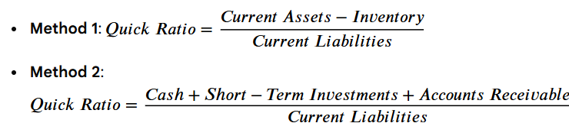
5. Cash Flow Management
CFO to Capex = CFO/Capex
CFO to Total Debt = CFO/total debt
CFO to Net Income = quality of earning ratio = accrual ratio = CFO/PAT. If PAT> CFO then there is accruality.
CFO to Current Liabilities
All above are higher the better
We are trying to looks at operating cash flow and not on cash flow generated from investing or from financing cash flow.
Current ratio = CA/CL

Slide 56

FAL PGDF (24-26)
Session4 23rd Nov 2025

Slide 57
CFO to CAPEX
2020 Data
+ Tangible Assets = INR 4960 Crores (Net PPE = Gross PPE – Acc Depr)
+ Intangible Assets = INR 402 Crores (
+ Capital Work in Progress = INR 597 Crores

Slide 58
CFO to Capex –HUL- Last 5 Fys
Particulars | March 2025 | March 2024 | March 2023 | 2022 | 2021 (2020) | 5 Year Average
Tangible Assets | 8625 | 8031 | 6949 | 6169 | 6116 (4960)
Intangible Assets | 28244 | 28247 | 28263 | 27907 | 27930 (402)
Capital WIP | 1009 | 1025 | 1132 | 1313 | 745 (597)
Delta Net Capex | 575 | 959 | 955 | 598 | 28832
+ D&A | 1355 | 1216 | 1137 | 1091 | 1074
Gross Capex | 1930 | 2175 | 2092 | 1689 | 29906
CFO | 11886 | 15469 | 9991 | 9048 | 9163
CFO to Capex | 6.16 | 7.11 | 4.78 | 5.36 | 0.31 | 4.74 times

Slide 59
CFO to Total Debt – HUL – Last 5 Fys
Particulars | March 2025 | 2024 | March 2023 | 2022 | 2021 | 5 Year Average
CFO | 11886 | 15469 | 9991 | 9048 | 9163
Total Debt | 1 | 13 | 98 | 0 | 0
CFO/Total Debt | 11886 | 1190 | 102 | NM | NM

Slide 60
CFO to Net Income – HUL – Last 5 Fys
Particulars | March 2025 | 2024 | 2023 | 2022 | 2021 | 5 Year Average
CFO | 11886 | 15469 | 9991 | 9048 | 9163
Net Income ( Reported Profit for period) | 10679 | 10286 | 10144 | 8892 | 7999
CFO/ Net Income | 1.11 | 1.50 | 0.98 | 1.02 | 1.15 | 1.15 times

Slide 61
CFO to Current Liabilities – HUL – Last 5 Fys
Particulars | March 2025 | 2024 | 2023 | 2022 | 2021 | 5 Year Average
CFO | 11886 | 15469 | 9991 | 9048 | 9163
CL | 16537 | 12876 | 12028 | 11280 | 11103
CFO/ CL | 0.72 | 1.20 | 0.83 | 0.80 | 0.83 | 0.88 times

Slide 62
6. Degree of Leverage
Degree of Operating Leverage = benefit of volume, more the volume and less is the fixed cost = = % change in EBIT/ % Change in Net Operating Revenue
Degree of Financial Leverage = usage of borrowing/debt = = % Change in PBT/ % Change in EBIT
Degree of Combined Leverage (Total Leverage) = = % Change in PBT/ % Change in Net Operating Revenue = DFL * DOL
2020 Data
+ Net Operating Revenue = INR 39238 Crores
+ EBIT = INR 8314 Crores
+ PBT = INR 8196 Crores

Slide 63
6 (a) Degree of Operating Leverage-HUL
Particulars | March 2025 | 2024 | 2023 | 2022 | 2021 | 5 Year Average
EBIT | 12663 | 12517 | 11981 | 10868 | 9845 (8314)
% Change in EBIT | 1.17 | 4.47 | 10.24 | 10.39 | 18.41
Net Op.Revenue | 62288 | 60966 | 59549 | 51548 | 46321 (39238)
% Change in Net Op.Rev | 2.17 | 2.38 | 15.52 | 11.28 | 18.05
DOL | 0.54 | 1.88 | 0.66 | 0.92 | 1.02 | 1 time

Slide 64
6 (b) Degree of Financial Leverage- HUL
Particulars | March 2025 | 2024 | 2023 | 2022 | 2021 | 5 Year Average
PBT (Adjusted) | 12268 | 12183 | 11867 | 10762 | 9728 (8196)
% Change in PBT | 0.70 | 2.66 | 10.27 | 10.63 | 18.69
EBIT | 12663 | 12517 | 11981 | 10868 | 9845 (8314)
% Change in EBIT | 1.17 | 4.47 | 10.24 | 10.39 | 18.41
DFL | 0.60 | 0.60 | 1.00 | 1.02 | 1.02 | 0.85 times

Slide 65
6 (C) Degree of Combined Leverage- HUL
Particulars | March 2025 | 2024 | March 2023 | 2022 | 2021 | 5 Year Average
% Change in PBT | 0.70 | 2.66 | 10.27 | 10.63 | 18.69
% Change in Net Op. Revenue | 2.17 | 2.38 | 15.52 | 11.28 | 18.05
DOL | 0.54 | 1.88 | 0.66 | 0.92 | 1.02
DFL | 0.60 | 0.60 | 1 | 1.02 | 1.02
D C L | 0.32 | 1.13 | 0.66 | 0.94 | 1.04 | 0.82 times

Slide 66
FSA
Profitability
Working Capital Efficiency
Liquidity
Solvency
Cash Flow Management
Leverage

Slide 67
Overall Financial Performance Score based on FSA on Cross Sectional (comparative with competitors) basis

Slide 68
Let Us Consider HUL & Its Peers for the year 2025
4 Major Competitors of HUL on the basis of Market Capitalization (on 22- November-2025; Source : MC )
Company | Market Cap ( in INR Crores )
HUL | 571820
Godrej Consumer Products Ltd | 115135
Marico Ltd | 96034
Dabur India | 91460
Vishal Mega Mart | 61154

Slide 69
Steps
Assign weights to parameters and sub-parameters
Rank firms on every parameter and sub-parameter & score them on a scale ( if there are 5 firms in total;Rank 1 gets a score of 5 and Rank 2 gets 4 and so on)
Compute weighted score for all the firms on every parameter
Compute total weighted score for all the firms
Identify the areas of strength and weakness for the firms
Assign overall rank

Slide 70
Assignment of weights to Parameters and Sub-Parameters
Parameters
Profitability
Working Capital Efficiency
Liquidity
Solvency
Cash Flow Management
Degree of Leverage

Slide 71
Profitability ( ROE)
Sub-Parameters Considered ( Higher the Better)
Gross Profit Before D&A Margin
SGA Advantage
D&A Advantage
Interest Advantage
Tax Advantage
Asset Turn
Equity Multiplier

Slide 72
Comparison on Profitability – FY ending March 2025
1 GPBDAM
2. SGA Advantage
3. DA Advantage
4. Interest Advantage
5. Tax Advantage
6. Asset Turn
7. Equity Multiplier

Slide 73
GPBDAM – FY 2025
Company | Gross Profit BDA | Net Op.Revenue | GPBDAM % | Rank
HUL | 28633 | 62288 | 45.97 | 2
Godrej Consumer Products Ltd | 6600 | 14285 | 46.20 | 1
Marico Ltd | 4514 | 10733 | 42.06 | 3
Dabur India | 4575 | 12400 | 36.90 | 4
Vishal Mega Mart | 2411 | 10716 | 22.50 | 5
GPBDA = NOR-(total expense – D&A- Other exp – finance cost)

Slide 74
SGA Advantage – FY 2025
Company | EBITDA | Gross Profit BDA | SGA Adv | Rank
HUL | 14018 | 28633 | 0.490 | 2
Godrej Consumer Products Ltd | 2924 | 6600 | 0.443 | 5
Marico Ltd | 2041 | 4514 | 0.452 | 4
Dabur India | 2154 | 4575 | 0.471 | 3
Vishal Mega Mart | 1529 | 2411 | 0.634 | 1

Slide 75
D&A Advantage – FY 2025
Company | EBIT | EBITDA | D&A Adv | Rank
HUL | 12663 | 14018 | 0.903 | 3
Godrej Consumer Products Ltd | 2690 | 2924 | 0.920 | 1
Marico Ltd | 1863 | 2041 | 0.913 | 2
Dabur India | 1708 | 2154 | 0.793 | 4
Vishal Mega Mart | 939 | 1529 | 0.614 | 5

Slide 76
Int Advantage – FY 2025
Company | PBT | EBIT | Int Adv | Rank
HUL | 12268 | 12663 | 0.969 | 2
Godrej Consumer Products Ltd | 2340 | 2690 | 0.870 | 4
Marico Ltd | 1810 | 1863 | 0.972 | 1
Dabur India | 1544 | 1708 | 0.904 | 3
Vishal Mega Mart | 790 | 939 | 0.841 | 5

Slide 77
Tax Advantage – FY 2025
Company | PAT | PBT | Tax Adv | Rank
HUL | 9083 | 12268 | 0.740 | 4
Godrej Consumer Products Ltd | 1615 | 2340 | 0.690 | 5
Marico Ltd | 1412 | 1810 | 0.780 | 1
Dabur India | 1190 | 1544 | 0.771 | 2
Vishal Mega Mart | 588 | 790 | 0.744 | 3

Slide 78
Asset Turn – FY 2025
Company | Net Op. Revenue | Total Assets | AT | Rank
HUL | 62288 | 60966 | 1.022 | 3
Godrej Consumer Products Ltd | 14285 | 19672 | 0.726 | 5
Marico Ltd | 10733 | 8338 | 1.287 | 1
Dabur India | 12400 | 16232 | 0.764 | 4
Vishal Mega Mart | 10716 | 9993 | 1.072 | 2

Slide 79
Equity Multiplier – FY 2025
Company | Total Assets | Owners Equity | EM | Rank
HUL | 60966 | 49609 | 1.229 | 5
Godrej Consumer Products Ltd | 19672 | 12004 | 1.639 | 2
Marico Ltd | 8338 | 4265 | 1.955 | 1
Dabur India | 16232 | 11211 | 1.448 | 4
Vishal Mega Mart | 9993 | 6401 | 1.561 | 3

Slide 80
HUL’s Profitability Score
Sub-Parameter | Rank of the firm | Score | Weight for SP | Weighted Score
1. GP Margin | 2 | 4 | 0.1428 | 0.5712
2. SGA Advantage | 2 | 4 | 0.1428 | 0.5712
3. D&A Advantage | 3 | 3 | 0.1428 | 0.4284
4. Interest Advantage | 2 | 4 | 0.1428 | 0.5712
5. Tax Advantage | 4 | 2 | 0.1428 | 0.2856
6 . Asset Turn | 3 | 3 | 0.1428 | 0.4284
7. Equity Multiplier | 5 | 1 | 0.1428 | 0.1428
Total Weighted Score |  |  |  | 2.9988

Slide 81
Godrej’s Profitability Score
Sub-Parameter | Rank of the firm | Score | Weight for SP | Weighted Score
1. GP Margin | 1 | 5 | 0.1428 | 0.7140
2. SGA Advantage | 5 | 1 | 0.1428 | 0.1428
3. D&A Advantage | 1 | 5 | 0.1428 | 0.7140
4. Interest Advantage | 4 | 2 | 0.1428 | 0.2856
5. Tax Advantage | 5 | 1 | 0.1428 | 0.1428
6 . Asset Turn | 5 | 1 | 0.1428 | 0.1428
7. Equity Multiplier | 2 | 4 | 0.1428 | 0.5712
Total Weighted Score |  |  |  | 2.7132

Slide 82
Marico’s Profitability Score
Sub-Parameter | Rank of the firm | Score | Weight for SP | Weighted Score
1. GP Margin | 3 | 3 | 0.1428 | 0.4284
2. SGA Advantage | 4 | 2 | 0.1428 | 0.2856
3. D&A Advantage | 2 | 4 | 0.1428 | 0.5712
4. Interest Advantage | 1 | 5 | 0.1428 | 0.7140
5. Tax Advantage | 1 | 5 | 0.1428 | 0.7140
6 . Asset Turn | 1 | 5 | 0.1428 | 0.7140
7. Equity Multiplier | 1 | 5 | 0.1428 | 0.7140
Total Weighted Score |  |  |  | 4.1412

Slide 83
Dabur’s Profitability Score
Sub-Parameter | Rank of the firm | Score | Weight for SP | Weighted Score
1. GP Margin | 4 | 2 | 0.1428 | 0.2856
2. SGA Advantage | 3 | 3 | 0.1428 | 0.4284
3. D&A Advantage | 4 | 2 | 0.1428 | 0.2856
4. Interest Advantage | 3 | 3 | 0.1428 | 0.4284
5. Tax Advantage | 2 | 4 | 0.1428 | 0.5712
6 . Asset Turn | 4 | 2 | 0.1428 | 0.2856
7. Equity Multiplier | 4 | 2 | 0.1428 | 0.2856
Total Weighted Score |  |  |  | 2.5704

Slide 84
Vishal’s Profitability Score
Sub-Parameter | Rank of the firm | Score | Weight for SP | Weighted Score
1. GP Margin | 5 | 1 | 0.1428 | 0.1428
2. SGA Advantage | 1 | 5 | 0.1428 | 0.7140
3. D&A Advantage | 5 | 1 | 0.1428 | 0.1428
4. Interest Advantage | 5 | 1 | 0.1428 | 0.1428
5. Tax Advantage | 3 | 3 | 0.1428 | 0.4284
6 . Asset Turn | 2 | 4 | 0.1428 | 0.5712
7. Equity Multiplier | 3 | 3 | 0.1428 | 0.4284
Total Weighted Score |  |  |  | 2.5704

Slide 85
Overall Score & Rank on Profitability
Firm | Overall W.Score on Profitability | Overall Rank
HUL | 2.9988 | 2
Godrej Consumer Products Ltd | 2.7132 | 3
Marico Ltd | 4.1412 | 1
Dabur India | 2.5704 | 4
Vishal Mega Mart | 2.5704 | 4

Slide 86
WC Efficiency – Sub Parameters Considered
Days Receivable ( Lower the Better)
Days Inventories ( Lower the Better)
Days Payable ( Higher the Better)

Slide 87
Days Receivables (DR) – FY 2025 ( Lower The Better)
Company | Trade Receivables | Net Op.Rev | DR | Rank
HUL | 3819 | 62288 | 22 | 2
Godrej Consumer Products Ltd | 1819 | 14285 | 46 | 5
Marico Ltd | 1271 | 10733 | 43 | 4
Dabur India | 889 | 12400 | 26 | 3
Vishal Mega Mart | 66 | 10716 | 2 | 1

Slide 88
Days Inventories (DI) – FY 2025 ( Lower The Better)
Company | Inventories | CGS (include D& A) | DI | Rank
HUL | 4415 | 35010 | 46 | 1
Godrej Consumer Products Ltd | 1419 | 7919 | 65 | 2
Marico Ltd | 1235 | 6397 | 70 | 3
Dabur India | 2300 | 8271 | 101 | 5
Vishal Mega Mart | 1850 | 8895 | 76 | 4

Slide 89
Days Payables (DP) – FY 2025 ( Higher the Better)
Company | Trade Payables | CGS (Includ. D&A) | DP | Rank
HUL | 11315 | 35010 | 118 | 2
Godrej Consumer Products Ltd | 2142 | 7919 | 99 | 3
Marico Ltd | 1363 | 6397 | 78 | 4
Dabur India | 2825 | 8271 | 125 | 1
Vishal Mega Mart | 1479 | 8895 | 61 | 5

Slide 90
HUL’s WCE score
Sub-Parameter | Rank of the firm | Score | Weight for SP | Weighted Score
DR | 2 | 4 | 0.3333 | 1.3332
2. DI | 1 | 5 | 0.3333 | 1.6665
3. DP | 2 | 4 | 0.3333 | 1.3332
Total Weighted Score |  |  |  | 4.3329

Slide 91
Godrej’s WCE score-
Sub-Parameter | Rank of the firm | Score | Weight for SP | Weighted Score
DR | 5 | 1 | 0.3333 | 0.3333
2. DI | 2 | 4 | 0.3333 | 1.3332
3. DP | 3 | 3 | 0.3333 | 0.9999
Total Weighted Score |  |  |  | 2.6664

Slide 92
Marico’s WCE score-
Sub-Parameter | Rank of the firm | Score | Weight for SP | Weighted Score
DR | 4 | 2 | 0.3333 | 0.6666
2. DI | 3 | 3 | 0.3333 | 0.9999
3. DP | 4 | 2 | 0.3333 | 0.6666
Total Weighted Score |  |  |  | 2.3331

Slide 93
Dabur’s WCE score-
Sub-Parameter | Rank of the firm | Score | Weight for SP | Weighted Score
DR | 3 | 3 | 0.3333 | 0.9999
2. DI | 5 | 1 | 0.3333 | 0.3333
3. DP | 1 | 5 | 0.3333 | 1.6665
Total Weighted Score |  |  |  | 2.9997

Slide 94
Vishal’s WCE score-
Sub-Parameter | Rank of the firm | Score | Weight for SP | Weighted Score
DR | 1 | 5 | 0.3333 | 1.6665
2. DI | 4 | 2 | 0.3333 | 0.6666
3. DP | 5 | 1 | 0.3333 | 0.3333
Total Weighted Score |  |  |  | 2.6664

Slide 95
Overall Score & Rank on WC Efficiency
Firm | Overall W.Score on WCE | Overall Rank
HUL | 4.3329 | 1
Godrej Consumer Products Ltd | 2.6664 | 3
Marico Ltd | 2.3331 | 5
Dabur India | 2.9997 | 2
Vishal Mega Mart | 2.6664 | 3

Slide 96
Liquidity- Sub Parameters Considered
Quick Ratio ( Higher the Better)
Defensive Interval (Higher the Better)

Slide 97
Quick Ratio – FY 2025 (Higher the Better)
Company | Monetary Current Assets | Current Liabilities | QR | Rank
HUL | 17636 | 16537 | 1.07 | 2
Godrej Consumer Products Ltd | 5919 | 6934 | 0.85 | 4
Marico Ltd | 3848 | 2461 | 1.56 | 1
Dabur India | 4232 | 4318 | 0.98 | 3
Vishal Mega Mart | 1252 | 2333 | 0.54 | 5

Slide 98
Defensive Interval – FY 2025 (Higher the Better)
Company | Quick Assets | Total Cash Expenses | Cash Burn | Rank
HUL | 17636 | 52285 | 123 | 4
Godrej Consumer Products Ltd | 5919 | 12158 | 178 | 1
Marico Ltd | 3848 | 9225 | 152 | 2
Dabur India | 4232 | 10909 | 142 | 3
Vishal Mega Mart | 1252 | 9553 | 48 | 5

Slide 99
HUL’s Liquidity score-
Sub-Parameter | Rank of the firm | Score | Weight for SP | Weighted Score
Quick Ratio | 2 | 4 | 0.50 | 2.00
2. Defensive Interval | 4 | 2 | 0.50 | 1.00
Total Weighted Score |  |  |  | 3.00

Slide 100
Godrej’s Liquidity score
Sub-Parameter | Rank of the firm | Score | Weight for SP | Weighted Score
Quick Ratio | 4 | 2 | 0.50 | 1.00
2. Defensive Interval | 1 | 5 | 0.50 | 2.50
Total Weighted Score |  |  |  | 3.50

Slide 101
Marico’s Liquidity score
Sub-Parameter | Rank of the firm | Score | Weight for SP | Weighted Score
Quick Ratio | 1 | 5 | 0.50 | 2.50
2. Defensive Interval | 2 | 4 | 0.50 | 2.00
Total Weighted Score |  |  |  | 4.50

Slide 102
Dabur’s Liquidity score
Sub-Parameter | Rank of the firm | Score | Weight for SP | Weighted Score
Quick Ratio | 3 | 3 | 0.50 | 1.50
2. Defensive Interval | 3 | 3 | 0.50 | 1.50
Total Weighted Score |  |  |  | 3.00

Slide 103
Vishal’s Liquidity score-
Sub-Parameter | Rank of the firm | Score | Weight for SP | Weighted Score
Quick Ratio | 5 | 1 | 0.50 | 0.50
2. Defensive Interval | 5 | 1 | 0.50 | 0.50
Total Weighted Score |  |  |  | 1.00

Slide 104
Overall Score & Rank on Liquidity
Firm | Overall W.Score on Liquidity | Overall Rank
HUL | 3.00 | 3
Godrej Consumer Products Ltd | 3.50 | 2
Marico Ltd | 4.50 | 1
Dabur India | 3.00 | 3
Vishal Mega Mart | 1.00 | 5

Slide 105
Solvency- Sub Parameters Considered
D/E Ratio ( Total Debt to Equity) – Lower the Better
Interest Cover (Higher the Better)
WC/TA (Higher the Better)
RE/TA (Higher the Better)
EBIT/TA (Higher the Better)
MV of Equity/ BV of Debt (Higher the Better)
Sales / TA (Higher the Better)

Slide 106
Total Debt to Equity (DE) – FY 2025 (Lower the Better)
Company | Total Debt | Equity | DE | Rank
HUL | 1 | 49609 | 0.00002 | 2
Godrej Consumer Products Ltd | 3883 | 12004 | 0.32 | 5
Marico Ltd | 379 | 4265 | 0.09 | 4
Dabur India | 730 | 11210 | 0.07 | 3
Vishal Mega Mart | 0 | 6401 | 0 | 1

Slide 107
Interest Coverage Ratio (ICR) – FY 2025 (Higher the Better)
Company | EBIT | Interest | ICR | Rank
HUL | 12663 | 395 | 32.06 | 2
Godrej Consumer Products Ltd | 2690 | 350 | 7.69 | 4
Marico Ltd | 1863 | 53 | 35.15 | 1
Dabur India | 1708 | 164 | 10.41 | 3
Vishal Mega Mart | 939 | 149 | 6.30 | 5

Slide 108
WC/TA – FY 2025
Company | WC | TA | WC/TA | Rank
HUL | 5514 | 79880 | 0.07 | 4
Godrej Consumer Products Ltd | 404 | 19672 | 0.02 | 5
Marico Ltd | 2622 | 8338 | 0.31 | 1
Dabur India | 2214 | 16232 | 0.14 | 2
Vishal Mega Mart | 769 | 9993 | 0.08 | 3

Slide 109
RE/TA – FY 2025
Company | RE | TA | RE/TA | Rank
HUL | 49167 | 79880 | 0.62 | 2
Godrej Consumer Products Ltd | 11902 | 19672 | 0.61 | 3
Marico Ltd | 3845 | 8338 | 0.46 | 4
Dabur India | 10623 | 16232 | 0.65 | 1
Vishal Mega Mart | 1804 | 9993 | 0.18 | 5

Slide 110
EBIT/TA – FY 2025
Company | EBIT | TA | EBIT/TA | Rank
HUL | 12663 | 79880 | 0.159 | 2
Godrej Consumer Products Ltd | 2690 | 19672 | 0.137 | 3
Marico Ltd | 1863 | 8338 | 0.223 | 1
Dabur India | 1708 | 16232 | 0.105 | 4
Vishal Mega Mart | 939 | 9993 | 0.094 | 5

Slide 111
Z score –MV of Equity / BV of Debt – PE ratio Last 5 Fys
Date | HUL | Godrej | Marico | Dabur | Vishal
31-03-2025 | 49.84 | 64.01 | 51.76 | 50.80 | 74.46
31-03-2024 | 51.77 | -228.43 | 43.39 | 50.30 | 0
31-03-2023 | 59.45 | 58.15 | 47.60 | 56.52 | 0
31-03-2022 | 54.21 | 42.85 | 53.02 | 54.49 | 0
31-03-2021 | 71.45 | 43.35 | 45.30 | 56.42 | 0

Slide 112
MV of Eq/BV of Total Debt – FY 2025
Company | MV Eq | BV of Total Debt | MV E/ BV D | Rank
HUL | 5,32,241 | 1 | 532241 | 2
Godrej Consumer Products Ltd | 1,18,547 | 3883 | 30.53 | 5
Marico Ltd | 85818 | 379 | 226.43 | 3
Dabur India | 88392 | 730 | 121.08 | 4
Vishal Mega Mart | 47059 | 0 | NM | 1

Slide 113
Sales/TA – FY 2025
Company | Net Op.Revenue | TA | Op.Rev/ TA | Rank
HUL | 62288 | 79880 | 0.78 | 3
Godrej Consumer Products Ltd | 14285 | 19672 | 0.73 | 5
Marico Ltd | 10733 | 8338 | 1.29 | 1
Dabur India | 12400 | 16232 | 0.76 | 4
Vishal Mega Mart | 10716 | 9993 | 1.07 | 2

Slide 114
HUL’s Solvency score
Sub-Parameter | Rank of the firm | Score | Weight for SP | Weighted Score
D/E | 2 | 4 | 0.1428 | 0.5712
2. Interest Cover | 2 | 4 | 0.1428 | 0.5712
3. WC/TA | 4 | 2 | 0.1428 | 0.2856
4. RE/TA | 2 | 4 | 0.1428 | 0.5712
5. EBIT/TA | 2 | 4 | 0.1428 | 0.5712
6. MV Eq/ BV of D | 2 | 4 | 0.1428 | 0.5712
7. Sales/ TA | 3 | 3 | 0.1428 | 0.4284
Total Weighted Score |  |  |  | 3.5700

Slide 115
Godrej’s Solvency score-
Sub-Parameter | Rank of the firm | Score | Weight for SP | Weighted Score
D/E | 5 | 1 | 0.1428 | 0.1428
2. Interest Cover | 4 | 2 | 0.1428 | 0.2856
3. WC/TA | 5 | 1 | 0.1428 | 0.1428
4. RE/TA | 3 | 3 | 0.1428 | 0.4284
5. EBIT/TA | 3 | 3 | 0.1428 | 0.4284
6. MV Eq/ BV of D | 5 | 1 | 0.1428 | 0.1428
7. Sales/ TA | 5 | 1 | 0.1428 | 0.1428
Total Weighted Score |  |  |  | 1.7136

Slide 116
Marico’s Solvency score-
Sub-Parameter | Rank of the firm | Score | Weight for SP | Weighted Score
D/E | 4 | 2 | 0.1428 | 0.2856
2. Interest Cover | 1 | 5 | 0.1428 | 0.7140
3. WC/TA | 1 | 5 | 0.1428 | 0.7140
4. RE/TA | 4 | 2 | 0.1428 | 0.2856
5. EBIT/TA | 1 | 5 | 0.1428 | 0.7140
6. MV Eq/ BV of D | 3 | 3 | 0.1428 | 0.4284
7. Sales/ TA | 1 | 5 | 0.1428 | 0.7140
Total Weighted Score |  |  |  | 3.8556

Slide 117
Dabur’s Solvency score
Sub-Parameter | Rank of the firm | Score | Weight for SP | Weighted Score
D/E | 3 | 3 | 0.1428 | 0.4284
2. Interest Cover | 3 | 3 | 0.1428 | 0.4284
3. WC/TA | 2 | 4 | 0.1428 | 0.5712
4. RE/TA | 1 | 5 | 0.1428 | 0.7140
5. EBIT/TA | 4 | 2 | 0.1428 | 0.2856
6. MV Eq/ BV of D | 4 | 2 | 0.1428 | 0.2856
7. Sales/ TA | 4 | 2 | 0.1428 | 0.2856
Total Weighted Score |  |  |  | 2.9988

Slide 118
Vishal’s Solvency score
Sub-Parameter | Rank of the firm | Score | Weight for SP | Weighted Score
D/E | 1 | 5 | 0.1428 | 0.7140
2. Interest Cover | 5 | 1 | 0.1428 | 0.1428
3. WC/TA | 3 | 3 | 0.1428 | 0.4284
4. RE/TA | 5 | 1 | 0.1428 | 0.1428
5. EBIT/TA | 5 | 1 | 0.1428 | 0.1428
6. MV Eq/ BV of D | 1 | 5 | 0.1428 | 0.7140
7. Sales/ TA | 2 | 4 | 0.1428 | 0.5712
Total Weighted Score |  |  |  | 2.8560

Slide 119
Overall Score & Rank on Solvency
Firm | Overall W.Score on Solvency | Overall Rank
HUL | 3.5700 | 2
Godrej Consumer Products Ltd | 1.7136 | 5
Marico Ltd | 3.8556 | 1
Dabur India | 2.9988 | 3
Vishal Mega Mart | 2.8560 | 4

Slide 120
Cash Flow Mgmt- Sub Parameters Considered
CFO to Capex
CFO to Current Liabilities
CFO to Total Debt
CFO to Net Income ( or Cash Realization)

Slide 121
CFO to Capex – FY 2025
Company | CFO | Capex | CFO/Capex | Rank
HUL | 11886 | 1930 | 6.16 | 2
Godrej Consumer Products Ltd | 2577 | 732 | 3.52 | 3
Marico Ltd | 1442 | 36 | 40.06 | 1
Dabur India | 1987 | 578 | 3.44 | 4
Vishal Mega Mart | 1399 | 918 | 1.52 | 5

Slide 122
CFO/CL – FY 2025
Company | CFO | CL | CFO/CL | Rank
HUL | 11886 | 16537 | 0.72 | 1
Godrej Consumer Products Ltd | 2577 | 6934 | 0.37 | 5
Marico Ltd | 1442 | 2461 | 0.59 | 3
Dabur India | 1987 | 4318 | 0.46 | 4
Vishal Mega Mart | 1399 | 2333 | 0.60 | 2

Slide 123
CFO/Total Debt – FY 2025
Company | CFO | Total Debt | CFO/TD | Rank
HUL | 11886 | 1 | 11886 | 2
Godrej Consumer Products Ltd | 2577 | 3883 | 0.66 | 5
Marico Ltd | 1442 | 379 | 3.80 | 3
Dabur India | 1987 | 730 | 2.72 | 4
Vishal Mega Mart | 1399 | 0 | NM | 1

Slide 124
CFO/PAT – FY 2025
Company | CFO | PAT (Adjusted) | CFO/PAT | Rank
HUL | 11886 | 10679 | 1.11 | 4
Godrej Consumer Products Ltd | 2577 | 1615 | 1.60 | 3
Marico Ltd | 1442 | 1412 | 1.02 | 5
Dabur India | 1987 | 1190 | 1.67 | 2
Vishal Mega Mart | 1399 | 588 | 2.38 | 1

Slide 125
HUL’s CF Mgmt score
Sub-Parameter | Rank of the firm | Score | Weight for SP | Weighted Score
1. CFO to Capex | 2 | 4 | 0.25 | 1.00
2. CFO to CL | 1 | 5 | 0.25 | 1.25
3. CFO to Total Debt | 2 | 4 | 0.25 | 1.00
4. CFO to Net Income | 4 | 2 | 0.25 | 0.50
Total Weighted Score |  |  |  | 3.75

Slide 126
Godrej’s CF Mgmt score
Sub-Parameter | Rank of the firm | Score | Weight for SP | Weighted Score
1. CFO to Capex | 3 | 3 | 0.25 | 0.75
2. CFO to CL | 5 | 1 | 0.25 | 0.25
3. CFO to Total Debt | 5 | 1 | 0.25 | 0.25
4. CFO to Net Income | 3 | 3 | 0.25 | 0.75
Total Weighted Score |  |  |  | 2.00

Slide 127
Marico ’s CF Mgmt score
Sub-Parameter | Rank of the firm | Score | Weight for SP | Weighted Score
1. CFO to Capex | 1 | 5 | 0.25 | 1.25
2. CFO to CL | 3 | 3 | 0.25 | 0.75
3. CFO to Total Debt | 3 | 3 | 0.25 | 0.75
4. CFO to Net Income | 5 | 1 | 0.25 | 0.25
Total Weighted Score |  |  |  | 3.00

Slide 128
Dabur’s CF Mgmt score
Sub-Parameter | Rank of the firm | Score | Weight for SP | Weighted Score
1. CFO to Capex | 4 | 2 | 0.25 | 0.50
2. CFO to CL | 4 | 2 | 0.25 | 0.50
3. CFO to Total Debt | 4 | 2 | 0.25 | 0.50
4. CFO to Net Income | 2 | 4 | 0.25 | 1.00
Total Weighted Score |  |  |  | 2.50

Slide 129
Vishal’s CF Mgmt score
Sub-Parameter | Rank of the firm | Score | Weight for SP | Weighted Score
1. CFO to Capex | 5 | 1 | 0.25 | 0.25
2. CFO to CL | 2 | 4 | 0.25 | 1.00
3. CFO to Total Debt | 1 | 5 | 0.25 | 1.25
4. CFO to Net Income | 1 | 5 | 0.25 | 1.25
Total Weighted Score |  |  |  | 3.75

Slide 130
Overall Score & Rank on CF Mgmt
Firm | Overall W.Score on CF mgmt | Overall Rank
HUL | 3.75 | 1
Godrej Consumer Products Ltd | 2.00 | 5
Marico Ltd | 3.00 | 3
Dabur India | 2.50 | 4
Vishal Mega Mart | 3.75 | 1

Slide 131
Leverage – Sub Parameters Considered
Degree of Operating Leverage
Degree of Financial Leverage

Slide 132
DOL – FY 2025
Company | % Ch in EBIT | % Ch in Op.Rev | DOL | Rank
HUL | 1.17 | 2.17 | 0.54 | 3
Godrej Consumer Products Ltd | (CY 2690 : PY2580) 4.26 | (CY 14285; PY 13974) 2.23 | 1.91 | 1
Marico Ltd | ( CY 1863 : PY 1788 ) 4.19 | (CY 10733 ; PY 9573 ) 12.12 | 0.35 | 4
Dabur India | ( CY 1708; PY 2001) -14.64 | ( CY 12400; PY 12262) 1.13 | -12.96 | 5
Vishal Mega Mart | ( CY 939; PY 732) 28.28 | (CY 10716; PY 8912) 20.24 | 1.40 | 2

Slide 133
DFL – FY 2025
Company | % Ch in PBT | % Ch in EBIT | DFL | Rank
HUL | 0.70 | 1.17 | 0.60 | 4
Godrej Consumer Products Ltd | (CY 2340 : PY 2284) 2.45 | 4.26 | 0.58 | 5
Marico Ltd | (CY1810; PY 1715) 5.54 | 4.19 | 1.32 | 1
Dabur India | (CY 1544; PY 18770 -17.74 | -14.64 | 1.212 | 3
Vishal Mega Mart | ( CY 790; PY 588) 34.35 | 28.28 | 1.215 | 2

Slide 134
HUL’s Leverage score
Sub-Parameter | Rank of the firm | Score | Weight for SP | Weighted Score
DOL | 3 | 3 | 0.50 | 1.50
2.DFL | 4 | 2 | 0.50 | 1.00
Total Weighted Score |  |  |  | 2.50

Slide 135
Godrej’s Leverage score
Sub-Parameter | Rank of the firm | Score | Weight for SP | Weighted Score
1. DOL | 1 | 5 | 0.50 | 2.50
2.DFL | 5 | 1 | 0.50 | 0.50
Total Weighted Score |  |  |  | 3.00

Slide 136
Marico’s Leverage score
Sub-Parameter | Rank of the firm | Score | Weight for SP | Weighted Score
1. DOL | 4 | 2 | 0.50 | 1.00
2.DFL | 1 | 5 | 0.50 | 2.50
Total Weighted Score |  |  |  | 3.50

Slide 137
Dabur’s Leverage score
Sub-Parameter | Rank of the firm | Score | Weight for SP | Weighted Score
1. DOL | 5 | 1 | 0.50 | 0.50
2.DFL | 3 | 3 | 0.50 | 1.50
Total Weighted Score |  |  |  | 2.00

Slide 138
Vishal’s Leverage score-
Sub-Parameter | Rank of the firm | Score | Weight for SP | Weighted Score
1. DOL | 2 | 4 | 0.50 | 2.00
2.DFL | 2 | 4 | 0.50 | 2.00
Total Weighted Score |  |  |  | 4.00

Slide 139
Overall Score & Rank on Leverage
Firm | Overall W.Score on Leverage | Overall Rank
HUL | 2.50 | 4
Godrej Consumer Products Ltd | 3.00 | 3
Marico Ltd | 3.50 | 2
Dabur India | 2.00 | 5
Vishal Mega Mart | 4.00 | 1

Slide 140
Overall Score & Rank on Profitability
Firm | Overall W.Score on Profitability | Overall Rank
HUL | 2.9988 | 2
Godrej Consumer Products Ltd | 2.7132 | 3
Marico Ltd | 4.1412 | 1
Dabur India | 2.5704 | 4
Vishal Mega Mart | 2.5704 | 4

Slide 141
Overall Score & Rank on WC Efficiency
Firm | Overall W.Score on WCE | Overall Rank
HUL | 4.3329 | 1
Godrej Consumer Products Ltd | 2.6664 | 3
Marico Ltd | 2.3331 | 5
Dabur India | 2.9997 | 2
Vishal Mega Mart | 2.6664 | 3

Slide 142
Overall Score & Rank on Liquidity
Firm | Overall W.Score on Liquidity | Overall Rank
HUL | 3.00 | 3
Godrej Consumer Products Ltd | 3.50 | 2
Marico Ltd | 4.50 | 1
Dabur India | 3.00 | 3
Vishal Mega Mart | 1.00 | 5

Slide 143
Overall Score & Rank on Solvency
Firm | Overall W.Score on Solvency | Overall Rank
HUL | 3.5700 | 2
Godrej Consumer Products Ltd | 1.7136 | 5
Marico Ltd | 3.8556 | 1
Dabur India | 2.9988 | 3
Vishal Mega Mart | 2.8560 | 4

Slide 144
Overall Score & Rank on CF Mgmt
Firm | Overall W.Score on CF mgmt | Overall Rank
HUL | 3.75 | 1
Godrej Consumer Products Ltd | 2.00 | 5
Marico Ltd | 3.00 | 3
Dabur India | 2.50 | 4
Vishal Mega Mart | 3.75 | 1

Slide 145
Overall Score & Rank on Leverage
Firm | Overall W.Score on Leverage | Overall Rank
HUL | 2.50 | 4
Godrej Consumer Products Ltd | 3.00 | 3
Marico Ltd | 3.50 | 2
Dabur India | 2.00 | 5
Vishal Mega Mart | 4.00 | 1

Slide 146
Overall Financial Score Analysis
Firm | Profit | WCE | Liquidity | Solvency | CF mgmt | Leverage | Total score
HUL | 2.9988 | 4.3329 | 3.00 | 3.5700 | 3.75 | 2.50 | 20.1517
Godrej Consumer Products Ltd | 2.7132 | 2.6664 | 3.50 | 1.7136 | 2.00 | 3.00 | 15.5932
Marico Ltd | 4.1412 | 2.3331 | 4.50 | 3.8556 | 3.00 | 3.50 | 21.3299
Dabur India | 2.5704 | 2.9997 | 3.00 | 2.9988 | 2.50 | 2.00 | 16.0689
Vishal Mega Mart | 2.5704 | 2.6664 | 1.00 | 2.8560 | 3.75 | 4.00 | 16.8428

Slide 147
Overall Score & Rank
Firm | Overall W.Score | Overall Rank
HUL | 20.1517 | 2
Godrej Consumer Products Ltd | 15.5932 | 5
Marico Ltd | 21.3299 | 1
Dabur India | 16.0689 | 4
Vishal Mega Mart | 16.8428 | 3

Slide 148

FAL PGDF (24-26)
Session5 ( 26-Nov-2025)

Slide 149
Piotroski’s F score
By Joseph Piotroski ( Accounting Professor at Stanford)
Score of zero or one
Three Major Parameters
Profitability
Leverage, Liquidity and Source of Funding
Operating Efficiency

Slide 150
1. Profitability ( 4 sub –parameters)
Return on Assets (ROA) (Net Income/Total Assets (ending year) )*100:
score of 1 If Positive else zero. Net income = Reported Profit/Loss for the period
Operating Cash Flow:
1 if positive else zero
CFO/ Net Income:
1 if CFO is higher than PAT ,else zero
Change in Return On Assets(ROA) :
1 if it is higher in current year compared to the previous year else zero

Slide 151
F Score -Profitability For HUL in 2025
Parameter | Result | Score
ROA ( = Reported Net Income/Total Assets) | 10679/ 79880 = 13.37 % | 1
CFO ( in INR Cr) | 11886 | 1
CFO/Net Income | 11886 / 10679 = 1.11 | 1
Change in ROA (PY = 10286/ 78499 ) | Cy ROA : 13.37 % PY ROA : 13.10% | 1
Total Score on Parameter |  | 4
Doing well in 4 out 4 sub- parameters | 100 %

Slide 152
2. Leverage, Liquidity & Source of Funding ( 3 sub-parameters)
Current Ratio
1 If current year CR is higher than that of previous year else zero
(b)Gearing (Leverage)
1 if current year LTD in absolute amount is lower than the previous year else zero
(C )Issue of Equity Capital
1 if there is no equity issuance else it is Zero

Slide 153
F Score –Liquidity, Leverage & source of funding For HUL in 2025
Parameter | Result | Score
Current Ratio CY & Prev. Year (CA/CL) | CY = 22051 / 16537 = 1.33 PY= 21324/ 12876= 1.66 | 0
Current year LTD & that of previous year | CY: 0 PY: 0 | 1
Equity issuance | No | 1
Total Score on Parameter |  | 2
Doing well in 2 out 3 sub- parameters | 66.67 %

Slide 154
3. Operating Efficiency ( 2 Sub –Parameters)
Gross Profit Margin
1 if CY GPM is higher than that of previous year else zero
(b)Asset Turn
1 if CY Asset Turn is higher than that of previous year else zero

Slide 155
F Score –Operating Efficiency For HUL in 2025
Parameter | Result | Score
GPM CY & Prev. Year GPM= (Net op.Rev- CGS/Net Op.Rev) *100 | CY =27278 / 62288 = 43.79 % PY= 26981 / 60966= 44.26 % | 0
Asset Turn CY& PY (= Net op.Revenue/ Total Assets) | CY = 62288 / 79880= 0 . 7798Times PY = 60966/ 78499 = 0.7766 Times | 1
Total Score on Parameter |  | 1
CGS = Cost of material consumed + purchase of stock in trade + Operating and direct expenses +_Changes in inventories of FG,WIP and stock in trade + Employee Benefit expenses + D & A | CY: 19458+11273+0- 153 +3077 +1355 = 35010 PY: 19257 + 10514 + 0 – 11 + 3009 + 1216 = 33985

Slide 156
Inference Guidelines on F Score
Score of 8 or 9 : Good
Score 0-2 : Weak
Score of 3-7 : Grey Zone
Less then 6 – don’t proceed with further valuation

Slide 157
HUL’s F Score in 2025
Parameter | Score
Profitability | 4
Liquidity Leverage & Source of funding | 2
Operating Efficiency | 1
Total Score | 7
Inference | End of Grey Zone

Slide 158
What is the Profitability Score for HUL in 2024?
Return on Assets (ROA) ( Net Income/ TA) *100 :
1 If Positive else zero ; Net income = Reported Profit or Loss for the period
Operating Cash Flow:
1 if positive else zero
CFO/ Net Income:
1 if CFO is higher than PAT else zero
Change in Return On Assets(ROA) :
1 if it is higher in current year compared to the previous year else zero

Slide 159
F Score -Profitability For HUL in 2024
Parameter | Result | Score
ROA ( = Net Income/Total Assets) | 10286/ 78499 = 13.10 % | 1
CFO ( in INR Cr) | 15469 | 1
CFO/Net Income | 15469 / 10286 = 1.50 | 1
Change in ROA (PY = 10144 / 73087 ) | Cy ROA : 13.10 % PY ROA : 13.88 % | 0
Total Score on Parameter |  | 3
Doing well in 3 out 4 sub- parameters | 75 %

Slide 160
2. Leverage, Liquidity & Source of Funding ( 3 sub-parameters)
Current Ratio
1 If current year CR is higher than that of previous year else zero
(b)Gearing (Leverage)
1 if current year LTD in absolute amount is lower than the previous year else zero
(C )Issue of Equity Capital
1 if there is no equity issuance else it is Zero

Slide 161
What is the Leverage, Liquidity & Source of Funding Score for HUL in 2024?
Current Ratio
1 If current year CR is higher than that of previous year else zero
(b)Gearing (Leverage)
1 if current year LTD in absolute amount is lower than the previous year else zero ; LTD= Long term borrowings
(C )Issue of Equity Capital
1 if there is no equity issuance else it is Zero

Slide 162
F Score –Liquidity, Leverage & source of funding For HUL in 2024
Parameter | Result | Score
Current Ratio CY & Prev. Year (CA/CL) | CY = 21324 / 12876 = 1.66 PY= 16998/ 12028= 1.41 | 1
Current year LTD & that of previous year | CY: 0 PY: 0 | 1
Equity issuance | No | 1
Total Score on Parameter |  | 3
Doing well in 3 out 3 sub- parameters | 100 %

Slide 163
3. Operating Efficiency ( 2 Sub –Parameters)
Gross Profit Margin
1 if CY GPM is higher than that of previous year else zero
(b)Asset Turn
1 if CY Asset Turn is higher than that of previous year else zero

Slide 164
What is the Score of HUL on Operating Efficiency in 2024?
Gross Profit Margin
1 if CY GPM is higher than that of previous year else zero
(b)Asset Turn
1 if CY Asset Turn is higher than that of previous year else zero

Slide 165
F Score –Operating Efficiency For HUL in 2024
Parameter | Result | Score
GPM CY & Prev. Year GPM= (Net op.Rev- CGS/Net Op.Rev) *100 | CY = 26981/ 60966 = 44.26% PY= 23842 / 59549= 40.04 % | 1
Asset Turn CY& PY (= Net op.Revenue/ Total Assets) | CY = 60966/ 78499 = 0 .78 Times PY = 59549 / 73087 = 0.81 Times | 0
Total Score on Parameter |  | 1
CGS = Cost of material consumed + purchase of stock in trade + Operating and direct expenses +_Changes in inventories of FG,WIP and stock in trade + Employee Benefit expenses + D & A | CY: 19257+10514+ 0- 11+ 3009+ 1216 = 33985 PY: 20212 + 11579 + 0 – 75 + 2854 + 1137 = 35707

Slide 166
Inference Guidelines on F Score
Score of 8 or 9 : Good
Score 0-2 : Weak
Score of 3-7 : Grey Zone

Slide 167
HUL’s F Score in 2025 &2024
Parameter | 2024 Score | 2025 Score
Profitability | 3 | 4
Liquidity Leverage & Source of funding | 3 | 2
Operating Efficiency | 1 | 1
Total Score | 7 | 7
Inference | End of Grey Zone | End of Grey Zone

Slide 168
F Score -Profitability For HUL in 2023
Parameter | Result | Score
ROA ( = Net Income/Total Assets) | 9021 / 73087 = 12.34 % | 1
CFO ( in INR Cr) | 9991 | 1
CFO/Net Income | 9991 / 9021 = 1.11 | 1
Change in ROA (PY = 8054 / 70517 ) | Cy ROA : 12.34 % PY ROA : 11.42 % | 1
Total Score on Parameter |  | 4
Doing well in 4 out 4 sub- parameters | 100 %

Slide 169
F Score –Liquidity, Leverage & source of funding For HUL in 2023
Parameter | Result | Score
Current Ratio CY & Prev. Year | CY = 16998 / 12028 = 1.41 PY= 15522 / 11280 = 1.38 | 1
Current year LTD & that of previous year | CY: 0 PY: 0 | 1
Equity issuance | No | 1
Total Score on Parameter |  | 3
Doing well in 3 out 3 sub- parameters | 100 %

Slide 170
F Score –Operating Efficiency For HUL in 2023
Parameter | Result | Score
GPM CY & Prev. Year GPM= (Net op.Rev- CGS/Net Op.Rev) *100 | CY = 23 842/ 59549 = 40.04 % PY= 22 177 / 51548= 43.02 % | 0
Asset Turn CY& PY (= Net op.Revenue/ Total Assets) | CY = 59549 / 73087 = 0.81 Times PY = 51548 / 70517 = 0.73 Times | 1
Total Score on Parameter |  | 1
CGS = Cost of material consumed + purchase of stock in trade + Operating and direct expenses +_Changes in inventories of FG,WIP and stock in trade + Employee Benefit expenses + D & A | CY: 20212 + 11579 + 0 – 75 + 2854 + 1137 = 35707 PY: 16446 + 9311 + 0 – 22 + 2545 + 1091 = 29371

Slide 171
Inference Guidelines on F Score
Score of 8 or 9 : Good
Score 0-2 : Weak
Score of 3-7 : Grey Zone

Slide 172
HUL’s F Score in 2023
Parameter | Score
Profitability | 4
Liquidity Leverage & Source of funding | 3
Operating Efficiency | 1
Total Score | 8
Inference | Good Company

Slide 173
F Score -Profitability For HUL in 2022
Parameter | Result | Score
ROA ( = Net Income/Total Assets) | 8054 / 70517 = 11.42 % | 1
CFO ( in INR Cr) | 9048 | 1
CFO/Net Income | 9048/ 8054 = 1.12 times | 1
Change in ROA (PY = 7338 / 68757) | Cy ROA : 11.42 % PY ROA : 10.67 % | 1
Total Score on Parameter |  | 4
Doing well in 4 out 4 sub- parameters | 100 %

Slide 174
F Score –Liquidity, Leverage & source of funding For HUL in 2022
Parameter | Result | Score
Current Ratio CY & Prev. Year | CY =15522 / 11280 = 1.38 PY= 14217 / 11103 = 1.28 times | 1
Current year LTD & that of previous year | CY: 0 PY: 0 | 1
Equity issuance | No | 1
Total Score on Parameter |  | 3
Doing well in 3 out 3 sub- parameters | 100 %

Slide 175
F Score –Operating Efficiency For HUL in 2022
Parameter | Result | Score
GPM CY & Prev. Year GPM= (Net op.Rev- CGS/Net Op.Rev) *100 | CY = 22 177 / 51548= 43.02 % PY= 20741 / 46321 = 44.78 % | 0
Asset Turn CY& PY (= Net op.Revenue/ Total Assets) | CY =51548 / 70517 = 0.73 Times PY = 46321 / 68757 = 0.67 Times | 1
Total Score on Parameter |  | 1
CGS = Cost of material consumed + purchase of stock in trade + Operating and direct expenses Changes in inventories of FG,WIP and stock in trade + D &A + Employee Benefit expenses | CY: 16446 + 9311 + 0 – 22 + 2545 + 1091 = 29371 PY: 15432 + 7121 + 0 - 405 + 2358 + 1074 = 25580

Slide 176
HUL ’s F Score in 2022
Parameter | Score
Profitability | 4
Liquidity Leverage & Source of funding | 3
Operating Efficiency | 1
Total Score | 8
Inference | Good company

Slide 177
F Score -Profitability For HUL in 2021
Parameter | Result | Score
ROA ( = Net Income/Total Assets) | 7338 / 68757 = 10.67 % | 1
CFO ( in INR Cr) | 9163 | 1
CFO/Net Income | 9163 / 7338 = 1.25 times | 1
Change in ROA (PY = 6044 / 20153 ) | Cy ROA : 10.67 % PY ROA : 29.99 % | 0
Total Score on Parameter |  | 3
Doing well in 3 out 4 sub- parameters | 75 %

Slide 178
F Score –Liquidity, Leverage & source of funding For HUL in 2021
Parameter | Result | Score
Current Ratio CY & Prev. Year | CY = 14217 / 11103 = 1.28 times PY= 12321 / 9317 = 1.32 times | 0
Current year LTD & that of previous year | CY: 0 PY: 0 | 1
Equity issuance | Yes | 0
Total Score on Parameter |  | 1
Doing well in 1 out 3 sub- parameters | 33.33 %

Slide 179
F Score –Operating Efficiency For HUL in 2021
Parameter | Result | Score
GPM CY & Prev. Year GPM= (Net op.Rev- CGS/Net Op.Rev) *100 | CY =20741 / 46321 = 44.78 % PY= 18157/ 39238 = 46.27 % | 0
Asset Turn CY& PY (= Net op.Revenue/ Total Assets) | CY = 46321 / 68757 = 0.67 Times PY = 39238 / 20153 = 1.95 times | 0
Total Score on Parameter |  | 0
CGS = Cost of material consumed + purchase of stock in trade + Operating and direct expenses Changes in inventories of FG,WIP and stock in trade + D &A + Employee Benefit expenses | CY: 15432 + 7121 + 0 - 405 + 2358 + 1074 = 25580 PY: 11976 + 6391 + 0 – 108 + 1820 + 1002 = 21081

Slide 180
HUL’s F Score in 2021
Parameter | Score
Profitability | 3
Liquidity Leverage & Source of funding | 1
Operating Efficiency | 0
Total Score | 4
Inference | Grey Zone –Near the Median Value

Slide 181
HUL’s F score in the last 5 Fys
2025 = 4 in profitability; 2 in liquidity, leverage & source of funding; 1 in Operating efficiency ; Total of 7
2024= 3 in profitability; 3 in liquidity, leverage & source of funding; 1 in Operating efficiency ; Total of 7
2023 = 4 in profitability; 3 in liquidity, leverage & source of funding; 1 in Operating efficiency ; Total of 8
2022 = 4 in profitability; 3 in liquidity, leverage & source of funding; 1 in Operating efficiency ; Total of 8
2021 = 3 in profitability; 1 in liquidity, leverage & source of funding; 0 in Operating efficiency ; Total of 4

Slide 182
Let Us Consider HUL & Its Peers for the year 2025
4 Major Competitors of HUL on the basis of Market Capitalization (on 25 - November-2025; Source : MC )
Company | Market Cap ( in INR Crores )
HUL | 567191
Godrej Consumer Products Ltd | 113867
Marico Ltd | 95246
Dabur India | 90644
Vishal Mega Mart | 61354

Slide 183
Let us Compute F score for all the Peers of HUL 2025?
Let us start with Godrej Consumer Products Ltd

Slide 184
F Score -Profitability For Godrej in 2025
Parameter | Result | Score
ROA ( = Net Income/Total Assets) | 1852 / 19672 = 9.41 % | 1
CFO ( in INR Cr) | 2577 | 1
CFO/Net Income | 2577 / 1852 = 1.39 times | 1
Change in ROA (PY = -561 / 18496 ) = -3.03% Negative net income due to very high exceptional loss caused by sale of business & impairment of goodwill in Africa | CY: 9.41 % PY: -3.03 % | 1
Total Score on Parameter |  | 4
Doing well in 4 out 4 sub- parameters | 100 %

Slide 185
F Score –Liquidity, Leverage & source of funding For Godrej in 2025
Parameter | Result | Score
Current Ratio CY & Prev. Year | CY = 7338 / 6934 = 1.06 PY= 5561 / 5590 = 0.99 | 1
Current year LTD & that of previous year | CY: 0 PY: 0 | 1
Equity issuance | Yes | 0
Total Score on Parameter |  | 2
Doing well in 2 out 3 sub- parameters | 66.67%

Slide 186
F Score –Operating Efficiency of Godrej in 2025
Parameter | Result | Score
GPM CY & Prev. Year | CY = 6366 / 14285 = 44.56 % PY= 6163 / 13974 = 44.10 % | 1
Asset Turn CY& PY (= Net Revenue/ Total Assets) | CY = 14285 / 19672 = 0. 726 times PY = 13974 / 18496= 0.756 times | 0
Total Score on Parameter |  | 1
CGS = Cost of material consumed + purchase of stock in trade +Operating and Direct expenses + Changes in inventories of FG,WIP and stock in trade + DA + Employee Benefit expenses | CY: 5729 +865+0-58+ 1149 +234 =7919 PY: 5678 +656 +0- 13 + 1249 + 241 = 7811

Slide 187
Inference Guidelines on F Score
Score of 8 or 9 : Good
Score 0-2 : Weak
Score of 3-7 : Grey Zone

Slide 188
Godrej’s F Score in 2025
Parameter | Score
Profitability | 4
Liquidity Leverage & Source of funding | 2
Operating Efficiency | 1
Total Score | 7
Inference | Grey Zone – Higher End

Slide 189
F score for all the Peers of HUL for 2025?
Marico

Slide 190
F Score -Profitability For Marico in 2025
Parameter | Result | Score
ROA ( = Net Income/Total Assets) | 1658 / 8338 = 19.88% | 1
CFO ( in INR Cr) | 1442 | 1
CFO/Net Income | 1442/ 1658 = 0.87 times | 0
Change in ROA (PY = 1502 / 7421 ) = 20.24 % | CY: 19.88 % PY: 20.24 % | 0
Total Score on Parameter |  | 2
Doing well in 2 out 4 sub- parameters | 50 %

Slide 191
F Score –Liquidity, Leverage & source of funding For Marico in 2025
Parameter | Result | Score
Current Ratio CY & Prev. Year | CY = 5083/ 2461 = 2.07 Times PY= 4003 / 2444 = 1.64 Times | 1
Current year LTD & that of previous year | CY: 0 PY: 0 | 1
Equity issuance | No | 1
Total Score on Parameter |  | 3
Doing well in 3 out 3 sub- parameters | 100%

Slide 192
F Score –Operating Efficiency of Marico in 2025
Parameter | Result | Score
GPM CY & Prev. Year | CY = 4336/10733 = 40.40 % PY= 3924 / 9573 = 40.99 % | 0
Asset Turn CY& PY (= Net Revenue/ Total Assets) | CY = 10733 / 8338 = 1.28724 PY = 9573 / 7421 = 1.28998 | 0
Total Score on Parameter |  | 0
CGS = Cost of material consumed + purchase of stock in trade +Operating and Direct expenses + Changes in inventories of FG,WIP and stock in trade + DA + Employee Benefit expenses | CY: 4572 + 960 +0 -144 +831 + 178 = 6397 PY: 3941 + 752 +0 + 55 + 743 + 158 = 5649

Slide 193
Inference Guidelines on F Score
Score of 8 or 9 : Good
Score 0-2 : Weak
Score of 3-7 : Grey Zone

Slide 194
Marico’s F Score in 2023
Parameter | Score
Profitability | 2
Liquidity Leverage & Source of funding | 3
Operating Efficiency | 0
Total Score | 5
Inference | Grey Zone – Median

Slide 195
F score for all the Peers of HUL for 2025?
Dabur

Slide 196
F Score -Profitability For Dabur in 2025
Parameter | Result | Score
ROA ( = Net Income/Total Assets) | 1740 / 16232 = 10.72 % | 1
CFO ( in INR Cr) | 1987 | 1
CFO/Net Income | 1987 / 1156 = 1.72 times | 1
Change in ROA (PY = 1812 / 15123 ) = 11.98 % | CY: 10.72 % PY: 11.98 % | 0
Total Score on Parameter |  | 3
Doing well in 3 out 4 sub- parameters | 75 %

Slide 197
F Score –Liquidity, Leverage & source of funding For Dabur in 2025
Parameter | Result | Score
Current Ratio CY & Prev. Year | CY = 6532 / 4318 = 1.51 Times PY= 5680 / 3930 = 1.45 times | 1
Current year LTD & that of previous year | CY: 304 PY: 536 | 1
Equity issuance | Yes | 0
Total Score on Parameter |  | 2
Doing well in 2 out 3 sub- parameters | 66.67 %

Slide 198
F Score –Operating Efficiency of Dabur in 2025
Parameter | Result | Score
GPM CY & Prev. Year | CY = 4128 / 12400 = 33.29 % PY= 4176 / 12262 = 34.06 % | 0
Asset Turn CY& PY (= Net Revenue/ Total Assets) | CY = 12400 / 16232 = 0.76 PY = 12262 / 15123 = 0.81 | 0
Total Score on Parameter |  | 0
CGS = Cost of material consumed + purchase of stock in trade +Operating and Direct expenses + Changes in inventories of FG,WIP and stock in trade + DA + Employee Benefit expenses | CY: 5264+1328+0-57+1291+446=8272 PY: 5187 + 1211 +0+49+1240+399 = 8086

Slide 199
Inference Guidelines on F Score
Score of 8 or 9 : Good
Score 0-2 : Weak
Score of 3-7 : Grey Zone

Slide 200
Dabur ’s F Score in 2025
Parameter | Score
Profitability | 3
Liquidity Leverage & Source of funding | 2
Operating Efficiency | 0
Total Score | 5
Inference | Grey Zone – Median

Slide 201
F score for all the Peers of HUL for 2025?
Vishal Mega Mart

Slide 202
F Score -Profitability For Vishal in 2025
Parameter | Result | Score
ROA ( = Net Income/Total Assets) | 632 / 9993 = 6.32 % | 1
CFO ( in INR Cr) | 1399 | 1
CFO/Net Income | 1399/ 632 = 2.21 times | 1
Change in ROA (PY = 462 / 8506 ) = 5.43 % | CY: 6.32 % PY: 5.43 % | 1
Total Score on Parameter |  | 4
Doing well in 4 out 4 sub- parameters | 100 %

Slide 203
F Score –Liquidity, Leverage & source of funding For Vishal in 2025
Parameter | Result | Score
Current Ratio CY & Prev. Year | CY = 3102/ 2333= 1.33 Times PY= 1972 / 1828= 1.08 times | 1
Current year LTD & that of previous year | CY: 0 PY: 0 | 1
Equity issuance | Yes | 0
Total Score on Parameter |  | 2
Doing well in 2 out 3 sub- parameters | 66.67%

Slide 204
F Score –Operating Efficiency of Vishal in 2025
Parameter | Result | Score
GPM CY & Prev. Year | CY = 1821 / 10716 = 16.99 % PY= 1444 / 8912 = 16.20% | 1
Asset Turn CY& PY (= Net Revenue/ Total Assets) | CY = 10716 / 9993 = 1.07 times PY = 8912 / 8506 = 1.05 times | 1
Total Score on Parameter |  | 2
CGS = Cost of material consumed + purchase of stock in trade +Operating and Direct expenses + Changes in inventories of FG,WIP and stock in trade + DA + Employee Benefit expenses | CY: 0 + 8049 +0-385 +641+590 = 8895 PY: 0 +6421+0+25 + 505 +517 = 7468

Slide 205
Inference Guidelines on F Score
Score of 8 or 9 : Good
Score 0-2 : Weak
Score of 3-7 : Grey Zone

Slide 206
Vishal’s F Score in 2023
Parameter | Score
Profitability | 4
Liquidity Leverage & Source of funding | 2
Operating Efficiency | 2
Total Score | 8
Inference | Good Company

Slide 207
HUL vs others on F score - 2025
Parameter | HUL’s score | Godrej’s score | Narico’s score | Dabur’s score | Vishal’s score
Profitability | 4 | 4 | 2 | 3 | 4
Liquidity Leverage & Source of funding | 2 | 2 | 3 | 2 | 2
Operating Efficiency | 1 | 1 | 0 | 0 | 2
Total Score | 7 | 7 | 5 | 5 | 8
Inference | Grey Zone- Higher End | Grey Zone – Higher End | Grey Zone – Median | Grey Zone – Median | Good Company

Slide 208
Some more modification that can be done in the F score calculation
Take AVG of TA instead of ending TA
ROE instead of ROA if we are talking about equity investor
Do for multi pair period

Slide 209
FAL PGDF (24-26)
Session6 ( 30-Nov-2025)

Slide 210
For Discussion
Beneish M Score
Benford Analysis
Introduction to PE Ratio
F score gives the fundamentals strength. M score and Benford analysis gives the reliability of financial statement.

Slide 211
M Score
= -4.840
+ 0.920 ( DSRI) = days sale receivable index
+0.528 (GMI) = gross margin index
+0.404 (AQI) = asset quality index
+0.892 (SGI) = sales growth index
+0.115 (DEPI) = depr index
-0.172 (SGAI) = selling general admin expense index
-0.327 (LVGI) = leverage index
+4.697 ( TATA) = total accrual to total asset
if M score > (-1.78) , then the firm is manipulating.
Companies are classified into two groups, company that manipulate their FS vs company that doesn’t . Here also we look at current year vs previous year figure of these Metrix to look at if company is manipulating FS.
For GMI and DEPI = previous year is numerator and current year is denominator. For other, it’s the opposite.
More is the intangible asset; less is the reliability. Very high growth rate in revenue is red flag. Capital WIP has zero depr.

Slide 212
M Score
Ratio | Formula | Inference
DSRI ( Days Receivable Index) Current year/Previous Year Coeff= + 0.920 | = (Net Receivable t / Sales t) / ( Net Receivable t-1 / Sales t-1) Net Receivable = Trade Receivable ; Sales = Net Operating Revenue | If Current year AR/Sales is higher than that of the previous year, then the firm is having pressure to manipulate its financials
Gross Margin Index (GMI) Coeff= + 0.528 | ( Sales t-1 - COGS t-1 / Sales t-1) / ( Sales t - COGS t / Sales t) | If previous year GPM is higher than that of the current year, then the firm is manipulating….when GPM comes down, firm has the pressure to manipulate
Asset Quality Index (AQI) Coeff= + 0.404 | ( 1- { CA t +PPE t+ Securities t}/ TA t)/( 1- { CA t-1 +PPE t-1+ Securities t-1}/ TA t-1) PPE here = sum of Tangible assets & Capital WIP. Securities = Non-current investments | If Current year intangible assets to TA ratio is higher than that of the previous year, then the firm is manipulating its financials
Sales Growth Index ( SGI) Coeff= +0.892 | Sales t / Sales t-1 | If Current year Sales is higher than that of the previous year, then the firm is manipulating its financials
Depreciation Index ( DEPI) Coeff= +0.115 | ( Dep t-1 / {PPE t-1 +Dep t-1}) / ( Dep t / {PPE t +Dep t}) ( PPE here = Tangible assets +Intangible assets ) | If Current year figure is lower than that of the previous year, then the firm is manipulating its financials
SGA expense Index ( SGAI) Coeff= -0.172 | ( SGA expense t/ Sales t) / (SGA expense t-1/ Sales t-1). SGA expenses = Other expenses | If Current year SGA/Sales is lower than that of the previous year, then the firm is manipulating its financials
Leverage Index ( LVGI) Coeff= -0.327 | = ( {CL t+ TLTD t }/ TA t) / ( {CL t-1+ TLTD t-1 }/ TA t-1) | If Current year proportion is lower than that of the previous year, then the firm is manipulating its financials
Total Accruals to Total Assets (TATA) Coeff= +4.697 | (Income from Continuing Operations t-CFO t ) / TA t Income from continuing operations = Profit/loss for the period

Slide 213
1.DSRI ( Days Receivable Index)
= ( Net Receivable t / Sales t) / ( Net Receivable t-1 / Sales t-1)
Net Receivable = Trade Receivable ; Sales = Net Operating Revenue
Coefficient : + 0.920
Inference: If Current year AR/Sales is higher than that of the previous year, then the firm is having pressure to manipulate its financials

Slide 214
2. Gross Margin Index (GMI)
= ( Sales t-1 - COGS t-1 / Sales t-1) / ( Sales t - COGS t / Sales t)
Coefficient : + 0.528
Inference: If previous year GPM is higher than that of the current year, then the firm is manipulating….when GPM comes down, firm has the pressure to manipulate

Slide 215
3. Asset Quality Index (AQI)
( 1- { CA t +PPE t+ Securities t}/ TA t)
/
( 1- { CA t-1 +PPE t-1+ Securities t-1}/ TA t-1)
Coefficient : + 0.404
Inference: If Current year intangible assets to TA ratio is higher than that of the previous year, then the firm is manipulating its financials

Slide 216
What is the AQI for Marico in 2025 ?
= ( 1- { CA t +PPE t+ Securities t}/ TA t)
/
( 1- { CA t-1 +PPE t-1+ Securities t-1}/ TA t-1)
PPE here = sum of Tangible assets & Capital WIP
Securities = Non-current investments

Slide 217
4. Sales Growth Index ( SGI)
= Sales t / Sales t-1
Coefficient : + 0.892
Inference: If Current year Sales is higher than that of the previous year, then the firm is manipulating its financials

Slide 218
5. Depreciation Index ( DEPI)
( Dep t-1 / {PPE t-1 +Dep t-1})
/
( Dep t / {PPE t +Dep t})
Coefficient : + 0.115
Inference: If Current year figure is lower than that of the previous year, then the firm is manipulating its financials

Slide 219
6. SGA expense Index ( SGAI)
= ( SGA expense t/ Sales t) / (SGA expense t-1/ Sales t-1)
Coefficient : -0.172
Inference: If Current year SGA/Sales is lower than that of the previous year, then the firm is manipulating its financials

Slide 220
7. Leverage Index ( LVGI)
= ( {CL t+ TLTD t }/ TA t)
/
( {CL t-1+ TLTD t-1 }/ TA t-1)
Coefficient : -0.327
Inference: If Current year proportion is lower than that of the previous year, then the firm is manipulating its financials

Slide 221
8. Total Accruals to Total Assets (TATA)
=
(Income from Continuing Operations t-CFO t ) / TA t
Income from continuing operations = Profit/loss for the period

Slide 222
Figures for Marico & Inferences
Variable | Expectation | C.Year | Prev.year | Inference
1. DSRI | C.Year to be lower | 0.1273 | 0.1098 | Manipulative
2. GMI | c.Year GPM to be higher | 0.4456 | 0.4410 | Non-Manipulative
3. Asset Quality | C.Year to be lower | 0.4984 | 0.5197 | Non-Manipulative
4. SGI | C. Year to be lower | 14285 | 13974 | Manipulative
5. DEPI | C.Year to be higher | 0.0426 | 0.0406 | Non-Manipulative
6. SGAI | C.Year to be higher | 0.2573 | 0.2564 | Non-Manipulative
7. LVGI | C.Year to be higher | 0.3525 | 0.3022 | Non-Manipulative
8.TATA | To be negative | -0.04 |  | Non-Manipulative

Slide 223
M score for Marico in 2025
Particulars | Weighted Score
Intercept | -4.840
DSRI | +1.07
GMI | +0.52
AQI | +0.39
SGI | +0.91
DEPI | +0.12
SGAI | -0.17
LVGI | -0.38
TATA | -0.19
M Score | -2.57

Slide 224
Conclusion
If M score > -1.78 , then firm is manipulating its financials
Marico’s score is -2.57, Marico is not manipulating its financials in 2025.

Slide 225
Benford’s Law ( or Law of Anomalous Numbers or The First Digit Law )
By Astronomer Simon Newcomb in 1881
Popularized by Physicist Frank Benford in 1938
Number One shall be the Leading Digit in a fair data set of numbers for 30.1% of the distribution; No 2 for 17.6% of the distribution; other numbers with decreasing frequency
Log (1 + {1/n} )
E-g : Log (1 + {1/1}) = Log (2) = 0.3010
Log (1+ {1/2}) = Log (1.5 ) = 0.1760
Earlier number have higher frequency of occurrence compared to later numbers. Which means No 1 have more frequency have number 2 etc.
Calculate expected distribution using log formula by putting n = 1 to 9 and put it in % terms.
Collect the data on the line items of annual BS,P&L and CFS for the firm for the last 3-5 years or quarterly data
Compute the Leading digit for all the line items for all the years
Count the actual frequency of Digits 1-9 from the above analysis
Compute the actual distribution of the digits
Find the Cumulative difference by comparing the actual distribution with the expected distribution ( Ignore sign differences)
Compute KS ( Kolmogorov Smirnov goodness of fit test) Value
Find out whether KS value is lower than the Cut-off value : If yes, the firm is Non-Manipulative else the firm is Manipulative

Slide 226
How to do the Analysis?
Collect the data on the line items of annual BS,P&L and CFS for the firm for the last 3-5 years or quarterly data
Compute the Leading digit for all the line items for all the years
Count the actual frequency of Digits 1-9 from the above analysis
Compute the actual distribution of the digits
Find the Cumulative difference by comparing the actual distribution with the expected distribution ( Ignore sign differences)
Compute KS ( Kolmogorov Smirnov goodness of fit test) Value
Find out whether KS value is lower than the Cut-off value : If yes, the firm is Non-Manipulative else the firm is Manipulative

Slide 227
Benford’s Law- Marico : Non- Manipulative ( 2025,2024 & 2023)
Leading Digit | Count | Actual Distribution in % | Expected Distribution | Cumulative Difference
1 | 48 | 28.4 | 30.1% | 1.7
2 | 24 | 14.2 | 17.6% | 5.1
3 | 21 | 12.4 | 12.5% | 5.2
4 | 21 | 12.4 | 9.7% | 2.5
5 | 12 | 7.1 | 7.9% | 3.3
6 | 11 | 6.5 | 6.7% | 3.5
7 | 10 | 5.9 | 5.8% | 3.4
8 | 8 | 4.7 | 5.1% | 3.8
9 | 14 | 8.4 | 4.6% | 0
 | 169 | 100 | KS | 5.2
 |  |  | Cut-off @ 5% significance | 10.5

Slide 228

PGDF 24-26 FAL
Session 7 (7-Dec-2025)

Slide 229
For Discussion in S 7
PE Ratio
PE Ratio of a Stable Growth Firm
PE Ratio of a 2 stage Growth Firm

Slide 230
Summary
Multiples OR ratios in the context of valuation (relative valuation). Value can be for the entire firm or equity investor hence based on that multiple can be divided into two types – Price based multiples/ratios and enterprise value based ratios
EV value = market value of equity + market value of debt – cash&cash equivalent. This is for equity+debt investors
EV/EBITDA
EV/EBIT
EV/EBIAT
EV/IC
EV/REVENUE
Price based ratio – this is only for equity investor
P/E
P/B
P/S

Slide 231
Price Based multiples
Companies can be categorized into – stable growth firm, 2 stage growth firm, 3 stage growth firm, n stage growth firm. Stable firm rate is near to the GDP of the company. 2 stage firm the growth rate is GDP and then higher then GDP. The more the stage, more number of phases in the growth. High growth phase, transformation phase and then stable phase, this is an example of 3 stage growth firm
P/E ratio: On per share basis, current market price per share/ earning per share. On aggregate basis we can write as = Market cap/PAT
Types of PE variants –
Current PE = Current market price per share/earning per share for current FY
TTM PE (Trailing 12 months) = Current market price per share/earning per share for TTM
Forward PE (next 12 months) = Current market price per share/earning per share for next 12 months (FY)
Future PE = Current market price per share/earning per share for future FY (long term beyond 12 months)
Basic PE = Current market price per share/earning per share basic
Diluted PE= Current market price per share/earning per share diluted
Determinants of PE ratio –
Dividend per share = earning per share * dividend payout ratio.
P0/EPS0= (1+g)*Dividend payout ratio/(Ke-g) → this gives in no of times like PE=5x
In valuation growth rate is - Fundamental growth rate that you can achieve without borrowing from market and use your retained earnings. This is also known as sustainable growth rate. g = ROE*(1-DPR) = ROE*Retention rate.
Once you know the PE, you can predict the price using = computed PE*EPS for the latest period

Slide 232
Let us Assume: DPR @40%; ROE at 12%; Rf @6%; Beta of 1.2 & MRP @ 8 % P/E = ???
Fundamental Growth rate = ROE * Retention Rate
= ROE (1-DPR) = 12 ( 1-0.40 ) = 7.2 %
Cost of equity = 6 + (1.2 *8) = 15.6 %

Slide 233
Let us Assume: DPR @40%; ROE at 12%; Rf @6%; Beta of 1.2 & MRP @ 8 % P/E = ???
P/E =
DPR (1+g)/ (COE-g) = 0.40 (1.072) / ( 0.156-0.072)
= 0.4288/ 0.084
= 5.10 times

Slide 234
Let us Assume: DPR @40%; ROE at 12%; Rf @6%; Beta of 1.2 & MRP @ 8 %; If DPR increase by 10% ,then P/E = ???
Assumption: Other things remain the same
Revised DPR : 0.40 (1.10) = 0.44
Revised Fundamental growth rate= ???
COE = 15.6 %

Slide 235

Let us Assume: DPR @40%; ROE at 12%; Rf @6%; Beta of 1.2 & MRP @ 8 %; If DPR increase by 10% ,then P/E = ???
Revised PE = 0.44 (1.0672) / (0.156-0.0672)= 0.4696/ 0.0888
= 5.29 times
Sensitivity = (5.29-5.10)/ 5.10 = 3.73 %/ 10 % = 0.373 times
---------------------
(44-40)/40

Slide 236

Impact of Change in Growth rate on PE ratio
Could be caused by Change in DPR ( already discussed)
Or by change in ROE
Or by both

Slide 237
Let us Assume: DPR @40%; Rf @6%; Beta of 1.2 & MRP @ 8 %; If ROE increase by 10%(from 12% to 13.2 % ),then P/E = ???
Assumption: Other things remain the same
Revised ROE : 13.2 %
Revised growth rate: ???
COE = 15.6 %

Slide 238
Let us Assume: DPR @40%; ROE at 13.2%; Rf @6%; Beta of 1.2 & MRP @ 8 %;,then P/E = ???
Revised g = 13.2 (0.6) = 7.92 %
Revised PE = 0.40 (1.0792)/ (0.156-0.0792)
= 0.4317/ 0.0768 = 5.62
Sensitivity = ( 5.62-5.1/5.1 ) / ( 13.2-12/12) = 0.1020/ 0.10 = 1.02 times

Slide 239
Let us Assume: DPR @40%; ROE at 12%; Rf @6%; Beta of 1.2 & MRP @ 8 %; If ROE&DPR increase by 10% ,then P/E = ???
Assumption: Other things remain the same
Revised DPR : 44%
Revised ROE : 13.20 %
Revised growth rate: ???
COE = 15.6%

Slide 240
Let us Assume: DPR @40%; ROE at 12%; Rf @6%; Beta of 1.2 & MRP @ 8 %; If ROE&DPR increase by 10% ,then P/E = ???
Revised g = 13.20 ( 0.56 ) = 7.39
PE = 0.44 ( 1.0739) / ( 0.156-0.0739) = 0.4725 / 0.0821 = 5.76
Sensitivity = (5.76-5.1)/ 5.1 / 0.10= 0.1294 /0. 10 = 1.294 times

Slide 241
Let us Assume: DPR @40%; ROE at 12%; Rf @6%; Beta of 1.2 & MRP @ 8 %; If g increase by 10% ,then P/E = ???
Assumption: Other things remain the same
Revised growth rate: 7.2 ( 1.1) = 7.92
COE = 15.6
It is similar to increase in ROE by 10 %

Slide 242

Let us Assume: DPR @40%; ROE at 12%; Rf @6%; Beta of 1.2 & MRP @ 8 %; If g increase by 10% ,then P/E = ???
Revised PE = 0.40 ( 1.0792) / ( 0.156- 0.0792) = 0.4317/ 0.0768
= 5.62
Sensitivity = 5.62-5.10/ 5.1 = 0.1020/0.10 = 1.02 times

Slide 243

Let us Assume: DPR @40%; ROE at 12%; Rf @6%; Beta of 1.2 & MRP @ 8 %; If COE decrease by 10% ,then P/E = ???
Assumption: Other things remain the same
Revised COE = 15.6 (0.90 ) = 14.04

Slide 244
Let us Assume: DPR @40%; ROE at 12%; Rf @6%; Beta of 1.2 & MRP @ 8 %; If COE increase by 10% ,then P/E = ???
Revised PE = 0.40 ( 1.072) / 0.1404- 0.072 = 0.4288/ 0.0684
= 6.27
Sensitivity = 6.27-5.1/5.1 = 0.2294/0.10 = 2.294 times

Slide 245
Sensitivity Analysis
10 % increase in DPR: 3.73% increase in PE
10% increase in ROE : 10.20% increase in PE
10% increase in g : 10.20% increase in PE
10% increase in both DPR & ROE : 12.94% increase in PE
10 % decrease in COE: 22.94 % increase in PE

Slide 246
PE & Fundamentals
Higher DPR results in Higher PE
Higher g leads to Higher PE
Lower COE leads to Higher PE
If you run regression between PE and independent variable (DPR,G,ROE,Ke), the variable which has highest coefficient is companion variable and also g seems to be the most influential variable for PE ratio for firms.

Slide 247
PE ratio using Fundamentals for Colgate Palmolive India Ltd (CPIL )
3 inputs required
DPR
Growth rate {a.}ROE & {b.} DPR
COE

Slide 248
Colgate Palmolive India Ltd( Standalone Ratios)
High growth firm test
ROE (2025) = 86.32 %
DPR (2025) = 51 / 52.83 = 96.54 %
Fundamental growth rate = 86.32* (1-0.97) = 2.59 %

Slide 249
DPR of Colgate Palmolive India for the last 5 years & its Average ( Moneycontrol.com; refer Financials, then Ratios and then per share ratios )
Particulars | March 2025 | 2024 | 2023 | 2022 | 2021
DPS in INR | 51 | 58 | 39 | 40 | 38
Basic EPS | 52.83 | 48.67 | 38.50 | 39.65 | 38.07
Dividend Payout Ratio in % | 97 | 119 | 101 | 101 | 99
Average DPR in % | 226/217.72= 104% |  | Let us assume 97 %

Slide 250
ROE of Colgate Palmolive India for the last 5 years & its Average ( Moneycontrol.com; refer Financials, then Ratios and then Return ratios )
Particulars | March 2025 | 2024 | 2023 | 2022 | 2021
ROE in % | 86.32 | 70.61 | 61.00 | 62.16 | 88.80
Average ROE in % | 73.78% | 74%

Slide 251

Fundamental growth rate of CPIL
ROE : 74 %
DPR : 97 %
Fundamental growth rate = 74 % ( 1-0.97) = 2.22%
Long Run growth rate for India = 6%
Hence , the firm is in Stable growth phase

Slide 252

COE for CPIL
Risk free rate (for India)
Yield on 40 year Indian govt bond = 7.35 % ( on 27 November 2025)
Source: Investing.com database

Slide 253
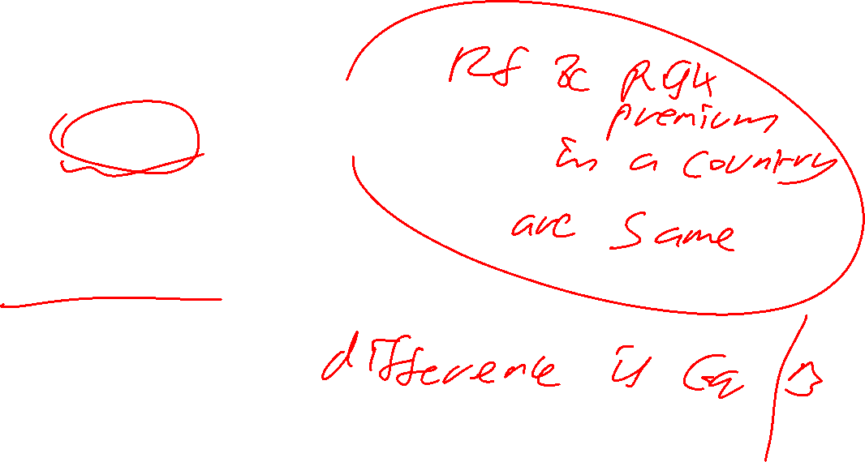
COE for CPIL
Market Risk Premium ( MRP)
India @ 7.46 %
July 2025 update by Aswath Damodaran

Slide 254
Equity Beta for CPIL
Beta = 0.61 (on 27 November 2025)
Source: Moneycontrol.com

Slide 255
Cost of Equity for CPIL ( 27 November 2025)
Rf = 7.35 %
MRP= 7.46 %
Beta = 0.61
COE = 7.35 % + (0.61* 7.46 %) = 11.90 %
But we may consider 9.60 % ( 6 % + 0.6 *6 %) for CPIL as it is a stable firm

Slide 256
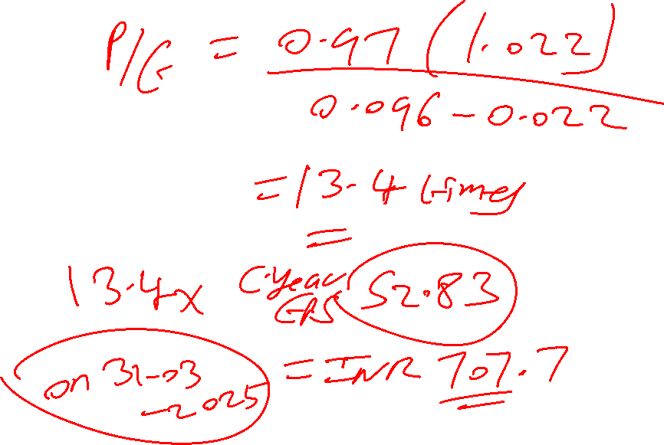
PE of CPIL =?
Assumptions
* DPR = 97 %
G = 2.22 %
COE = 9.60 %

Slide 257
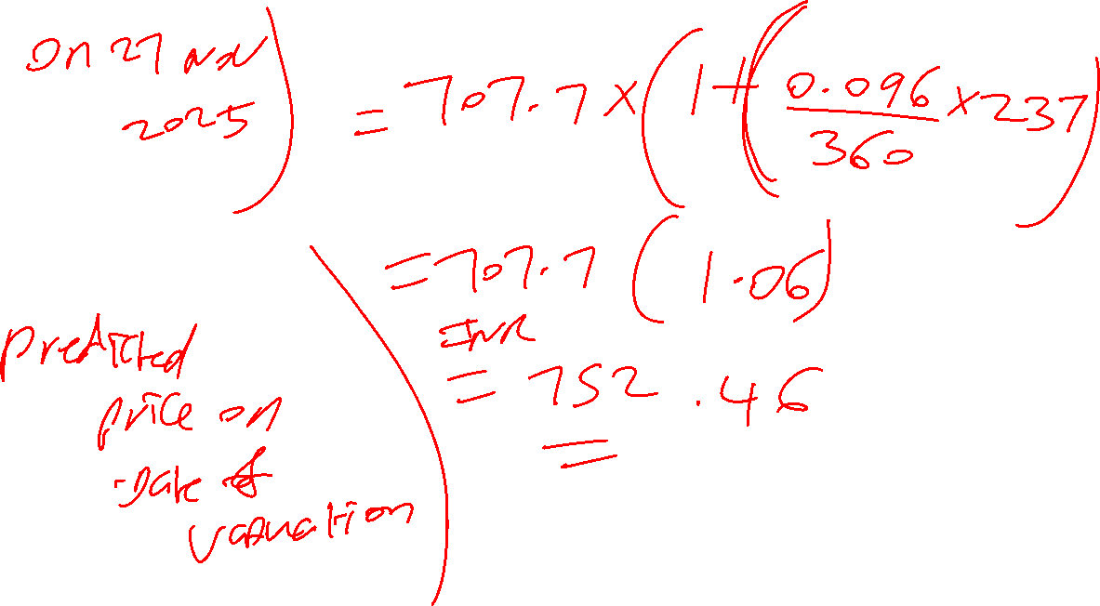

Slide 258

PE ratio using Fundamentals for CPIL
Predicted PE = DPR * (1+g) / (COE-g)
= 0.97 (1.022) / (0.096-0.022)
= 0.9913/ 0.074
= 13.40 times
Predicted Price on 27 Nov 25 = 13.40 * INR 52.83*( 1+ 0.096 / 360 * 237 = 1.06) = INR 750.40 VS Actual CMP @ INR 2163.30 on 27 Nov 2025
52 W low High : INR 2147.80 – 3115.00 Highly Overvalued

Slide 259

If we revise the assumptions , then PE of CPIL=?
Revised assumptions
- DPR @ 90 % instead of 97 %
Growth rate @ 6 % instead of 2.22 %
COE @ 9.6 %

Slide 260

If we assume stable phase g of 6 % & DPR of 90% for CPIL
Predicted PE = DPR * (1+g) / (COE-g)
= 0.90 (1.06) / (0.096-0.06)
= 0.9540 / 0.0360
= 26.50 times
Predicted Price on 27 Nov 25 = 26.50 * INR 52.83*( 1+ 0.096 / 360 * 237 = 1.06) = INR 1484 vs 750.40 (base case) VS Actual CMP @ INR 2163.30 on 27 Nov 2025
52 W low High : INR 2147.80 – 3115.00 Highly Overvalued

Slide 261
PGDF 24-26 FAL
Session 8 (14-Dec-2025)

Slide 262
Recap:
we started with basic financial statement analysis, FSA, Fscore (at least 6 as value)and earning management possibility with the help of M score or Benford analysis. This is preliminary analysis that can tells us if firms are manipulating their statements, if all good then we go with fundamental based valuation such as price-based multiples (this means we want to value the equity shares), enterprise-based multiples (this values the entire firm).
Price based multiple can be – P/E, P/B, P/S.
Enterprise based multiples – EV/EBITDA, EV/EBIT, EV/EBIAT, EV/IC, EV/REV
P/E ratio – we started with types of firms such as stable firm (g <=6%), two stage growth firm (6-12% growth), 3 stage growth firm (g>12%). Here growth rate is the long run expected growth rate of the country.
We will now start with Price based multiple of two stage firm.
Characteristic | HG phase | Stable phase
ROE | Higher | Avg
DPR | Lower | Higher
G | Higher | Lower
COE (reflected by beta) | Higher | Lower

Slide 263
PE for a High Growth Firm
Two stage model (PE of high growth phase + PE of stable phase)
High growth stage or Phase
= DPR hg *(1+ g hg) *( 1- [ {1+g hg}^n / {1+ COE hg }^n])
-----------------------------------------------------------------
COE hg – g hg
2. Stable stage or Phase
= DPR st *(1+ g hg)^n * (1+g st)
-----------------------------------------------------------------
( COE st – g st) * (1+ COE hg)^n

Slide 264
DPR of NALCO for the last 5 years & its Average ( Moneycontrol.com; refer Financials, then Ratios and then per share ratios )
Particulars | March 2025 | 2024 | 2023 | 2022 | 2021
DPS in INR | 10.50 | 5 | 4.50 | 6.50 | 3.50
Basic EPS | 28.68 | 10.83 | 7.81 | 16.07 | 6.97
Dividend Payout Ratio in % | 36.61 | 46.17 | 57.62 | 40.45 | 50.22
Average DPR in % | 30.00/ 70.36 | =42.64 = 43%

Slide 265
ROE of NALCO for the last 5 years & its Average ( Moneycontrol.com; refer Financials, then Ratios and then Return ratios )
Particulars | March 2025 | 2024 | 2023 | 2022 | 2021
ROE in % | 29.58 | 13.82 | 10.92 | 23.51 | 12.16
Average ROE in % | 18.00 %

Slide 266
Fundamental growth rate for NALCO based on 5-year average ROE & DPR
g = ROE * (1-DPR)
5 Year avg ROE = 18.00 %
5 year avg DPR = 43 %
Fundamental growth rate = 18.00* (1- 0.43) = 10.26 % ; 2 stage growth firm

Slide 267
COE for NALCO
Risk free rate (for India)
Yield on 40 year Indian govt bond = 7.35 % ( on 27 Nov 2025)
Source: Investing.com database

Slide 268
COE for NALCO
Market Risk Premium ( MRP)
India @ 7.46 %
July 2025 update by Aswath Damodaran

Slide 269
Equity Beta for Nalco
Beta = 1.61
Source: Moneycontrol.com ( as on 27 Nov 2025)

Slide 270
Cost of Equity for NALCO
Rf = 7.35 %
MRP= 7.46%
Beta = 1.61
COE = 7.35% + (1.61* 7.46%) = 19.36% for High Growth Phase
For Stable Phase
St phase Beta of 1.2
Rf of 6% and MRP of 6%
Then St.Phase COE = 6 + (1.2*6) = 13.2%

Slide 271
PE for a High Growth Firm
Two stage model (PE of high growth phase + PE of stable phase)
High growth stage or Phase
= DPR hg *(1+ g hg) *( 1- [ {1+g hg}^n / {1+ COE hg }^n])
-----------------------------------------------------------------
COE hg – g hg
2. Stable stage or Phase
= DPR st *(1+ g hg)^n * (1+g st)
-----------------------------------------------------------------
( COE st – g st) * (1+ COE hg)^n

Slide 272
PE ratio for NALCO- High Growth (HG) Phase
DPR = 43 %
G = 10.26 %
COE = 19.36
Length of HG Phase =n= let us assume 10 years

Slide 273
PE of Nalco – HG Phase
= DPR hg *(1+ g hg) *( 1- [ {1+g hg}^n / {1+ COE hg }^n])
-----------------------------------------------------------------
COE hg – g hg
= 0.43 *(1.1026) *( 1- [ {1.1026}^10 / {1.1936 }^10])
-----------------------------------------------------------------
0.1936 – 0.1026
= 0.4741 * (1- {2.6557/5.8693} ) / 0.091 = 2.85 times

Slide 274
PE of Nalco- Stable Phase(st)
Assumptions
DPR St = 70 %
(1+g hg )^n = 2.6557
G st phase = 6 %
COE st phase = 13.2 %
(1+coe hg )^n = 5.8693

Slide 275
PE of Nalco- Stable Phase
= DPR st *(1+ g hg)^n * (1+g st)
-----------------------------------------------------------------
( COE st – g st) * (1+ COE hg)^n
= 0.70 (2.6557) (1.06) / (0.132-0.06) (5.8693)
= 1.9705 / 0.4226
= 4.66 times

Slide 276
PE ratio using Fundamentals for NALCO ( based on 5 year avg data)
Total Predicted PE = PE hg phase + PE st phase = 2.85 + 4.66 =
= 7.51 times
Predicted Price = 7.51* INR 28.68* (1 + 0.1936/360 * 237 = 1.13) = INR 243.39 on 27 Nov 2025
VS Actual CMP @ INR 261.33
52 W low High : INR 137.75 – 271.89 as on 27 Nov 2025 Slightly Overvalued

Slide 277
Revised PE ratio using Fundamentals for NALCO ( Revised DPR of 60% & g st phase at 4 % & st COE at 13.2 % in stable phase )
Keeping HG phase estimates as it is ( HG PE =2.85 )
DPR St = 60 %
(1+g hg )^n = 2.6557
G st phase = 4 %
COE st phase = 13.2 %
(1+coe hg )^n = 5.8693

Slide 278
Revised PE of Nalco- Stable Phase
= DPR st *(1+ g hg)^n * (1+g st)
-----------------------------------------------------------------
( COE st – g st) * (1+ COE hg)^n
= 0.60 (2.6557) (1.04) / (0.132-0.04) (5.8693)
= 1.6572 / 0.5400
= 3.07 times

Slide 279
Revised PE ratio using Fundamentals for NALCO (Revised DPR of 60% & g st phase at 4 % & st COE at 13.2 % in stable phase )
Total Predicted PE = PE hg phase + PE st phase = 2.85 + 3.07 =
= 5.92 times
Predicted Price = 5.92* INR 28.68* (1 + 0.1936/360 * 237 = 1.13) = INR 191.86 vs 243.39 (base case) on 27 Nov 2025
VS Actual CMP @ INR 261.33
52 W low High : INR 137.75 – 271.89 as on 27 Nov 2025 Overvalued

Slide 280

PGDF 24-26 FAL
Session 9 (21-dec-2025)

Slide 281
For Discussion in Session 9
PE of a 2 Stage Growth Firm
PE of a 3 Stage Growth Firm

Slide 282
PE for a High Growth Firm
Two stage model (PE of high growth phase + PE of stable phase)
High growth stage or Phase
= DPR hg *(1+ g hg) *( 1- [ {1+g hg}^n / {1+ COE hg }^n])
-----------------------------------------------------------------
COE hg – g hg
2. Stable stage or Phase
= DPR st *(1+ g hg)^n * (1+g st)
-----------------------------------------------------------------
( COE st – g st) * (1+ COE hg)^n

Slide 283
F Score -Profitability For UTCL in 2024
Parameter | Result | Score
ROA ( = Net Income/Total Assets) | 6982 / 100802 = 6.93% | 1
CFO ( in INR Cr) | 9069 | 1
CFO/Net Income | 9069 / 6982 = 1.30 | 1
Change in ROA (PY = 5069/91387 | CY ROA : 6.93 % PY ROA : 5.55 % | 1
Total Score on Parameter |  | 4

Slide 284
F Score –Liquidity, Leverage & source of funding For UTCL in 2024
Parameter | Result | Score
Current Ratio CY & Prev. Year | CY = 23158/ 26906 = 0.86 PY= 20743 / 23432= 0.89 | 0
Current year LTD & that of previous year | 5308 & 5356 | 1
Equity issuance | No | 1
Total Score on Parameter |  | 2

Slide 285
F Score –Operating Efficiency of UTCL in 2024
Parameter | Result | Score
GPM CY & Prev. Year | CY = 51724/ 69810 = 74.09 % PY= 46996 / 62338 = 75.39 % | 0
Asset Turn CY& PY (= Net Revenue/ Total Assets) | CY = 69810 / 100802 = 0. 693 Times PY = 62338 / 91387 = 0. 682 Times | 1
Total Score on Parameter |  | 1
CGS = Cost of material consumed + purchase of stock in trade +Op & Direct exp + Changes in inventories of FG,WIP and stock in trade + D& A + Employee Benefit Expenses | CY: 10252+ 1734+0-83+ 3038 + 3145 = 18086 PY:8933 + 1300 + 0 -518 + 2739 + 2888 = 15342

Slide 286
F score –UTCL in 2024
Profitability = 4
Liquidity,leverage & source of funding = 2
Operating Efficiency = 1
Total F score = 7
Grey zone- Higher End

Slide 287
F Score -Profitability For UTCL in 2023
Parameter | Result | Score
ROA ( = Net Income/Total Assets) | 5069 / 91387 = 5.55 % | 1
CFO ( in INR Cr) | 9069 | 1
CFO/Net Income | 9069 / 5069 = 1.79 | 1
Change in ROA (PY = 7333/83828 | Cy ROA : 5.55% PY ROA : 8.75 % | 0
Total Score on Parameter |  | 3

Slide 288
F Score –Liquidity, Leverage & source of funding For UTCL in 2023
Parameter | Result | Score
Current Ratio CY & Prev. Year | CY = 20743 / 23432 = 0.89 PY= 17489 / 20155= 0.87 | 1
Current year LTD & that of previous year | 5356 & 5303 | 0
Equity issuance | Yes | 0
Total Score on Parameter |  | 1

Slide 289
F Score –Operating Efficiency of UTCL in 2023
Parameter | Result | Score
GPM CY & Prev. Year | CY = 46996 / 62338 = 75.39 % PY= 38493 / 51708 = 74.44 % | 1
Asset Turn CY& PY (= Net Revenue/ Total Assets) | CY = 62338 / 91387 = 0. 682 Times PY = 51708 / 83828 = 0. 617 Times | 1
Total Score on Parameter |  | 2
CGS = Cost of material consumed + purchase of stock in trade +Op & Direct exp + Changes in inventories of FG,WIP and stock in trade + D& A + Employee Benefit Expenses | CY: 8933 + 1300 + 0 -518 + 2739 + 2888 = 15342 PY: 7096 + 1252 +0 – 383 + 2535 + 2715 = 13215

Slide 290
F score –UTCL in 2023
Profitability = 3
Liquidity,leverage & source of funding = 1
Operating Efficiency = 2
Total F score = 6
Grey zone- Above Median

Slide 291

F Score of UTCL – 2025,2024 vs 2023
Year | Profitability | Leverage, Liquidity and Source of Funding | Operating Efficiency | Total F score
2025 | 3 | 0 | 0 | 3
2024 | 4 | 2 | 1 | 7
2023 | 3 | 1 | 2 | 6

Slide 292
Beneish M Score UTCL -2025

Slide 293
M Score
= -4.840
+ 0.920 ( DSRI)
+0.528 (GMI)
+0.404 (AQ) if M score > (-1.78) , then the firm is manipulating
+0.892 (SGI)
+0.115 (DEPI)
-0.172 (SGAI)
-0.327 (LVGI)
+4.697 ( TATA)

Slide 294
1.What is the DSRI for UTCL in 2025?
= ( Net Receivable t / Sales t) / ( Net Receivable t-1 / Sales t-1)
= ( 5890 / 74936 ) / (4278 / 69810)
= (0.0786) / (0.0613)
= 1.2822
Weighted DSRI = 0.920 * 1.2822= 1.18

Slide 295
2. What is the GMI for UTCL in 2025?
= ( Sales t-1 - COGS t-1 / Sales t-1) / ( Sales t - COGS t / Sales t)
= [( 69810 -18086 )/ 69810] / [ ( 74936 -21324)/ 74936]
= 0.7409/ 0.7154 = 1.0356
Weighted GMI = 0.528* 1.0356 = 0.55

Slide 296
3. What is the AQI for UTCL in 2025 ? (PPE= Tangible assets + Capital WIP)
= 1- ({ CA t +PPE t+ Securities t}/ TA t)
/
1- ({ CA t-1 +PPE t-1+ Securities t-1}/ TA t-1)
= 1- ({ 23737 + 76851 + 6188 + 2297 }/ 133697)
/
1- ({ 23158 + 51042+6783 + 2764}/ 100802) = 0.1842 / 0.1692 = 1.0887
Weighted AQ = 0.404* 0.8845 = 0.44

Slide 297
4. What is Sales Growth Index ( SGI) for UTCL in 2025?
= Sales t / Sales t-1
= 74936 / 69810 = 1.0734
Weighted SGI = 0.892* 1.0734
= 0.96

Slide 298
5. What is the Depreciation Index ( DEPI) for UTCL in 2025 ?( PPE here = Tang.assets + Intang.assets)
( Dep t-1 / {PPE t-1 +Dep t-1})
/
( Dep t / {PPE t +Dep t})
= {3145 / 51042 +5490+3145} / {4015 / 76851 +10032+4015} = 0.0527 /0.0442 = 1.1923
Weighted DEPI = 0.115*1.1923 = 0.14

Slide 299
6. What is the SGA expense Index ( SGAI) for UTCL in 2025?
= ( SGA expense t/ Sales t) / (SGA expense t-1/ Sales t-1)
SGA expenses = Other expenses
= (46089 / 74936 ) / ( 42999/ 69810) = 0.6150/ 0.6159 = 0.9985
Weighted SGAI = -0.172 * 0.9985 = -0.17

Slide 300
7.What is the Leverage Index ( LVGI) for UTCL in 2025?
= ( {CL t+ TLTD t }/ TA t)
/
( {CL t-1+ TLTD t-1 }/ TA t-1)
= ( {32365+15781}/ 133697 ) / ( {26906+5308}/ 100802 )
= 0.3601/0.3196 = 1.1267
Weighted LVGI = -0.327 * 1.1267 = -0.37

Slide 301
8. What is the Total Accruals to Total Assets (TATA) for UTCL in 2025?
=
(Income from Continuing Operations t-CFO t ) / TA t
= (6050- 10673) / 133697 = -0.0346
Weighted TATA = 4.697 *(-0.0346) = -0.16

Slide 302
Figures for UTCL & Inferences in 2025
Variable | Expectation | C.Year | Prev.year | Inference
1. DSRI | C.Year to be lower | 0.0786 | 0.0613 | Manipulative
2. GMI | C.Year GPM to be higher | 0.7154 | 0.7409 | Manipulative
3. Asset Quality | C.Year to be lower | 0.1842 | 0.1692 | Manipulative
4. SGI | C. Year to be lower | 74936 | 69810 | Manipulative
5. DEPI | C.Year to be higher | 0.0442 | 0.0527 | Manipulative
6. SGAI | C.Year to be higher | 0.6150 | 0.6159 | Manipulative
7. LVGI | C.Year to be higher | 0.3601 | 0.3196 | Non-Manipulative
8.TATA | To be negative (lower) | -0.0346 |  | Non-Manipulative

Slide 303
M score for UTCL in 2025
Particulars | Weighted Score
Intercept | -4.840
DSRI | +1.18
GMI | +0.55
AQ | +0.44
SGI | +0.96
DEPI | +0.14
SGAI | -0.17
LVGI | -0.37
TATA | -0.16
M Score | -2.27

Slide 304
Inference in 2025
If M score > -1.78 , then firm is manipulating its financials
UTCL’s M score is -2.27, it is not manipulating its financials in 2025

Slide 305
Beneish M Score UTCL -2024

Slide 306
M Score
= -4.840
+ 0.920 ( DSRI)
+0.528 (GMI)
+0.404 (AQ) if M score > (-1.78) , then the firm is manipulating
+0.892 (SGI)
+0.115 (DEPI)
-0.172 (SGAI)
-0.327 (LVGI)
+4.697 ( TATA)

Slide 307
1.What is the DSRI for UTCL in 2024?
= ( Net Receivable t / Sales t) / ( Net Receivable t-1 / Sales t-1)
= ( 4278 / 69810 ) / ( 3867 / 62338)
= (0.0613) / (0.0620)
= 0.9887
Weighted DSRI = 0.920 * 0.9887= 0.91

Slide 308
2. What is the GMI for UTCL in 2024?
= ( Sales t-1 - COGS t-1 / Sales t-1) / ( Sales t - COGS t / Sales t)
= [( 62338 -15342 )/ 62338] / [ ( 69810 -18086)/ 69810]
= 0.7539/ 0.7409 = 1.0175
Weighted GMI = 0.528* 1.0175 = 0.54

Slide 309
3. What is the AQI for UTCL in 2024 ? (PPE= Tangible assets + Capital WIP)
= 1- ({ CA t +PPE t+ Securities t}/ TA t)
/
1- ({ CA t-1 +PPE t-1+ Securities t-1}/ TA t-1)
= 1- ({ 23158 + 51042 + 6783 + 2764 }/ 100802)
/
1- ({ 20743 + 47671+4035 + 1460}/ 91387) = 0.1692 / 0.1913 = 0.8845
Weighted AQ = 0.404* 0.8845 = 0.36

Slide 310
4. What is Sales Growth Index ( SGI) for UTCL in 2024?
= Sales t / Sales t-1
= 69810 / 62338 = 1.1199
Weighted SGI = 0.892* 1.1199
= 1.00

Slide 311
5. What is the Depreciation Index ( DEPI) for UTCL in 2024 ?( PPE here = Tang.assets + Intang.assets)
( Dep t-1 / {PPE t-1 +Dep t-1})
/
( Dep t / {PPE t +Dep t})
= {2888 / 47671 +5579+2888} / {3145 / 51042 +5490+3145} = 0.0514 /0.0527 = 0.9753
Weighted DEPI = 0.115*0.9753 = 0.11

Slide 312
6. What is the SGA expense Index ( SGAI) for UTCL in 2024?
= ( SGA expense t/ Sales t) / (SGA expense t-1/ Sales t-1)
SGA expenses = Other expenses
= (42999 / 69810 ) / ( 40166/ 62338) = 0.6159/ 0.6443 = 0.9559
Weighted SGAI = -0.172 * 0.9559 = -0.16

Slide 313
7.What is the Leverage Index ( LVGI) for UTCL in 2024?
= ( {CL t+ TLTD t }/ TA t)
/
( {CL t-1+ TLTD t-1 }/ TA t-1)
= ( {26906+5308}/ 100802 ) / ( {23432+5356}/ 91387 )
= 0.3196/0.3150 = 1.0146
Weighted LVGI = -0.327 * 1.0146 = -0.33

Slide 314
8. What is the Total Accruals to Total Assets (TATA) for UTCL in 2024?
=
(Income from Continuing Operations t-CFO t ) / TA t
= (6982- 10898) / 100802 = -0.0388
Weighted TATA = 4.697 *(-0.0388) = -0.18

Slide 315
Figures for UTCL & Inferences in 2024
Variable | Expectation | C.Year | Prev.year | Inference
1. DSRI | C.Year to be lower | 0.0613 | 0.0620 | Non-Manipulative
2. GMI | c.Year GPM to be higher | 0.7409 | 0.7539 | Manipulative
3. Asset Quality | C.Year to be lower | 0.1692 | 0.1913 | Non-Manipulative
4. SGI | C. Year to be lower | 69810 | 62338 | Manipulative
5. DEPI | C.Year to be higher | 0.0527 | 0.0514 | Non-Manipulative
6. SGAI | C.Year to be higher | 0.6159 | 0.6443 | Manipulative
7. LVGI | C.Year to be higher | 0.3196 | 0.3150 | Non-Manipulative
8.TATA | To be negative (lower) | -0.0388 |  | Non-Manipulative

Slide 316
M score for UTCL in 2024
Particulars | Weighted Score
Intercept | -4.840
DSRI | +0.91
GMI | +0.54
AQ | +0.36
SGI | +1.00
DEPI | +0.11
SGAI | -0.16
LVGI | -0.33
TATA | -0.18
M Score | -2.59

Slide 317
Inference in 2024
If M score > -1.78 , then firm is manipulating its financials
UTCL’s M score is -2.59, it is not manipulating its financials in 2024

Slide 318
Beneish M Score UTCL -2023

Slide 319
M Score
= -4.840
+ 0.920 ( DSRI)
+0.528 (GMI)
+0.404 (AQ) if M score > (-1.78) , then the firm is manipulating
+0.892 (SGI)
+0.115 (DEPI)
-0.172 (SGAI)
-0.327 (LVGI)
+4.697 ( TATA)

Slide 320
1.What is the DSRI for UTCL in 2023?
= ( Net Receivable t / Sales t) / ( Net Receivable t-1 / Sales t-1)
= ( 3867 / 62338 ) / ( 3072 / 51708)
= (0.0620) / (0.0594)
= 1.0438
Weighted DSRI = 0.920 * 1.0438= 0.96

Slide 321
2. What is the GMI for UTCL in 2023?
= ( Sales t-1 - COGS t-1 / Sales t-1) / ( Sales t - COGS t / Sales t)
= [( 51708 -13215 )/ 51708] / [ ( 62338 -15342)/ 62338]
= 0.7444/ 0.7539 = 0.9874
Weighted GMI = 0.528* 0.9874 = 0.52

Slide 322
3. What is the AQ for UTCL in 2023? (PPE= Tangible assets + Capital WIP)
= 1- ({ CA t +PPE t+ Securities t}/ TA t)
/
1- ({ CA t-1 +PPE t-1+ Securities t-1}/ TA t-1)
= 1- ({ 20743 + 47671 + 4035 + 1460 }/ 91387)
/
1- ({ 17489 + 43771+4777 + 1372}/ 83828) = 0.1913 / 0.1959 = 0.9765
Weighted AQ = 0.404* 0.9765 = 0.39

Slide 323
4. What is Sales Growth Index ( SGI) for UTCL in 2023?
= Sales t / Sales t-1
= 62338 / 51708 = 1.2056
Weighted SGI = 0.892* 1.2056
= 1.08

Slide 324
5. What is the Depreciation Index ( DEPI) for UTCL in 2023?( PPE here = Tang.assets + Intang.assets)
( Dep t-1 / {PPE t-1 +Dep t-1})
/
( Dep t / {PPE t +Dep t})
= {2715 / 43771 +5467+2715} / {2888 / 47671 +5579+2888} = 0.0523 /0.0514 = 1.0175
Weighted DEPI = 0.115*1.0175 = 0.12

Slide 325
6. What is the SGA expense Index ( SGAI) for UTCL in 2023?
= ( SGA expense t/ Sales t) / (SGA expense t-1/ Sales t-1)
SGA expenses = Other expenses
= (40166 / 62338 ) / ( 30585/ 51708) = 0.6443/ 0.5915 = 1.0893
Weighted SGAI = -0.172 * 1.0893 = -0.19

Slide 326
7.What is the Leverage Index ( LVGI) for UTCL in 2023?
= ( {CL t+ TLTD t }/ TA t)
/
( {CL t-1+ TLTD t-1 }/ TA t-1)
= ( {23432+5356}/ 91387 ) / ( {20155+5303}/ 83828 )
= 0.3150/0.3037 = 1.0372
Weighted LVGI = -0.327 * 1.0372 = -0.34

Slide 327
8. What is the Total Accruals to Total Assets (TATA) for UTCL in 2023?
=
(Income from Continuing Operations t-CFO t ) / TA t
= (5069- 9069) / 91387 = -0.0438
Weighted TATA = 4.697 *(-0.0438) = -0.21

Slide 328
Figures for UTCL & Inferences in 2023
Variable | Expectation | C.Year | Prev.year | Inference
1. DSRI | C.Year to be lower | 0.0620 | 0.0594 | Manipulative
2. GMI | c.Year GPM to be higher | 0.7539 | 0.7444 | Non-manipulative
3. Asset Quality | C.Year to be lower | 0.1913 | 0.1959 | Non-Manipulative
4. SGI | C. Year to be lower | 62338 | 51708 | Manipulative
5. DEPI | C.Year to be higher | 0.0514 | 0.0523 | Manipulative
6. SGAI | C.Year to be higher | 0.6443 | 0.5915 | Non- Manipulative
7. LVGI | C.Year to be higher | 0.3150 | 0.3037 | Non-Manipulative
8.TATA | To be negative (lower) | -0.0438 |  | Non-Manipulative

Slide 329
M score for UTCL in 2023
Particulars | Weighted Score
Intercept | -4.840
DSRI | +0.96
GMI | +0.52
AQ | +0.39
SGI | +1.08
DEPI | +0.12
SGAI | -0.19
LVGI | -0.34
TATA | -0.21
M Score | -2.51

Slide 330
Inference
If M score > -1.78 , then firm is manipulating its financials
UTCL’s M score is -2.51, it is not manipulating its financials in 2023

Slide 331
Benford Analysis- UTCL Manipulative -2025,2024 & 2023
Leading Digit | Count | Actual Distribution | Expected Distribution | Cumulative Difference
1 | 35 | 20.2 | 30.1 | 9.9
2 | 23 | 13.3 | 17.6 | 14.2
3 | 12 | 6.9 | 12.5 | 19.8
4 | 11 | 6.4 | 9.7 | 23.1
5 | 24 | 13.9 | 7.9 | 17.1
6 | 22 | 12.7 | 6.7 | 11.1
7 | 23 | 13.3 | 5.8 | 3.6
8 | 10 | 5.8 | 5.1 | 2.9
9 | 13 | 7.5 | 4.6 | 0
 | 172 | 100 | KS | 23.1
 |  |  | Cut-off | 10.37

Slide 332
Benford Analysis- UTCL Manipulative -2024,2023 & 2022
Leading Digit | Count | Actual Distribution | Expected Distribution | Cumulative Difference
1 | 29 | 16.9 | 30.1 | 13.2
2 | 25 | 14.5 | 17.6 | 16.3
3 | 12 | 7 | 12.5 | 21.8
4 | 13 | 7.6 | 9.7 | 23.9
5 | 34 | 19.8 | 7.9 | 12
6 | 19 | 11 | 6.7 | 7.7
7 | 16 | 9.3 | 5.8 | 4.2
8 | 12 | 7 | 5.1 | 2.3
9 | 12 | 7 | 4.6 | 0
 | 172 | 100 | KS | 23.9
 |  |  | Cut-off | 10.37

Slide 333
Benford Analysis- UTCL Manipulative – 2023,2022 &2021
Leading Digit | Count | Actual Distribution | Expected Distribution | Cumulative Difference
1 | 32 | 18.7 | 30.1 | 11.4
2 | 28 | 16.4 | 17.6 | 12.6
3 | 12 | 7 | 12.5 | 18.1
4 | 22 | 12.9 | 9.7 | 14.9
5 | 31 | 18.1 | 7.9 | 4.7
6 | 13 | 7.6 | 6.7 | 3.8
7 | 14 | 8.2 | 5.8 | 1.4
8 | 11 | 6.4 | 5.1 | 0.1
9 | 8 | 4.7 | 4.6 | 0
 | 171 | 100 | KS | 18.1
 |  |  | Cut-off | 10.4

Slide 334

Ultra Tech Cements Ltd (UTCL)
High growth firm test
ROE (FY March 2025) = 8.54 %
DPR (FY March 2025) = 77.50/205.30 = 37.75%
Fundamental growth rate = 8.54* (1-0.3775) = 5.32%

Slide 335
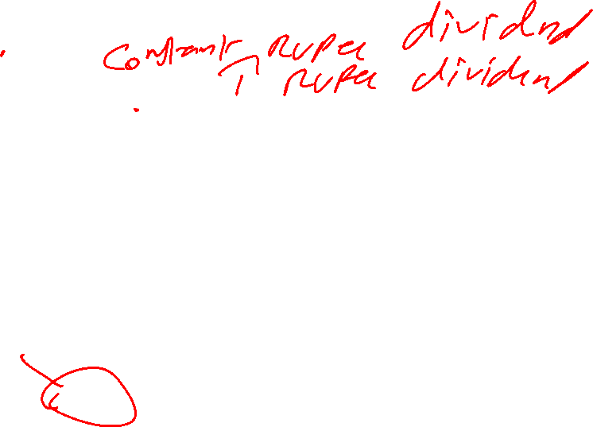
DPR of UTCL for the last 5 years & its Average ( Moneycontrol.com; refer Financials, then Ratios and then per share ratios )
Particulars | FY 2025 | FY 2024 | 2023 | 2022 | 2021
DPS in INR | 77.50 | 70 | 38 | 38 | 37
Basic EPS | 205.30 | 243.05 | 175.63 | 254.64 | 189.40
Dividend Payout Ratio in % | 37.75 | 28.80 | 21.64 | 14.92 | 19.54
Average DPR in % | 260.50/ 1068.02= | 24.39 %

Slide 336
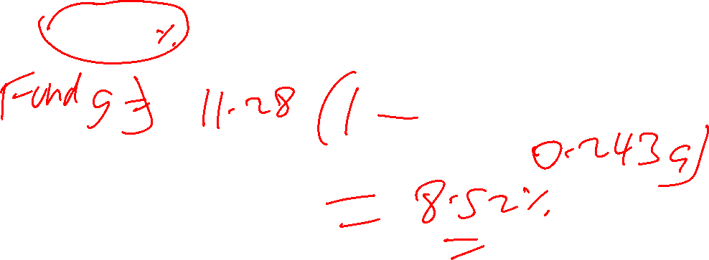
ROE of UTCL for the last 5 years & its Average ( Moneycontrol.com; refer Financials, then Ratios and then Return ratios )
Particulars | FY 2025 | FY 2024 | 2023 | 2022 | 2021
ROE in % | 8.54 | 11.63 | 9.32 | 14.56 | 12.36
Average ROE in % | 11.28

Slide 337
What is the fundamental growth rate for UTCL?
DPR @ 24.39 %
ROE @11.28 %

Slide 338

Fundamental growth rate of UTCL
ROE : 11.28 %
DPR : 24.39 %
Fundamental growth rate = 11.28% ( 1-0.2439) = 8.53%
Long Run growth rate for India = 6%
Hence , the firm is a 2- stage growth candidate

Slide 339
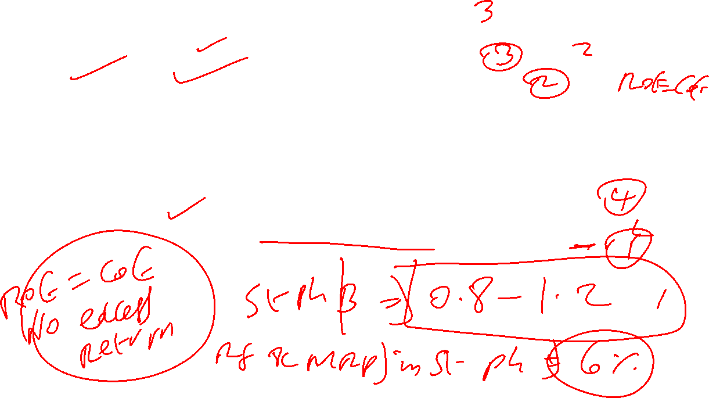
Assumptions
Particulars | High Growth Phase | Stable Phase
DPR (in %) | 24.39 | 70
ROE (in %) | 11.28 | 10.80
Length | 10 years | After year 10
Beta | 0.93 on 13 December 2025 | 0.8
Rf (in %) | 7.35 | 6
MRP (in %) | 7.46 | 6
Fundamental growth rate (= ROE * {1-DPR}) | 11.28 (1-0.2439) = 8.53 % | 10.80 (1-0.70) = 3.24 %
Cost of Equity | 7.35 %+ (0.93*7.46 %) = 14.29 % | 6+ (0.8*6%) = 10.80%

Slide 340
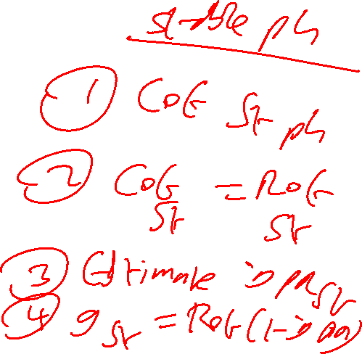
PE for a High Growth Firm
Two stage model
High growth stage or Phase
= DPR hg *(1+ g hg) *( 1- [ {1+g hg}^n / {1+ COE hg }^n])
-----------------------------------------------------------------
COE hg – g hg
2. Stable stage or Phase
DPR st *(1+ g hg)^n * (1+g st)
-----------------------------------------------------------------
( COE st – g st) * (1+ COE hg)^n

Slide 341
PE for UTCL ( 2 stage model)
= 0.2439 (1.0853) [ 1- {(1.0853)^10/ (1.1429)^10 }] / (0.1429- 0.0853)
+
0.70 (1.0324) (1.0853)^10 / (0.1080-0.0324) (1.1429)^10
= {0.2647[1- (2.2672/ 3.8026)] / 0.0576} + {0.70 (1.0324) (2.2672) / (0.0756*3.8026}
= 1.8557 + 5.6990 = 7.5547 times
Predicted Price = 7.55* INR 205.30 = INR 1550.02 on 31-03-2025
Predicted price on 13 , December 2025 = 1550.02 ( 1+ 0.1429/360 * 253= 1.10) = INR 1705.02
CMP at INR 11723( 13 December 2025)
52 w LH : 10047.85 to 13097 Highly Overvalued

Slide 342
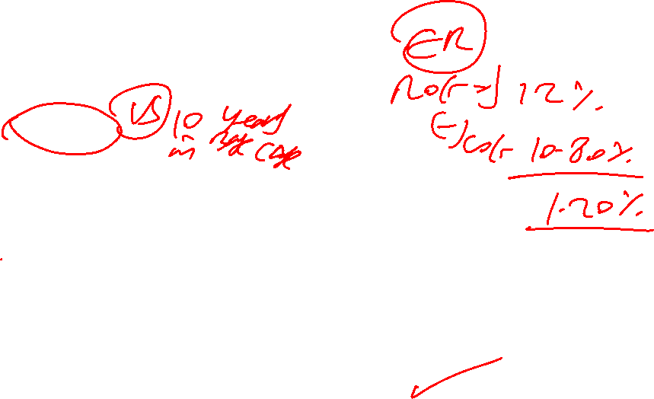
Let us have revised assumptions- UTCL
Particulars | High Growth Phase | Stable Phase
DPR (in %) | 24.39 | 70
ROE (in %) | 11.28 | 12
Length | 15 years | After year 15
Beta | 0.93 on 13 December 2025 | 0.8
Rf (in %) | 7.35 | 6
MRP (in %) | 7.46 | 6
Fundamental growth rate (= ROE * {1-DPR}) | 11.28 (1-0.2439) = 8.53 % | 12 (1-0.70) = 3.60 %
Cost of Equity | 7.35 %+ (0.93*7.46 %) = 14.29 % | 6+ (0.8*6%) = 10.80%

Slide 343
PE for a High Growth Firm
Two stage model
High growth stage or Phase
= DPR hg *(1+ g hg) *( 1- [ {1+g hg}^n / {1+ COE hg }^n])
-----------------------------------------------------------------
COE hg – g hg
2. Stable stage or Phase
DPR st *(1+ g hg)^n * (1+g st)
-----------------------------------------------------------------
( COE st – g st) * (1+ COE hg)^n

Slide 344
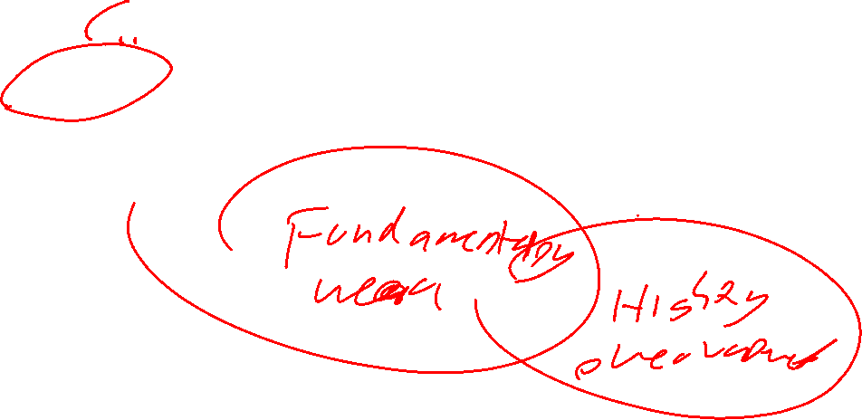
PE for UTCL ( 2 stage model)
= 0.2439 (1.0853) [ 1- {(1.0853)^15/ (1.1429)^15 }] / (0.1429- 0.0853)
+
0.70 (1.0360) (1.0853)^15 / (0.1080-0.0360) (1.1429)^15
= {0.2647[1- (3.4139/ 7.4152)] / 0.0576} + {0.70 (1.0360) (3.4139) / (0.0720*7.4152
= 2.4797 + 4.6371 = 7.1168 times
= Predicted Price on 31-03-2025 = 7.12* INR 205.30 = INR 1462
Predicted price on 13 , December 2025 = 1462 ( 1+ 0.1429/360 * 253= 1.10) = INR 1608 vs 1705.02 (Base case)
CMP at INR 11723( 13 December 2025)
52 w LH : 10047.85 to 13097

Slide 345
Three Stage Model of Growth-PE
High Growth Phase
Transition Phase
Stable Phase
Growth should be > 12%. If its exact 12% then you can decide based on excess return (ROE-COE) if its high then you can decide.
Let Us consider INFOSYS

Slide 346

INFOSYS ( is a 3 stage candidate)
Particulars | 2025 | 2024 | 2023 | 2022 | 2021
ROE (In %) | 27.87 | 29.77 | 31.95 | 29.34 | 25.34
DPS (INR) | 43.00 | 46.00 | 34.00 | 31.00 | 27.00
EPS (INR)-Basic | 64.50 | 63.39 | 57.63 | 52.52 | 45.61
DPR (in %)
5 Avg.ROE (in %) | 28.85= 28 % | Last 3 yr Avg ROE = 29.86% | Let us take 30 %
Avg DPR | 181/ 283.65 | = 63.81% = 64% | Let us take 60 %
Fundamental g = ROE*(1-DPR) | 30 (0.40) = 12.00 %

Slide 347
Assumptions in the computation of Fundamental PE for Infosys
Particulars | High Growth Phase | Transition Phase | Stable Phase
Length (in years ) | 5 years | 5 years (i.e y6 to y10) | After year 10
DPR | 60 % | (80-60)/5 = 4 % p.year Y6: 60+4 = 64 % Y7: 64 + 4= 68% Y8: 72 % Y9: 76 % Y10: 80 % | 80 %
Growth Rate | 12.00 % | (12.00-6.00 )/5 = 1.20 Y6: 10.80% ; Y7: 9.60 % Y8: 8.40 % ; Y9: 7.20 % Y10: 6% | 6%
COE | 7.35 %+ (1.22*7.46%) = 16.45 % (18 March 2025 Beta =1.22) | (16.45-10.80)/5 = 1.13 Y6: 15.32% ; Y7: 14.19% Y8: 13.06% ; Y9: 11.93% Y10: 10.80% | 6% + (0.80*6%) = 10.80%

Slide 348
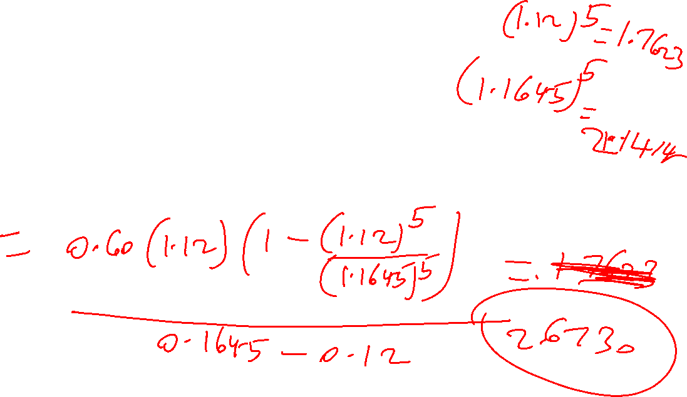
Infosys- High Growth PE ???
DPR hg *(1+ g hg) *( 1- [ {1+g hg}^n / {1+ COE hg }^n])
-----------------------------------------------------------------
COE hg – g hg
Where DPR hg = 60% ; g hg = 12.00% ; COE hg = 16.45% : n hg = 5 years

Slide 349
Infosys- High Growth PE
= 0.60(1.12)(1- [{1.12}^5/ {1.1645}^5]) / (0.1645-0.1200)
= 0.6720 ( 1- {1.7623/ 2.1414) / 0.0445
= 2.6729 times

Slide 350
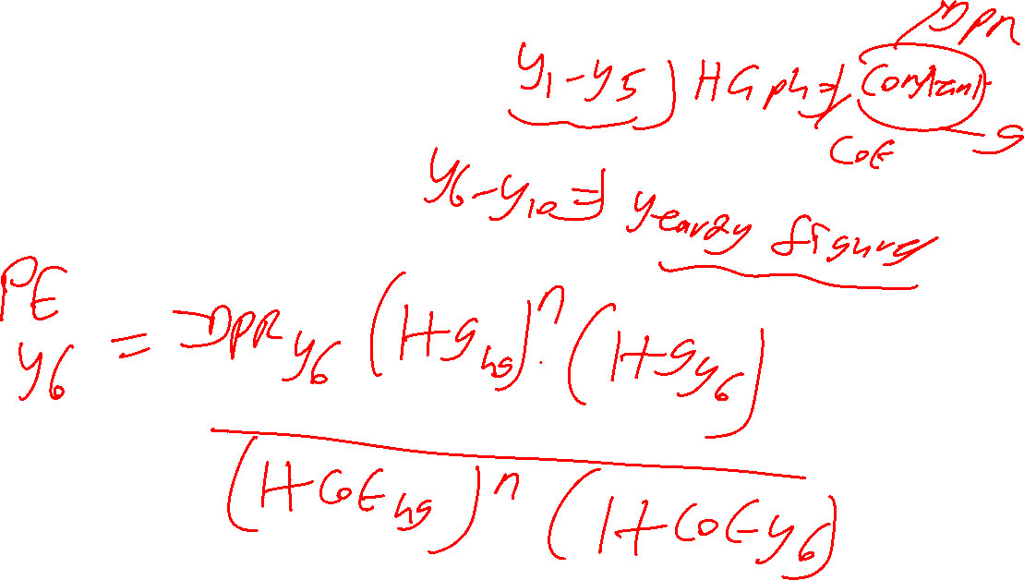
Infosys : Year 6 PE =???
What do we need ?

Slide 351
Infosys : Year 6 PE =???
Year 6 DPR = 64 % or 0.64
Year 1-5 growth factor = 1.7623
Year 6 growth rate = 10.80 % or 0.1080
Year 1-5 COE factor = 2.1414
Year 6 COE = 15.32% = 0.1532

Slide 352
Infosys : Year 6 PE
= year 6 DPR * (1+G hg)^ hg period * (1+ G year 6)
-----------------------------------------------------------------------
(1+ COE hg) ^ hg period * (1+ COE year 6)
= 0.64 * (1.7623) (1.1080) / (2.1414) (1.1532)
= 0.64 (1.9526)/ 2.4695
= 1.2497 / 2.4695 = 0.5061 times

Slide 353
Infosys : Year 7 PE =???
Year 7 DPR = 68% or 0.68
Year 1-6 growth factor = 1.9526
Year 7 growth rate = 9.60 %
Year 1-6 COE factor = 2.4695
Year 7 COE = 14.19 % = 0.1419

Slide 354
Infosys : Year 7 PE
= year 7 DPR * (1+G hg)^ hg period * (1+ G year 6)*(1+G y7)
---------------------------------------------------------------------------------
(1+ COE hg) ^ hg period * (1+ COE year 6)*(1+COE y7)
= 0.68 * (1.9526) (1.0960) / (2.4695) (1.1419)
= 0.68 ( 2.1400)/ 2.8199
= 1.4552 / 2.8199 = 0.5160 times

Slide 355
Infosys : Year 8 PE =???
Year 8 DPR = 72 % or 0.72
Year 1-7growth factor = 2.1400
Year 8 growth rate = 8.40 %
Year 1-7 COE factor = 2.8199
Year 8 COE = 13.06% = 0.1306

Slide 356
Infosys : Year 8 PE
= year 8 DPR * (1+G hg)^ hg p * (1+ G y 6)*(1+G y7) (1+G y8)
--------------------------------------------------------------------------------------
(1+ COE hg) ^ hg p * (1+ COE y 6)*(1+COE y7)* (1+COE y8)
= 0.72 * (2.1400) (1.0840)
/ (2.8199) (1.1306)
= 0.72 (2.3198) / 3.1882
= 1.6703/ 3.1882 = 0.5239 times

Slide 357
Infosys : Year 9 PE =???
Year 9 DPR = 76 % or 0.76
Year 1-8 growth factor = 2.3198
Year 9 growth rate = 7.20 %
Year 1-8 COE factor = 3.1882
Year 9 COE = 11.93% = 0.1193

Slide 358
Infosys : Year 9 PE
= year 9 DPR * (1+G hg)^ hg p * (1+ G y 6)*(1+G y7) (1+G y8) (1+Gy9)
-----------------------------------------------------------------------------------------
(1+ COE hg) ^ hg p * (1+ COE y 6)*(1+COE y7)* (1+COE y8) (1+COE y9)
= 0.76 * (2.3198) (1.072) /(3.1882) (1.1193)
= 0.76 ( 2.4868) / 3.5686
= 1.8900/ 3.5686 = 0.5296 times

Slide 359
Infosys : Year 10 PE =???
Year 10 DPR =80% or 0.80
Year 1-9 growth factor = 2.4868
Year 10 growth rate = 6%
Year 1-9 COE factor = 3.5686
Year 10 COE = 0.1080 or 10.80%

Slide 360

Infosys : Year 10 PE
year10DPR * (1+G hg)^ hg p * (1+ Gy6)*(1+Gy7) (1+Gy8) (1+Gy9)(1+G Y 10)
--------------------------------------------------------------------------------------------------
(1+ COE hg) ^ hg p * (1+ COE y 6)*(1+COE y7)* (1+COE y8) (1+COE y9) (1+COE y10)
= 0.80 * (2.4868) (1.06) / (3.5686) (1.1080)
=0.80 ( 2.6360) / 3.9540
= 2.1088 / 3.9540 = 0.5333 times

Slide 361
Infosys : Year 6-10 PE
= 0.5061+ 0.5160+ 0.5239+0.5296 +0.5333
= 2.6089 times

Slide 362
Infosys : Stable Phase PE
St. Ph DPR * (1+G hg)^ hg p * (1+ Gy6)*(1+Gy7) (1+Gy8) (1+Gy9)(1+G Y 10)(1+G st.ph)
-----------------------------------------------------------------------------------------
(COE st.ph – G st.ph) (1+ COE hg) ^ hg p * (1+ COE y 6)*(1+COE y7)* (1+COE y8) (1+COE y9) (1+COE y10)

Slide 363

Infosys : Stable Phase PE
St. Ph DPR * (1+G hg)^ hg p * (1+ Gy6)*(1+Gy7) (1+Gy8) (1+Gy9)(1+G Y 10)(1+G st.ph)
-----------------------------------------------------------------------------------------
(COE st.ph – G st.ph) (1+ COE hg) ^ hg p * (1+ COE y 6)*(1+COE y7)* (1+COE y8) (1+COE y9) (1+COE y10)
= 0.80 * (2.6360) (1.06) / (0.1080-0.06) (3.9540)
= 2.2353 / 0.1898 = 11.7771 times

Slide 364
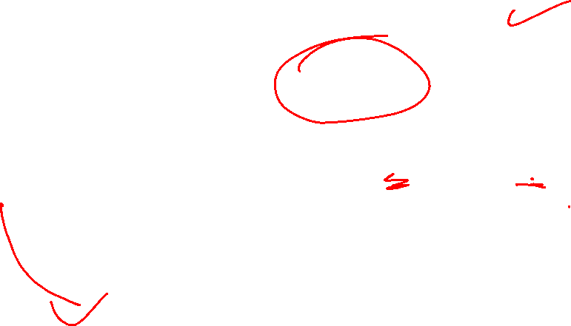
Infosys : Total PE
= PE HG phase + PE Transition phase + PE stable Phase
= 2.6729 + 2.6089 + 11.7771 = 17.0589 or 17.06 times
Predicted Price on 31-03-25 = 17.06* EPS of INR 64.50 = INR 1100.37
Predicted Price on 18 December 2025 = 1100.37 * ( 1+0.1645/360 *258= 1.12) = INR 1232.41
Current Market Price @ INR 1626.80 on 18 December 2025
52 W High Low : INR 1307 to INR 1982.80
Overvalued

Slide 365
What can We Do?
We may consider 10 years as the length of High Growth Phase ; 5 years for transition phase and stable phase to start from year 16

Slide 366
Assumptions in the computation of Fundamental PE for Infosys
Particulars | High Growth Phase | Transition Phase | Stable Phase
Length (in years ) | 10 years | 5 years (i.e y11 to y15) | After year 15
DPR | 60 % | (80-60)/5 = 4 % p.year Y11: 60+4 = 64 % Y12: 64 + 4= 68% Y13: 72 % Y14: 76 % Y15: 80 % | 80 %
Growth Rate | 12.00 % | (12.00-6.00 )/5 = 1.20 Y11: 10.80% ; Y12 9.60 % Y13: 8.40 % ; Y14: 7.20 % Y15: 6% | 6%
COE | 7.35 %+ (1.22*7.46%) = 16.45 % (18 March 2025 Beta =1.22) | (16.45-10.80)/5 = 1.13 Y11: 15.32% ; Y12: 14.19% Y13: 13.06% ; Y14: 11.93% Y15: 10.80% | 6% + (0.80*6%) = 10.80%

Slide 367
Infosys- High Growth PE ???
DPR hg *(1+ g hg) *( 1- [ {1+g hg}^n / {1+ COE hg }^n])
-----------------------------------------------------------------
COE hg – g hg
Where DPR hg = 60% ; g hg = 12.00% ; COE hg = 16.45% : n hg = 10 years

Slide 368
Infosys- High Growth PE
= 0.60(1.12)(1- [{1.12}^10/ {1.1645}^10]) / (0.1645-0.1200)
= 0.6720 ( 1- {3.1058/ 4.5856) / 0.0445
= 4.8731 times

Slide 369
Infosys : Year 11 PE =???
What do we need ?

Slide 370
Infosys : Year 11 PE =???
Year 11 DPR = 64 % or 0.64
Year 1-10 growth factor = 3.1058
Year 11 growth rate = 10.80 % or 0.1080
Year 1-10 COE factor = 4.5856
Year 11 COE = 15.32 % = 0.1532

Slide 371
Infosys : Year 11 PE
= year 11 DPR * (1+G hg)^ hg period * (1+ G year 11)
-----------------------------------------------------------------------
(1+ COE hg) ^ hg period * (1+ COE year 11)
= 0.64 * (3.1058) (1.1080) / (4.5856) (1.1532)
= 0.64 ( 3.4412)/ 5.2881
= 2.2024 / 5.2881 = 0.4165 times

Slide 372
Infosys : Year 12 PE =???
Year 12 DPR = 68 % or 0.68
Year 1-11 growth factor = 3.4412
Year 12 growth rate = 9.60 %
Year 1-11 COE factor = 5.2881
Year 12 COE = 14.19 % = 0.1419

Slide 373
Infosys : Year 12 PE
= year 12 DPR * (1+G hg)^ hg period * (1+ G year 11)*(1+G y12)
---------------------------------------------------------------------------------
(1+ COE hg) ^ hg period * (1+ COE year 11)*(1+COE y12)
= 0.68* ( 3.4412) (1.0960) / (5.2881) (1.1419)
= 0.68 ( 3.7716 )/ 6.0385
= 2.5647/ 6.0385 = 0.4247 times

Slide 374
Infosys : Year 13 PE =???
Year 13 DPR = 72% or 0.72
Year 1-12 growth factor = 3.7716
Year 13 growth rate = 8.40 %
Year 1-12 COE factor = 6.0385
Year 13 COE = 13.06 % = 0.1306

Slide 375
Infosys : Year 13 PE
= year 13 DPR * (1+G hg)^ hg p * (1+ G y 11)*(1+G y12) (1+G y13)
--------------------------------------------------------------------------------------
(1+ COE hg) ^ hg p * (1+ COE y 11)*(1+COE y12)* (1+COE y13)
= 0.72 * (3.7716) (1.0840) / (6.0385) (1.1306)
= 0.72 (4.0884) / 6.8271
= 2.9436/ 6.8271 = 0.4312 times

Slide 376
Infosys : Year 14 PE =???
Year 14 DPR = 76 % or 0.76
Year 1-13 growth factor = 4.0884
Year 14 growth rate = 7.20 %
Year 1-13 COE factor = 6.8271
Year 14 COE = 11.93 % = 0.1193

Slide 377
Infosys : Year 14 PE
= year 14 DPR * (1+G hg)^ hg p * (1+ G y 11)*(1+G y12) (1+G y13) (1+Gy14)
-----------------------------------------------------------------------------------------
(1+ COE hg) ^ hg p * (1+ COE y 11)*(1+COE y12)* (1+COE y13) (1+COE y14)
= 0.76 * (4.0884) (1.0720) /(6.8271 ) (1.1193)
= 0.76 ( 4.3828) / 7.6416
= 3.3309 / 7.6416 = 0.4359 times

Slide 378
Infosys : Year 15 PE =???
Year 15 DPR = 80% or 0.80
Year 1-14 growth factor = 4.3828
Year 15 growth rate = 6%
Year 1-14 COE factor = 7.6416
Year 15 COE = 10.80 % or 0.1080

Slide 379
Infosys : Year 15 PE
year15DPR * (1+G hg)^ hg p * (1+ Gy11)*(1+Gy12) (1+Gy13) (1+Gy14)(1+G Y 15)
--------------------------------------------------------------------------------------------------
(1+ COE hg) ^ hg p * (1+ COE y 11)*(1+COE y 12)* (1+COE y 13) (1+COE y14) (1+COE y15)
= 0.80 * (4.3828) (1.06) / (7.6416) (1.1080)
=0.80 ( 4.6458) / 8.4669
= 3.7166/ 8.4669 = 0.4390 times

Slide 380
Infosys : Year 11-15 PE
= 0.4165+ 0.4247+ 0.4312 +0.4359 +0.4390 =
2.1473 times

Slide 381
Infosys : Stable Phase PE
St. Ph DPR * (1+G hg)^ hg p * (1+ Gy11)*(1+Gy12) (1+Gy13) (1+Gy14)(1+G Y 15)(1+G st.ph)
-----------------------------------------------------------------------------------------
(COE st.ph – G st.ph) (1+ COE hg) ^ hg p * (1+ COE y 11)*(1+COE y12)* (1+COE y13) (1+COE y14) (1+COE y15)

Slide 382

Infosys : Stable Phase PE
St. Ph DPR * (1+G hg)^ hg p * (1+ Gy11)*(1+Gy12) (1+Gy13) (1+Gy14)(1+G Y 15)(1+G st.ph)
-----------------------------------------------------------------------------------------
(COE st.ph – G st.ph) (1+ COE hg) ^ hg p * (1+ COE y 11)*(1+COE y12)* (1+COE y13) (1+COE y14) (1+COE y15)
= 0.80 * (4.6458) (1.06) / (0.1080-0.06) ( 8.4669)
= 3.9396 / 0.4064 = 9.6939 times

Slide 383
Infosys : Total PE
= PE HG phase + PE Transition phase + PE stable Phase
= 4.8731 + 2.1473 + 9.6939 = 16.71 times
Predicted Price on 31-03-25 = 16.71 * EPS of INR 64.50 = INR 1077.80
Predicted Price on 18 December 2025 = 1077.80 * ( 1+0.1645/360 *258= 1.12) = INR 1207 vs INR 1232.41(when Length of HG Phae is 5 years)
Current Market Price @ INR 1626.80 on 18 December 2025
52 W High Low : INR 1307 to INR 1982.80
Overvalued

Slide 384

FAL PGDF 24-26
Session 10 (28-Dec-2025)

Slide 385

For Discussion in session 10
PE of a 3 Stage Growth Firm ( Infosys)
PE using Comparable Firms Approach
PEG

Slide 386
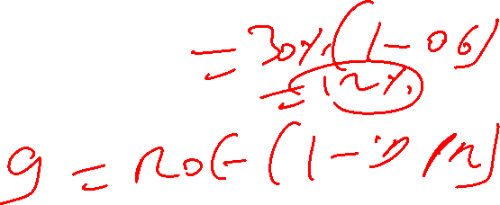
INFOSYS ( is a 3 stage candidate)
Particulars | 2025 | 2024 | 2023 | 2022 | 2021
ROE (In %) | 27.87 | 29.77 | 31.95 | 29.34 | 25.34
DPS (INR) | 43.00 | 46.00 | 34.00 | 31.00 | 27.00
EPS (INR)-Basic | 64.50 | 63.39 | 57.63 | 52.52 | 45.61
DPR (in %)
5 Avg.ROE (in %) | 28.85= 28 % | Last 3 yr Avg ROE = 29.86% | Let us take 30 %
Avg DPR | 181/ 283.65 | = 63.81% = 64% | Let us take 60 %
Fundamental g = ROE*(1-DPR) | 30 (0.40) = 12.00 %

Slide 387
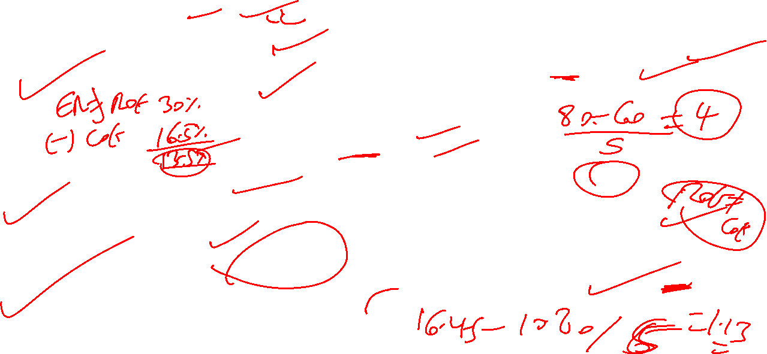
Assumptions in the computation of Fundamental PE for Infosys
Particulars | High Growth Phase | Transition Phase | Stable Phase
Length (in years ) | 5 years | 5 years (i.e y6 to y10) | After year 10
DPR | 60 % | (80-60)/5 = 4 % p.year Y6: 60+4 = 64 % Y7: 64 + 4= 68% Y8: 72 % Y9: 76 % Y10: 80 % | 80 %
Growth Rate | 12.00 % | (12.00-6.00 )/5 = 1.20 Y6: 10.80% ; Y7: 9.60 % Y8: 8.40 % ; Y9: 7.20 % Y10: 6% | 6%
COE | 7.35 %+ (1.22*7.46%) = 16.45 % (18 March 2025 Beta =1.22) | (16.45-10.80)/5 = 1.13 Y6: 15.32% ; Y7: 14.19% Y8: 13.06% ; Y9: 11.93% Y10: 10.80% | 6% + (0.80*6%) = 10.80%

Slide 388
Infosys : Total PE
= PE HG phase + PE Transition phase + PE stable Phase
= 2.6729 + 2.6089 + 11.7771 = 17.0589 or 17.06 times
Predicted Price on 31-03-25 = 17.06* EPS of INR 64.50 = INR 1100.37
Predicted Price on 18 December 2025 = 1100.37 * ( 1+0.1645/360 *258= 1.12) = INR 1232.41
Current Market Price @ INR 1626.80 on 18 December 2025
52 W High Low : INR 1307 to INR 1982.80
Overvalued

Slide 389
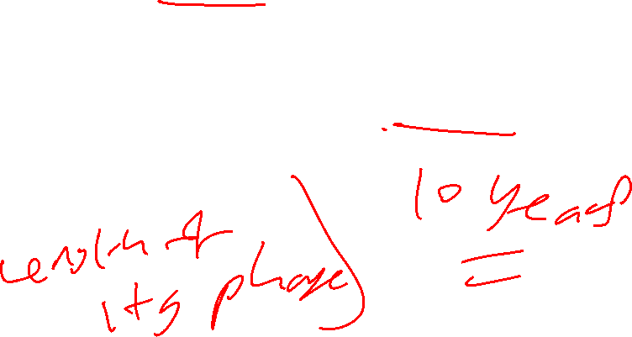
What can We Do?
We may consider 10 years as the length of High Growth Phase ; 5 years for transition phase and stable phase to start from year 16

Slide 390
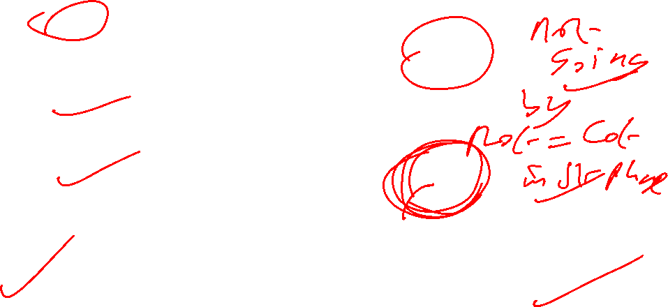
Assumptions in the computation of Fundamental PE for Infosys
Particulars | High Growth Phase | Transition Phase | Stable Phase
Length (in years ) | 10 years | 5 years (i.e y11 to y15) | After year 15
DPR | 60 % | (80-60)/5 = 4 % p.year Y11: 60+4 = 64 % Y12: 64 + 4= 68% Y13: 72 % Y14: 76 % Y15: 80 % | 80 %
Growth Rate | 12.00 % | (12.00-6.00 )/5 = 1.20 Y11: 10.80% ; Y12 9.60 % Y13: 8.40 % ; Y14: 7.20 % Y15: 6% | 6%
COE | 7.35 %+ (1.22*7.46%) = 16.45 % (18 March 2025 Beta =1.22) | (16.45-10.80)/5 = 1.13 Y11: 15.32% ; Y12: 14.19% Y13: 13.06% ; Y14: 11.93% Y15: 10.80% | 6% + (0.80*6%) = 10.80%

Slide 391
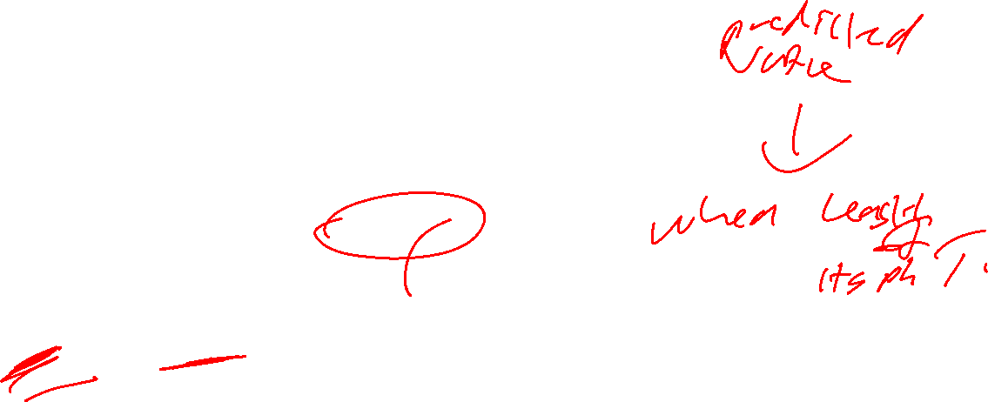
Infosys : Total PE
= PE HG phase + PE Transition phase + PE stable Phase
= 4.8731 + 2.1473 + 9.6939 = 16.71 times
Predicted Price on 31-03-25 = 16.71 * EPS of INR 64.50 = INR 1077.80
Predicted Price on 18 December 2025 = 1077.80 * ( 1+0.1645/360 *258= 1.12) = INR 1207 vs INR 1232.41(when Length of HG Phase is 5 years)
Current Market Price @ INR 1626.80 on 18 December 2025
52 W High Low : INR 1307 to INR 1982.80
Overvalued

Slide 392

What is the flaw in the assumptions?
ROE- COE at current year = 27.87-16.45= 11.42 %
Therefore, Length of HG Phase could be 15 years and transition phase could be of 5 years and stable phase start at year 21
In stable phase, Infosys shall earn no excess return i.e COE=ROE= 10.80 % ; meaning stable phase g = 10.80 ( 1-0.80) = 2.16 %

Slide 393
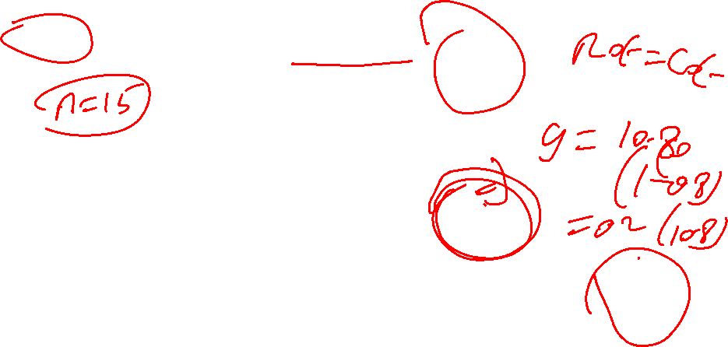
Revised Assumptions in the computation of Fundamental PE for Infosys
Particulars | High Growth Phase | Transition Phase | Stable Phase
Length (in years ) | 15 years | 5 years (i.e y16 to y20) | After year 20
DPR | 60 % | (80-60)/5 = 4 % p.year Y16: 60+4 = 64 % Y17: 64 + 4= 68% Y18: 72 % Y19: 76 % Y 20: 80 % | 80 %
Growth Rate | 12.00 % | (12.00-2.16 )/5 = 1.968 Y16: 10.032% ; Y17 8.064 % Y18: 6.096 % ; Y19: 4.128% Y20: 2.16% | 2.16%
COE | 7.35 %+ (1.22*7.46%) = 16.45 % (18 March 2025 Beta =1.22) | (16.45-10.80)/5 = 1.13 Y16: 15.32% ; Y17: 14.19% Y18: 13.06% ; Y19: 11.93% Y20: 10.80% | 6% + (0.80*6%) = 10.80%

Slide 394
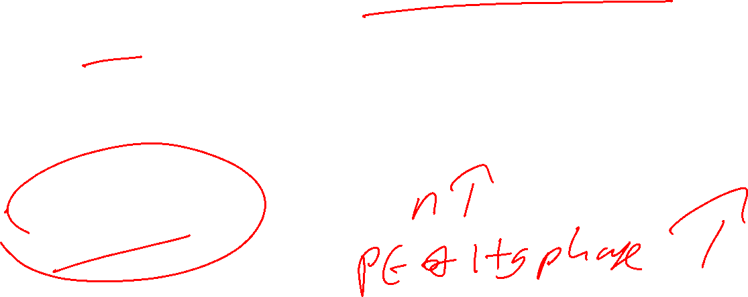
Infosys- High Growth PE
= 0.60(1.12)(1- [{1.12}^15/ {1.1645}^15]) / (0.1645-0.1200)
= 0.6720 ( 1- {5.4736/ 9.8196) / 0.0445
= 6.6838 times

Slide 395
Infosys : Year 16 PE =???
Year 16 DPR = 64 % or 0.64
Year 1-15 growth factor = 5.4736
Year 16 growth rate = 10.032 % or 0.1003
Year 1-15 COE factor = 9.8196
Year 16 COE = 15.32 % = 0.1532

Slide 396
Infosys : Year 16 PE
= year 16 DPR * (1+G hg)^ hg period * (1+ G year 16)
-----------------------------------------------------------------------
(1+ COE hg) ^ hg period * (1+ COE year 16)
= 0.64 * (5.4736) (1.1003) / (9.8196) (1.1532)
= 0.64 ( 6.0226)/ 11.3240
= 3.8545 / 11.3240 = 0.3404 times

Slide 397
Infosys : Year 17 PE =???
Year 17 DPR = 68 % or 0.68
Year 1-16 growth factor = 6.0226
Year 17 growth rate = 8.064 % = 0.0806
Year 1-16 COE factor = 11.3240
Year 17 COE = 14.19 % = 0.1419

Slide 398
Infosys : Year 17 PE
= year 17 DPR * (1+G hg)^ hg period * (1+ G year 16)*(1+G y17)
---------------------------------------------------------------------------------
(1+ COE hg) ^ hg period * (1+ COE year 16)*(1+COE y17)
= 0.68* ( 6.0226) (1.0806) / (11.3240) (1.1419)
= 0.68 ( 6.5080 )/ 12.9309
= 4.4254/ 12.9309 = 0.3422 times

Slide 399
Infosys : Year 18 PE =???
Year 18 DPR = 72% or 0.72
Year 1-17 growth factor = 6.5080
Year 18 growth rate = 6.096 % = 0.0610
Year 1-17 COE factor = 12.9309
Year 18 COE = 13.06 % = 0.1306

Slide 400
Infosys : Year 18 PE
= year 18 DPR * (1+G hg)^ hg p * (1+ G y 16)*(1+G y17) (1+G y18)
--------------------------------------------------------------------------------------
(1+ COE hg) ^ hg p * (1+ COE y 16)*(1+COE y17)* (1+COE y18)
= 0.72 * (6.5080) (1.0610) / (12.9309) (1.1306)
= 0.72 (6.9050) / 14.6197
= 4.9716/ 14.6197 = 0.3401 times

Slide 401
Infosys : Year 19 PE =???
Year 19 DPR = 76 % or 0.76
Year 1-18 growth factor = 6.9050
Year 19 growth rate = 4.128 % =0.0413
Year 1-18 COE factor = 14.6197
Year 19 COE = 11.93% = 0.1193

Slide 402
Infosys : Year 19 PE
= year 19 DPR * (1+G hg)^ hg p * (1+ G y 16)*(1+G y17) (1+G y18) (1+Gy19)
-----------------------------------------------------------------------------------------
(1+ COE hg) ^ hg p * (1+ COE y 16)*(1+COE y17)* (1+COE y18) (1+COE y19)
= 0.76 * (6.9050) (1.0413) /( 14.6197 ) (1.1193)
= 0.76 ( 7.1902) / 16.3638
= 5.4646 / 16.3638 = 0.3339 times

Slide 403
Infosys : Year 20 PE =???
Year 20 DPR = 80% or 0.80
Year 1-19 growth factor = 7.1902
Year 20 growth rate = 2.16% =0.0216
Year 1-19 COE factor = 16.3638
Year 20 COE = 0.1080

Slide 404
Infosys : Year 20 PE
year20DPR * (1+G hg)^ hg p * (1+ Gy16)*(1+Gy17) (1+Gy18) (1+Gy19)(1+G Y 20)
--------------------------------------------------------------------------------------------------
(1+ COE hg) ^ hg p * (1+ COE y 16)*(1+COE y 17)* (1+COE y 18) (1+COE y19) (1+COE y20)
= 0.80 * (7.1902) (1.0216) / (16.3638) (1.1080)
=0.80 ( 7.3455) / 18.1311
= 5.8764/ 18.1311 = 0.3241 times

Slide 405
Infosys : Year 16-20 PE
= 0.3404+ 0.3422+ 0.3401 +0.3339 +0.3241 =
1.6807 times

Slide 406

Infosys : Stable Phase PE
St. Ph DPR * (1+G hg)^ hg p * (1+ Gy16)*(1+Gy17) (1+Gy18) (1+Gy19)(1+G Y 20)(1+G st.ph)
-----------------------------------------------------------------------------------------
(COE st.ph – G st.ph) (1+ COE hg) ^ hg p * (1+ COE y 16)*(1+COE y17)* (1+COE y18) (1+COE y19) (1+COE y20)
= 0.80 * (7.3455) (1.0216) / (0.1080-0.0216) ( 18.1311)
= 6.0033 / 1.5665 = 3.8323 times

Slide 407

Infosys : Total PE
= PE HG phase + PE Transition phase + PE stable Phase
= 6.6838 + 1.6807 + 3.8323 = 12.20 times
Predicted Price on 31-03-25 = 12.20 * EPS of INR 64.50 = INR 786.90
Predicted Price on 18 December 2025 = 786.90 * ( 1+0.1645/360 *258= 1.12) =INR 881.32 Vs INR 1207( when length of HG is 10 years & stable ph g of 6% ) vs INR 1232.41(when Length of HG Phae is 5 years & stable ph g of 6 %)
Current Market Price @ INR 1626.80 on 18 December 2025
52 W High Low : INR 1307 to INR 1982.80
Overvalued

Slide 408
PE on Comparable Firms Approach
Relative valuation: take P/E of company and take comparable company, find avg PE for sector and compare PE of company with avg of sector. This is niave comparison

Slide 409
PE on Comparable Firms Approach
Steps
Identify the comparable firms
Collect data on the fundamental variables for comparable firms
Run the regression ( Dependent Variable = PE; Independent Variables = DPR, Beta and growth rate)
Get the output of the regression
Predict PE for the target firm
Conclude on whether the firm is overvalued or undervalued by comparing the Actual PE with the Predicted PE

Slide 410
Sample Firm : TCS
Industry: IT Services and Consulting
CMP on 24 December 2025: INR 3308.20
52 W L-H: INR 2866.60 TO INR 4322.95
Market Cap: INR 11,96,863 Crores
Source: Moneycontrol.com

Slide 411
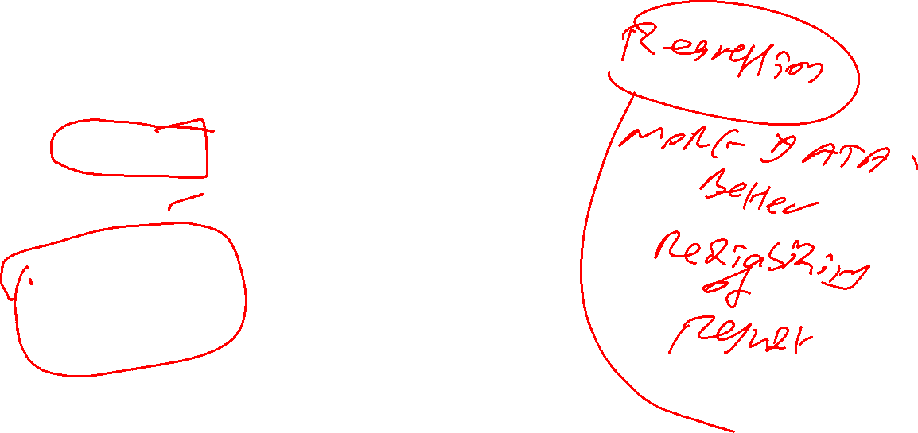
S 1: Comparable firms of TCS based on Market Cap (24 December 2025)
Serial No. | Company | Market Cap ( in INR crores)
1 | Infosys | 672467
2 | HCL Tech | 455055
3 | Wipro | 281361
4 | LTI Mindtree | 184268
5 | Tech Mahindra | 159332
6 | Persistent | 99940
7 | Oracle Fin Serv | 67786
8 | COFORGE Ltd | 58606
9 | MphasiS | 54900
10 | Hexaware Tech | 45590

Slide 412
S 2: Fundamental Variables for TCS and its peers
Company | DPR (March 2025)- 5 year average | G % = ROE * (1-DPR) (5 year average ) | Beta (current) | Current PE ( 24 December 2025)
TCS | 395/ 565.59= 0.70 | 45.82 ( 1-0.70) = 13.75 | 0.88 | 3308.20/134.19 = 24.65
Infosys | 181/ 283.65 = 0.64 | 28.85 (1-0.64) = 10.39 | 1.24 | 1658.30/ 64.50 = 25.71
HCL Tech | 212 / 267.84 = 0.79 | 22.21(1-0.79 ) = 4.66 | 1.18 | 1676.50/ 64.16 = 26.13
Wipro | 15/ 95.66 = 0.16 | 16.74(1-0.16 ) = 14.06 | 1.08 | 268.10/ 12.56 = 21.35
LTI Mindtree | 285 / 701.38 =0.41 | 24.45(1-0.41) = 14.43 | 1.22 | 6209.00 / 155.29 = 39.98
Tech Mahindra | 225/ 243.38 = 0.92 | 16.04 (1-0.92 ) = 1.28 | 1.11 | 1630.00/ 48 = 33.96
Persistent | 162 / 436.70 = 0.37 | 20.81 (1-0.37 ) = 13.11 | 1.55 | 6428.00/ 91.22 = 70.47
Oracle Fin Serv | 1120 / 1163.89 = 0.96 | 26.64 (1-0.96 ) = 1.07 | 1.53 | 7797.00 / 274.27 = 28.43
COFORGE Ltd | 281 / 552.04 = 0.51 | 20.04 ( 1- 0.51 ) = 9.82 | 1.58 | 1752.90 / 123.01 = 14.25
MphasiS | 273/ 400.90 =0.68 | 19.04 ( 1-0.68) = 6.09 | 1.47 | 2890.40/89.87 = 32.16
Hexaware Tech | 55.50/ 83.67 = 0.66 | 20.78(1-0.66) = 7.07 | 0.93 | 748.55/ 19.37 = 38.64
Average | 0.62 | 23.77 (1-0.62) = 9.03 | 1.25 | 32.34

Slide 413
S3 : Run the Regression ( Exclude data for TCS)
Dependent Variable : PE ( absolute value for e-g 22.34)
Independent Variable 1: DPR ( in decimals for e-g 0.45)
Independent Variable 2 : Growth Rate (absolute value
for e-g 20 )
Independent Variable 3: Beta ( absolute value for e-g 1.54)

Slide 414
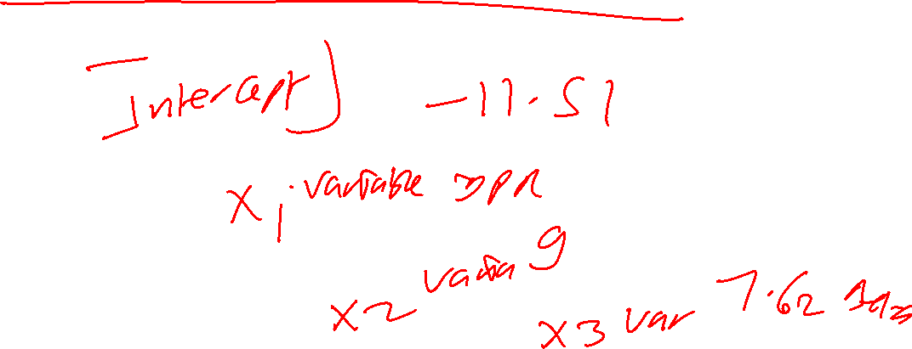
Step 4: Output of Regression (TCS)
PE = -11.51 +28.80 (DPR) +2.10 (g) +7.62(Beta)

Slide 415
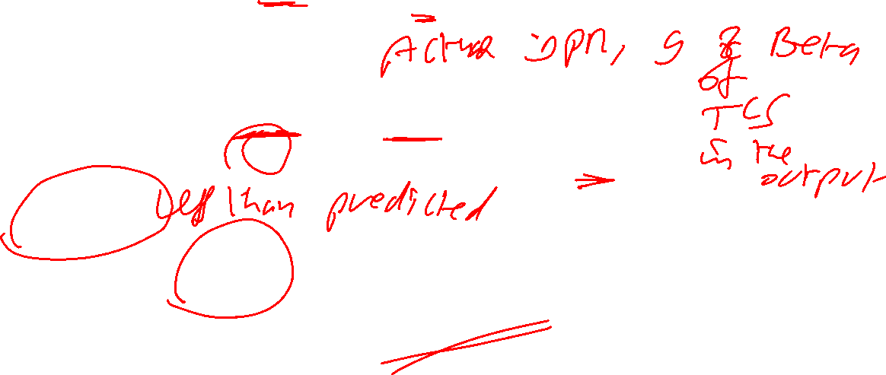
S5 :Predicted PE for TCS
PE =-11.51 +28.80 (DPR) +2.10 (g) +7.62(Beta)
PE TCS (predicted)
= -11.51 +28.80 (0.70) +2.10(13.75) + 7.62 (0.88)
= -11.51+20.16+28.88+6.71
= 44.24
Actual PE = 24.65 Undervalued

Slide 416
Output of Regression (Infosys )
PE = 7.53 +2.66 (DPR) +0.75 (g) +13.92 (Beta)

Slide 417

Predicted PE for Infosys
PE =7.53 +2.66 (DPR) +0.75 (g) +13.92 (Beta)
PE Infosys (predicted)
= 7.53 +2.66 (0.64) +0.75(10.39) + 13.92 (1.24)
= 7.53+ 1.70+ 7.79 + 17.26 = 34.28
Actual PE = 25.71
Undervalued

Slide 418
Output of Regression ( Persistent )
PE = 48.71 + 1.05 (DPR) - 0.48 (g) -13.84 (Beta)

Slide 419
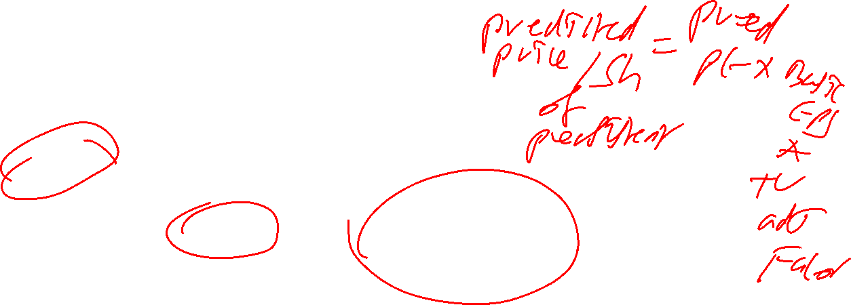
Predicted PE for Persistent
PE =48.71 + 1.05 (DPR) - 0.48 (g) -13.84 (Beta)
PE Persistent (predicted)
=48.71 + 1.05 (0.37) - 0.48 (13.11) -13.84 (1.55)
= 48.71 + 0.39- 6.29 – 21.45
= 21.36
Actual PE = 70.47 Overvalued

Slide 420
PEG Ratio
On Naïve Comparison: If PEG is less than 1; then the firm is undervalued
Why PEG – there are companies which has similar growth rate, so we remove the impact of growth rate and this is not stable growth rate.
Its more for two stage firm.
PE of a two stage firm / g = PEG.
Why we divide high growth g in stable stage formula

Slide 421
PEG ratio
= PE / growth rate
PEG for a stable firm = DPR (1+g )/ (COE-g) g
PEG of a high growth firm is
DPR hg *(1+ g hg) *( 1- [ {1+g hg}^n / {1+ COE hg }^n])
----------------------------------------------------------------------- +
g hg (COE hg – g hg)
DPR st (1+g hg) ^hg period (1+ g st)
--------------------------------------------------------------
g hg ( COE st – g st) (1+COE hg)^ hg period

Slide 422
PEG & Fundamentals
PEG & Risk
PEG & DPR → positive and linear
PEG & Growth Rate → non linear.
( firms with very high or very low growth rates have higher PEG ratios than firms with average growth rates)
Relationship between PEG and risk -> negative and linear

Slide 423
PEG for a hypothetical firm using 2 stage growth model
DPR hg *(1+ g hg) *( 1- [ {1+g hg}^n / {1+ COE hg }^n])
----------------------------------------------------------------------- +
g hg (COE hg – g hg)
DPR st (1+g hg) ^hg period (1+ g st)
--------------------------------------------------------------
g hg ( COE st – g st) (1+COE hg)^ hg period

Slide 424

Assumptions- Hypothetical Firm
Particulars | High Growth Phase | Stable Phase
DPR (in %) | 40 | 70
ROE (in %) | 15 | 10.80
Length | 10 years | After year 10
Beta | 1 | 0.8
Rf (in %) | 7.42 | 6
MRP (in %) | 9.73 | 6
Fundamental growth rate (= ROE * {1-DPR}) | 15 (1-0.40) = 9% | 10.80 (1-0.70) = 3.24 %
Cost of Equity | 7.42 %+ (1 *9.73%) = 17.15% | 6+ (0.8*6%) = 10.80%

Slide 425

PEG for a hypo firm using 2 stage growth model ( when g hg=9%)
= 0.40 (1.09) [ 1- {2.3674/4.8688} ] / (0.0815) (0.09)
+
0.70 (2.3674) (1.0324) / (0.0756) (4.8688) (0.09)
= (0.2240/0.0073) + (1.7109/ 0.0331)
= (30.68) + (51.69) = 82.37 or 0.82 times

Slide 426
What happens to PEG when we increase g of HG phase from 9 % to 12% by increasing ROE from 15% to 20% in HG phase
Keeping other variables constant in HG phase
Keeping stable phase variables constant

Slide 427
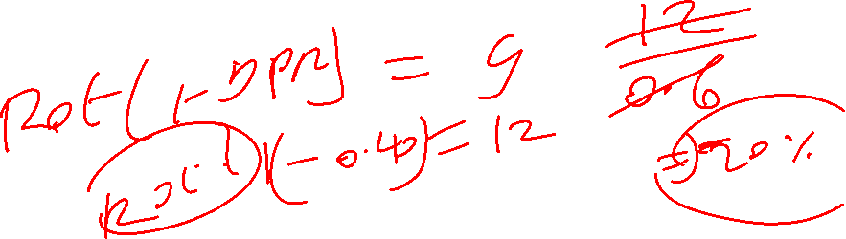
Assumptions- Hypo Firm
Particulars | High Growth Phase | Stable Phase
DPR (in %) | 40 | 70
ROE (in %) | 20 | 10.80
Length | 10 years | After year 10
Beta | 1 | 0.8
Rf (in %) | 7.42 | 6
MRP (in %) | 9.73 | 6
Fundamental growth rate (= ROE * {1-DPR}) | 20(1-0.40) = 12% | 10.80 (1-0.70) = 3.24 %
Cost of Equity | 7.42 %+ (1 *9.73%) = 17.15% | 6+ (0.8*6%) = 10.80%

Slide 428
PEG for a hypo firm using 2 stage growth model ( when g hg=12%)
= 0.40 (1.12) [ 1- {3.1058/4.8688} ] / (0.0515) (0.12)
+
0.70 (3.1058) (1.0324) / (0.0756) (4.8688) (0.12)
= (0.1622/0.0062) + (2.2445/ 0.0442)
= (26.16) + (50.78) = 76.94 or 0.77 times

Slide 429
Comparison of PEG at HG phase g of 9% & 12%
PEG at 9% g in HG Phase = 0.82 times
PEG at 12% g in HG Phase = 0.77 times

Slide 430
What happens to PEG when g of HG Phase =15 % ? by increasing ROE from 20% to 25% in HG phase
Keeping other variables constant in HG phase
Keeping stable phase variables constant

Slide 431
Assumptions- Hypo Firm
Particulars | High Growth Phase | Stable Phase
DPR (in %) | 40 | 70
ROE (in %) | 25 | 10.80
Length | 10 years | After year 10
Beta | 1 | 0.8
Rf (in %) | 7.42 | 6
MRP (in %) | 9.73 | 6
Fundamental growth rate (= ROE * {1-DPR}) | 25(1-0.40) = 15% | 10.80 (1-0.70) = 3.24 %
Cost of Equity | 7.42 %+ (1 *9.73%) = 17.15% | 6+ (0.8*6%) = 10.80%

Slide 432
PEG for a hypo firm using 2 stage growth model ( when g hg=15%)
= 0.40 (1.15) [ 1- {4.0456/4.8688} ] / (0.0215) (0.15)
+
0.70 (4.0456) (1.0324) / (0.0756) (4.8688) (0.15)
= (0.0778/0.0032) + (2.9237/ 0.0552)
= (24.31) + (52.97) = 77.28 or 0.77 times

Slide 433
Comparison of PEG at HG phase g of 9%, 12 % & 15%
PEG at 9% g in HG Phase = 0.82 times
PEG at 12% g in HG Phase = 0.77 times
PEG at 15% g in HG Phase =0.77 times

Slide 434
What happens to PEG when g of HG phase =20 % ? By increasing ROE from 25% to 33.33%
Keeping other variables constant in HG phase
Keeping Stable Phase variables constant

Slide 435
Assumptions- Hypo Firm
Particulars | High Growth Phase | Stable Phase
DPR (in %) | 40 | 70
ROE (in %) | 33.33 | 10.80
Length | 10 years | After year 10
Beta | 1 | 0.8
Rf (in %) | 7.42 | 6
MRP (in %) | 9.73 | 6
Fundamental growth rate (= ROE * {1-DPR}) | 33.33(1-0.40) = 20% | 10.80 (1-0.70) = 3.24 %
Cost of Equity | 7.42 %+ (1 *9.73%) = 17.15% | 6+ (0.8*6%) = 10.80%

Slide 436
PEG for a hypo firm using 2 stage growth model ( when g hg=20%)
= 0.40 (1.20) [ 1- {6.1917/4.8688} ] / (-0.0285) (0.20)
+
0.70 (6.1917) (1.0324) / (0.0756) (4.8688) (0.20)
= (-0.1304/-0.0057) + (4.4746/ 0.0736)
= (22.88) + (60.80) = 83.68 or 0.84 times

Slide 437
Comparison of PEG at HG phase g of 9% , 12%, 15 % & 20 %
PEG at 9% g in HG Phase = 0.82 times
PEG at 12% g in HG Phase = 0.77 times
PEG at 15% g in HG Phase = 0.77 times
PEG at 20% g in HG Phase = 0.84 times

Slide 438
What happens to PEG when we decrease g of HG Phase from 9 % to 7 %? By decreasing ROE from 15% to 11.67%
Keeping other variables constant in HG Phase
Keeping Stable Phase Variables Constant

Slide 439
Assumptions
Particulars | High Growth Phase | Stable Phase
DPR (in %) | 40 | 70
ROE (in %) | 11.67 | 10.80
Length | 10 years | After year 10
Beta | 1 | 0.8
Rf (in %) | 7.70 | 6
MRP (in %) | 6.42 | 6
Fundamental growth rate (= ROE * {1-DPR}) | 11.67 (1-0.40) = 7% | 10.80 (1-0.70) = 3.24 %
Cost of Equity | 7.42 %+ (1 *9.73%) = 17.15% | 6+ (0.8*6%) = 10.80%

Slide 440
PEG for a hypo firm using 2 stage growth model ( when g hg=7%)
= 0.40 (1.07) [ 1- {1.9672/4.8688} ] / (0.1015) * (0.07)
+
0.70 (1.9672) (1.0324) / (0.0756) (4.8688) (0.07)
= (0.2550/0.0071) + (1.4217/0.0258) =35.92+ 55.10
91.02 or 0.91 times

Slide 441
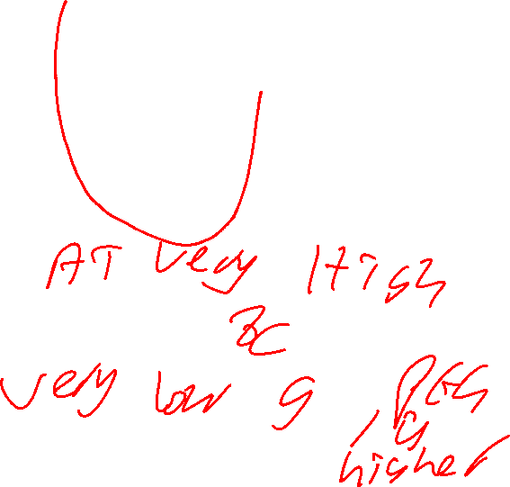
Summary on PEG of Hypo firm
If g = 7 %, then PEG is 0.91 times
If g = 9%, then PEG is 0.82 times
If g = 12%, then PEG is 0.77 times
If g= 15%, then PEG is 0.77 times
If g= 20 %, then PEG is 0.84 times

Slide 442
PEG & Fundamentals
PEG & Risk
PEG & DPR
PEG & Growth Rate
( firms with very high or very low growth rates have higher PEG ratios than firms with average growth rates)

Slide 443

FAL PGDF 24-26
Session 11 (4th Jan 2026)

Slide 444
For Discussion in session 11
PEG – if you are going to do for three stage firm then divide by g every year.
PEGY
PERG
PB Ratio & Determinants

Slide 445
PEGY ratio
PEGY ratio (st .firm)= PE / ( growth rate+ Dividend Yield)
Dividend yield = dividend per share /market price per share OR total dividend/market cap
DPR = DPS/EPS or total dividend/PAT
On Naïve Comparison: If PEGY is less than 1; then the firm is undervalued

Slide 446
Dividend Yield for TCS & its’ Peers
Company | Dividend Per Share (INR) - 5 year average | CMP (INR) 24 December 2025 | Dividend Yield = DPS/CMP *100
TCS | 395/ 5= 79.00 | 3308.20 | 79/3308.20 = 2.39
Infosys | 181/ 5 = 36.20 | 1658.30 | 2.18
HCL Tech | 212 / 5 = 42.40 | 1676.50 | 2.53
Wipro | 15/ 5 = 3.00 | 268.10 | 1.12
LTI Mindtree | 285/ 5 = 57.00 | 6209.00 | 0.92
Tech Mahindra | 225 / 5 = 45.00 | 1630.00 | 2.76
Persistent | 162/ 5 = 32.40 | 6428.00 | 0.50
Oracle Fin Serv | 1120 / 5 = 224.00 | 7797.00 | 2.87
COFORGE Ltd | 281/ 5= 56.20 | 1752.90 | 3.21
MphasisS | 273 / 5 = 54.60 | 2890.40 | 1.89
Hexaware Tech | 55.50/5 = 11.10 | 748.55 | 1.48

Slide 447
PEGY of TCS & its Peers
Company | PE | G | Dividend Yield | PEGY = PE / (g+y) in Times
TCS | 24.65 | 13.75 | 2.39 | 24.65/ ( 13.75 + 2.39) =1.52
Infosys | 25.71 | 10.39 | 2.18 | 25.71/ ( 10.39 +2.18) =2.05
HCL Tech | 26.13 | 4.66 | 2.53 | 26.13 / ( 4.66 + 2.53 ) =3.63
Wipro | 21.35 | 14.06 | 1.12 | 21.35 / ( 14.06 + 1.12 ) =1.41
LTI Mindtree | 39.98 | 14.43 | 0.92 | 39.98/ ( 14.43 + 0.92) =2.60
Tech Mahindra | 33.96 | 1.28 | 2.76 | 33.96 / ( 1.28 + 2.76) =8.41
Persistent | 70.47 | 13.11 | 0.50 | 70.47/ ( 13.11 + 0.50 ) =5.18
Oracle Fin Serv | 28.43 | 1.07 | 2.87 | 28.43 / (1.07 + 2.87) =7.22
COFORGE Ltd | 14.25 | 9.82 | 3.21 | 14.25 / ( 9.82 + 3.21 ) =1.09
MphasisS | 32.16 | 6.09 | 1.89 | 32.16 / ( 6.09 +1.89 ) =4.03
Hexaware Tech | 38.64 | 7.07 | 1.48 | 38.64/ ( 7.07 +1.48) = 4.52
Notes:
You can do a regression, dependent variable is PEGY and independent variable is PE,G,dividend yield.

Slide 448
PERG Ratio
PE ratio adjusted for growth & Risk
PERG = PEG * Risk or [ (PE/g) * Risk ]
Risk could be proxied by Beta
Compare firms first on PE
Then on PEG
And on PERG

Slide 449
PE, PEG & PERG of HCL Tech
Particulars | Calculation
PE (in Times) on 24 December 2025 | 26.13 times
Fundamental growth rate (in%) | 4.66 %
PEG (in Times) | 26.13 / 4.66 = 5.61 times
Beta | 1.18
PERG (in Times) | 5.61 (1.18) = 6.62 times

Slide 450
PB Ratio for a firm in stable phase of growth Let us Consider
State Bank of India (SBI)
Consolidated Financials
PB = price to book ratio = price per share/book value per share = market cap/OE
when EPS is negative which mean firm is incurring loss hence finding out PE is negative and difficult hence we go for PB value. Also to avoid the impact of good or bad years, PE doesn’t capture this but PB is cumulative number so it can be useful.
4 determinants of PB ratio = ROE,DPR, g, cost of equity. Companion variable is the highest coefficient when you run regression and in this case ROE is the companion variable.

Slide 451
PB Ratio for SBI
Particulars | 2025 | 2024 | 2023 | 2022 | 2021
DPS (in INR) | 15.90 | 13.70 | 11.30 | 7.10 | 4
EPS Basic (in INR) | 86.91 | 75.17 | 62.35 | 39.64 | 25.11
Avg DPR |  | Last 5 years 52/ 289.18 | = 17.98 | Last 3 years 40.90/224.43= 18.22 | Let us consider 20 %
ROE (IN %) | 16.87 | 17.31 | 16.80 | 12.53 | 8.89
Avg.ROE | 14.48 |  | Consider st/phase ROE of 12% | St.phase DPR of 60%
Fundamental Growth rate (in %) | 14.48 ( 1-0.2)= | 11.58 But assume it as a stable firm | St phase g= 4.8%
COE | Current Beta 0.92 on 2 January 2026 |  | WE may assume stable phase COE of 12 %

Slide 452
PB Ratio for SBI- Base Case
P/B = ROE *DPR *(1+g) / (COE-g)
= 0.12 *0.60*1.048 / (0.1200-0.0480) = 0.0755/ 0.0720 = 1.05 times
BPS 2025= INR 515.07
Predicted price = 515.07*1.05*(1+ 0.1200/360 *272= 1.09) = INR 589.50
Actual Price @ INR 998.95 on 2 January 2026
52 Week LH : 680.00 to 1009.50 Highly Overvalued

Slide 453
PB Ratio for a High Growth firm
ROE hg *
[DPR hg *(1+ g hg) *( 1- [ {1+g hg}^n / {1+ COE hg }^n])
----------------------------------------------------------------------- +
COE hg – g hg
DPR st *(1+ g hg)^n * (1+g st)
----------------------------------------------------------------- ]
( COE st – g st) * (1+ COE hg)^n

Slide 454
PB Ratio for SBI
Particulars | 2025 | 2024 | 2023 | 2022 | 2021
DPS (in INR) | 15.90 | 13.70 | 11.30 | 7.10 | 4
EPS Basic (in INR) | 86.91 | 75.17 | 62.35 | 39.64 | 25.11
Avg DPR |  | Last 5 years 52/ 289.18 | = 17.98 | Last 3 years 40.90/224.43= 18.22 | Let us consider 20 %
ROE (IN %) | 16.87 | 17.31 | 16.80 | 12.53 | 8.89
Avg.ROE | 14.48 |  | Consider st/phase ROE of 12% | St.phase DPR of 60%
Fundamental Growth rate (in %) | 14.48 ( 1-0.2)= | 11.58 assume it as a 2 stage firm | St phase g= 4.8%
COE | Current Beta 0.92 on 2 January 2026 |  | WE may assume stable phase COE of 12 %

Slide 455
If we Assume SBI as a 2 stage growth firm
Growth Rate- HG phase = 11.58 % ; DPR HG phase @ 20 %
ROE hg = 14.48 %
Length of HG phase = 10 years
COE hg = 7.35 % + ( 0.92 * 7.46 ) = 14.21 %
Stable Phase growth rate = 4.8%
Stable phase DPR = 60 %
Stable phase COE = ROE= 12 %

Slide 456

PB ratio for SBI as a 2- stage firm – HG PB
0.1448 [ 0.20*(1.1158) *( 1- [ {1.1158}^10/ {1.1421}^10])
= ------------------------------------------------------------ ]
0.1421 – 0.1158
= 0.1448* 0.20* (1.1158) (1-{2.9913/3.7761}) / 0.0263 =0.0067/0.0263
= 0.2548 times

Slide 457
PB ratio for SBI as a 2 -stage firm – Stable Phase PB
PB in Stable Phase
= ROE * [DPR st *(1+ g hg)^n * (1+g st)
-------------------------------------------------------
( COE st – g st) * (1+ COE hg)^n
ROE hg = 14.48% ; DPR st = 60% ; g st = 4.8% ; g hg = 11.58%
COE st = 6% + 1(6) = 12 % ; length of HG phase = 10 years
COE hg = 14.21 %

Slide 458
PB ratio for SBI as a 2 -stage firm – Stable Phase PB
0.1448 * [0.60 *(1.1158)^10 * (1.048)
-------------------------------------------------------
( 0.12 – 0.048) * (1.1421)^10
= 0.1448 (0.60) (2.9913) (1.048)/
(0.072) (3.7761) = 0.2724/0.2719 = 1.0018

Slide 459
PB of SBI – as a 2 –stage firm
Total PB ratio = 0.2548+ 1.0018 = 1.2566 times= 1.26 times
BPS 2025= INR 515.07
Predicted price = 515.07*1.26*(1+ 0.1421/360 *272= 1.11) = INR 720.38 vs INR 589.50 as a stable growth firm
Actual Price @ INR 968.95 on 2 January 2026
52 Week LH : 680.00 to 1009.50 Overvalued

Slide 460
PB Ratio for MRF Ltd (consolidated financials)
Particulars | 2025 | 2024 | 2023 | 2022 | 2021
DPS (in INR) | 200 | 175 | 150 | 150 | 100
EPS Basic (in INR) | 4407.51 | 4907.24 | 1813.10 | 1577.97 | 3011.14
Avg DPR | 775 / 15716.96 | = 4.93 % | Let us take 5%
ROE (IN %) | 10.11 | 12.46 | 5.22 | 4.76 | 9.52
Avg.ROE | 8.41
Fundamental Growth rate (in %) | 8.41 (1-0.05) = | 8.00 %
COE | 7.35%+ (0.83 *7.46%) = 13.54%
We need to look at three things to say if the company has good fundamental, = Profit margin, ROE, ROE-COE

Slide 461
PB Ratio for MRF???
PB in High growth phase = ???
ROE [DPR hg *(1+ g hg) *( 1- [ {1+g hg}^n / {1+ COE hg }^n])
-----------------------------------------------------------------------
COE hg – g hg
ROE hg = 8.41 % ; DPR hg = 5.00 % ; g hg = 8.00% ; COE hg = 13.54%
Length of HG phase = 10 years

Slide 462
High Growth Phase PB Ratio for MRF
0.0841 [ 0.05*(1.08) *( 1- [ {1.08}^10/ {1.1354}^10])
= ------------------------------------------------------------ ]
0.1354 – 0.0800
= 0.0841* 0.05* (1.08) (1-{2.1589/ 3.5603}) / 0.0554 =0.0018/0.0554
= 0.0325 times

Slide 463
PB Ratio for MRF
PB in Stable Phase
= ROE * [DPR st *(1+ g hg)^n * (1+g st)
-------------------------------------------------------
( COE st – g st) * (1+ COE hg)^n
ROE hg = 8.41% ; DPR st = 70% ; g st = 2.88% ; g hg = 8%
COE st = 6% + 0.6(6) = 9.6% ; length of HG phase = 10 years
COE hg = 13.54 %

Slide 464
PB Ratio for MRF
= 0.0841 * [0.70 *(1.08)^10 * (1.0288)
-------------------------------------------------------
( 0.096 – 0.0288) * (1.1354)^10
= 0.0841 (0.70) (2.1589) (1.0288)/
(0.0672) (3.5603) = 0.1308/0.2393 = 0.5466
Total PB ratio = 0.0325+ 0.5466 = 0.5791 0r 0.58 times
Predicted Price = 0.58 * March 2025 BPS of INR 43604.86 *(1 + 0.1354/360 *272= 1.10) = INR 27820
Actual Price @ INR 150685 ( 2 January 2026)
52 W LH : 102124.05 – 163600 Highly Overvalued

Slide 465
Three Stage Model of Growth-PB
High Growth Phase
Transition Phase
Stable Phase

Slide 466
TVS Motor Company Limited
Mkt Cap : INR I,69,629 Crores on 29 Dec 2025
CMP: INR 3570.50
52 Week LH : 2171.40 to 3734.90
Consolidated Financials from Moneycontrol
F score, M score & Benford Analysis ???

Slide 467
TVS Motor Company Ltd ( is a 3 -stage candidate)
Particulars | 2025 | 2024 | 2023 | 2022 | 2021
ROE (In %) | 26.29 | 24.85 | 24.13 | 17.20 | 15.52
DPS (INR) | 10.00 | 8.00 | 5.00 | 3.75 | 3.50
EPS (INR) | 47.05 | 35.50 | 27.97 | 15.93 | 12.51
Avg.ROE (in %) | 21.60 % | Consider 22 %
Avg DPR | 30.25/ 138.96= | 21.77 Consider 22%
Fundamental g = ROE*(1-DPR) | 22 ( 1-0.22) = 17.16 %

Slide 468
Assumptions in the computation of Fundamental PB for TVS Motor Company Ltd
Particulars | High Growth Phase | Transition Phase | Stable Phase
Length (in years ) | 15 years | 5 years (i.e y 16 to y 20) | After year 20
DPR | 22% | (70-22)/5 = 9.6 % p.year Y 16: 22 + 9.6= 31.6% Y 17: 41.2% Y18: 50.8 % Y 19: 60.4% Y 20: 70 % | 70 %
Growth Rate | 17.16% | (17.16-3.6 )/5 = 2.712 Y 16: 14.448% ; Y 17 11.736% Y 18: 9.024% ; Y19: 6.312% Y 20: 3.6% | 12 % (1-0.70) = 3.6 %
COE | 7.35 %+ ( 1.22 *7.46%) = 16.45% | (16.45-12.00)/5 = 0.89 Y16: 15.56% ; Y17: 14.67% Y18: 13.78 % ; Y19: 12.89% Y20: 12% | 6% + (1*6%) = 12%

Slide 469
TVS Motor Company Ltd -High Growth PB ???
ROE hg * DPR hg *(1+ g hg) *( 1- [ {1+g hg}^n / {1+ COE hg }^n])
-------------------------------------------------------
COE hg – g hg
Where DPR hg = 22% ; g hg = 17.16% ; COE hg = 16.45%; ROE hg = 22 %; Length of HG Phase = 15 years

Slide 470

TVS Motor Company Ltd -High Growth PB
= (0.22) (0.22)(1.1716)(1- [{1.1716}^15/ {1.1645}^15]) /
(0.1645-0.1716)
= (0.22) (0.2578) ( 1- { 10.7570 / 9.8196}) / -0.0071
= 0.7629 times

Slide 471
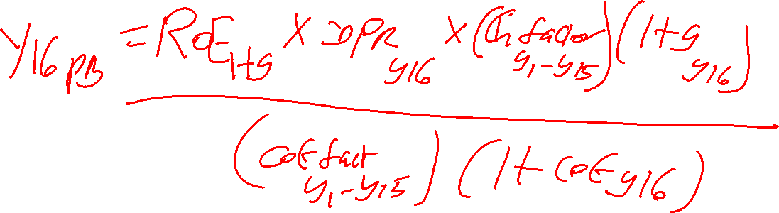
TVS Motor Company Ltd : Year 16 PB =???
What do we need ?

Slide 472
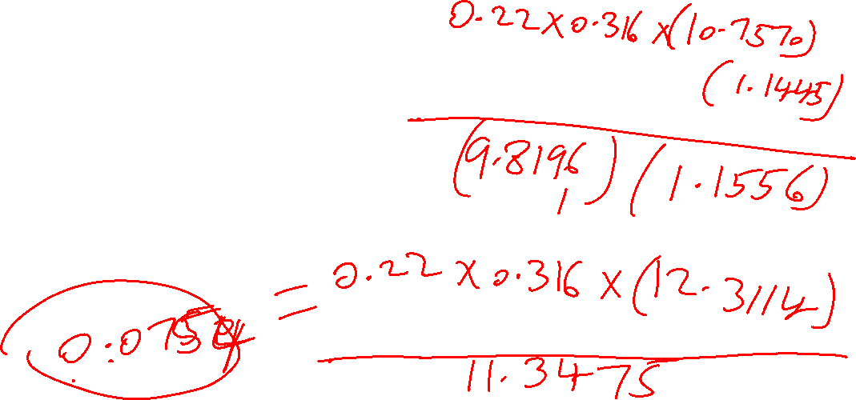
TVS Motor Company Ltd : Year 16 PB =???
Year 16 DPR = 31.6 % or 0.316
Year 1-15 growth factor = 10.7570
Year 16 growth rate = 0.1445
Year 1-15 COE factor = 9.8196
Year 16 COE = 0.1556
ROE hg = 0.22

Slide 473
TVS Motor Company Ltd-Year 16 PB
= year 16 DPR * (1+G hg)^ hg period * (1+ G year 16)
ROE hg -----------------------------------------------------------------------
(1+ COE hg) ^ hg period * (1+ COE year 16)
= 0.22 * 0.316 (10.7570) (1.1445) / (9.8196) (1.1556)
= 0.22 *0.316 ( 12.3114)/ 11.3475
= 0.8559/ 11.3475 = 0.0754 times

Slide 474
TVS Motor Company Ltd : Year 17 PB =???
Year 17 DPR = 41.2% or 0.412
Year 1-16 growth factor = 12.3114
Year 17 growth rate = 0.1174
Year 1-16 COE factor = 11.3475
Year 17 COE = 0.1467
ROE hg = 0.22

Slide 475

FAL PGDF 24-26
Session 12 (7-Jan-2026)

Slide 476
TVS Motor Company Ltd : Year 18 PB =???
Year 18 DPR = 0.508
Year 1-17 growth factor = 13.7568
Year 18 growth rate = 0.0902
Year 1-17 COE factor = 13.0122
Year 18 COE = 0.1378
ROE hg = 0.22

Slide 477
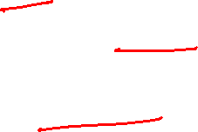
TVS Motor Company Ltd-Year 18 PB
= year 18 DPR * (1+G y1-y17) (1+g y18)
ROE hg -----------------------------------------------------------------------
(1+ COE y1-17)(1+COE y18)
= 0.22 * 0.508 (13.7568) (1.0902) / (13.0122) (1.1378)
= 0.22 *0.508 ( 14.9977)/ 14.8053
= 1.6761/ 14.8053 = 0.1132 times

Slide 478
TVS Motor Company Ltd : Year 19 PB =???
Year 19 DPR = 0.604
Year 1-18 growth factor = 14.9977
Year 19 growth rate = 0.0631
Year 1-18 COE factor = 14.8053
Year 19 COE = 0.1289
ROE hg = 0.22

Slide 479
TVS Motor Company Ltd-Year 19 PB
= year 19 DPR * (1+G y1-y18) (1+g y19)
ROE hg -----------------------------------------------------------------------
(1+ COE y1-18)(1+COE y19)
= 0.22 * 0.604 (14.9977) (1.0631) / (14.8053) (1.1289)
= 0.22 *0.604 ( 15.9441)/ 16.7137
= 2.1187/ 16.7137 = 0.1268 times

Slide 480
TVS Motor Company Ltd : Year 20 PB =???
Year 20 DPR = 0.70
Year 1-19 growth factor = 15.9441
Year 20 growth rate = 0.036
Year 1-19 COE factor = 16.7137
Year 20 COE = 0.12
ROE hg = 0.22

Slide 481
TVS Motor Company Ltd-Year 20 PB
= year 20 DPR * (1+G y1-y19) (1+g y20)
ROE hg -----------------------------------------------------------------------
(1+ COE y1-19)(1+COE y20)
= 0.22 * 0.70 (15.9441) (1.036) / (16.7137) (1.12)
= 0.22 *0.70 ( 16.5181)/ 18.7193
= 2.5438/ 18.7193 = 0.1359 times

Slide 482
TVS Motor Company Ltd-Year 16-20 PB
= 0.0754 + 0.0958+ 0.1132 +0.1268 +0.1359 = 0.5471 times

Slide 483
TVS Motor Company Ltd- : Stable Phase PB
St. Ph DPR * (1+G Y1-Y20)(1+G st.ph)
ROE hg ---------------------------------------------------
(COE st.ph – G st.ph) (1+ COE Y1-Y 20)
ROE hg = 0.22 ; st ph DPR = 0.70; G factor y1-y20= 16.5181;g st pha = 0.036
COE st ph = 0.12 ; COE factor y1-y20= 18.7193

Slide 484

TVS Motor Company Ltd- : Stable Phase PB
St. Ph DPR * (1+G Y1-Y20)(1+G st.ph)
ROE hg ---------------------------------------------------
(COE st.ph – G st.ph) (1+ COE Y1-Y 20)
= 0.22 (0.70 ) (16.5181) (1.036) / ( 0.12-0.036) (18.7193)
= 2.6354/ 1.5724 = 1.6760 times

Slide 485
TVS Motor Company Ltd- : Total PB
= PE HG phase + PE Transition phase + PE stable Phase
= 0.7629 + 0.5471+ 1.6760 = 2.9860 times = 2.99 times
Predicted Price = 2.99 * Mar 2025 BPS of INR 178.98*(1+ 0.1645/360*269= 1.12)
= INR 599.36
on 29 Dec 2025
CMP: INR 3570.50
52 Week LH : 2171.40 to 3734.90
Highly Overvalued

Slide 486
Assumptions in the computation of Fundamental PB for TVS Motor Company Ltd
Particulars | High Growth Phase | Transition Phase | Stable Phase
Length (in years ) | 15 years | 5 years (i.e y 16 to y 20) | After year 20
DPR | 22% | (70-22)/5 = 9.6 % p.year Y 16: 22 + 9.6= 31.6% Y 17: 41.2% Y18: 50.8 % Y 19: 60.4% Y 20: 70 % | 70 %
Growth Rate | 17.16% | (17.16-3.6 )/5 = 2.712 Y 16: 14.448% ; Y 17 11.736% Y 18: 9.024% ; Y19: 6.312% Y 20: 3.6% | 12 % (1-0.70) = 3.6 %
COE | 7.35 %+ ( 1.22 *7.46%) = 16.45% | (16.45-12.00)/5 = 0.89 Y16: 15.56% ; Y17: 14.67% Y18: 13.78 % ; Y19: 12.89% Y20: 12% | 6% + (1*6%) = 12%

Slide 487
Mismatches in the relation b/w PB Ratio & ROE
Low ROE vs Low PB – fair valuation
Low ROE vs high PB – overvalued zone
High ROE vs high PB – fair valuation
High ROE vs low PB – under valued

Slide 488
Price to Sales Ratio for a Stable Firm
High the sales, higher the value and revenue is the key metric here.
NPM = EPS0/sales0 = pat/sales revenue
Determinants of P/S – NPM, DPR, g, COE
PS (hg) = NPM(hg) * PE ratio
PS (st) = NPM (hg) * PE ratio
PS (st)= NPM *DPR (1+G) / (COE-G)
PS metrics
High NPM, high p/s – fair valuation
High NPM, low p/s – under valuation
low NPM, high p/s – over valuation
low NPM, low p/s – fair valuation

Slide 489
Let us take Ashok Leyland
Net Revenue ( Operations ) for FY 2025 = INR 48342 Crores
Number of shares = 587.39 crores

Slide 490
PS Ratio for Ashok Leyland Ltd
Particulars | 2025 | 2024 | 2023 | 2022 | 2021
DPS (in INR) | 6.25 | 4.95 | 2.60 | 1.00 | 0.60
EPS Basic (in INR) | 10.58 | 8.46 | 4.23 | -1.22 | -0.56
Avg DPR |  | 15.40/21.49= 71.66% | Lets us assume 60%
ROE (IN %) | 25.39 | 27.58 | 14.50 | -4.90 | -2.10
Avg.ROE |  | 12.09 % | Let us assume 12 %
Fundamental Growth rate (in %) | 12 (0.40) = 4.80% | Stable Firm
COE hg Phase (30 Dec 2025) | 7.35+ 1.31*7.46 | = 17.12 % | St phase COE 12%
NPM (in %) | 6.90 | 5.85 | 3.24 | -1.11 | -0.35
Avg NPM % | 5 year avg 2.91 % | 3 yr avg = 5.33 % | Let us take 5.33 %

Slide 491
PS Ratio of Ashok Leyland
= NPM *DPR (1+G) / (COE-G)
= 0.0533 *0.60 (1.048) / (0.12-0.048)
= 0.034/0.072 = 0.47 times
Predicted Mkt Cap = P/S * Sales 2025* (1+ 0.12/360 * 270= 1.09) = 0.47* 48342*1.09 = INR 24766 Crores
Predicted price/share = 24766 / 587.39 cr shares = INR 42.16
Actual Mkt Cap = INR 104925 crores
Actual Price /share = INR 178.63 ( 30 Dec 2025)
52 w LH: INR 95.93 – INR 179.97 Highly Overvalued

Slide 492
What to do ?
We may consider Ashok Leyland as a 2 –stage growth candidate under PS Multiple ( with following assumptions )
Particulars | HG Phase | Stable Phase
DPR | 60 % | 80 %
ROE | 25 % | 10.80 %
G | 10 % | 2.16 %
COE | 17.12 % | 10.80 %
NPM | 10 %
Length of HG Phase | 15 years

Slide 493
PS Ratio for a Two Stage Firm ( High Growth firm)
=
NPM hg *
[DPR hg *(1+ g hg) *( 1- [ {1+g hg}^n / {1+ COE hg }^n])
----------------------------------------------------------------------- +
COE hg – g hg
DPR st *(1+ g hg)^n * (1+g st)
----------------------------------------------------------------- ]
( COE st – g st) * (1+ COE hg)^n

Slide 494
Revised PS Ratio for Ashok Leyland Ltd
PS in High growth phase = ???
NPM hg [DPR hg *(1+ g hg) *( 1- [ {1+g hg}^n / {1+ COE hg }^n])
-----------------------------------------------------------------------
COE hg – g hg
NPM hg = 10.00 % ; DPR hg = 60% ; g hg = 10 % ; COE hg = 17.12 %
Length of HG phase = 15 years

Slide 495
Revised PS Ratio for Ashok Leyland Ltd in HG Phase
0.08 [ 0.60*(1.10) *( 1- [ {1.10}^15/ {1.1712}^15])
= ------------------------------------------------------------ ]
0.1712 – 0.10
= 0.10 * 0.60* (1.10) (1- {4.1772/ 10.7020 }) / 0.0712 = 0.0402/0.0712
= 0.5646 times

Slide 496
Revised PS Ratio for Ashok Leyland Ltd
PS in Stable Phase
= NPM hg * [DPR st *(1+ g hg)^n * (1+g st)
-------------------------------------------------------
( COE st – g st) * (1+ COE hg)^n
NPM hg = 10.00 % ; DPR st = 80% ; g st = 2.16% ; g f hg = 4.1772
COE st = 6% + 0.8(6) = 10.80% ; length of HG phase = 15 years
COE f hg = 10.7020

Slide 497
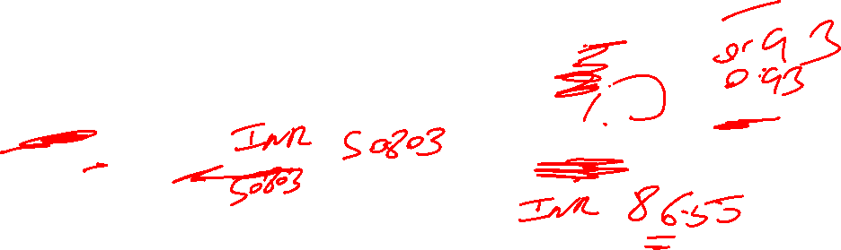
Revised PS Ratio for Ashok Leyland Ltd
= 0.10 * [0.80 *(4.1772) * (1.0216)
-------------------------------------------------------
( 0.1080 – 0.0216) * (10.7020)
= 0.10 ( 3.4139/0. 9247) = 0.3692 times
Total PS ratio = 0.5646+ 0.3692= 0.9338 times= 0.94 times
Predicted Mkt Cap = P/S * Sales 2025* (1+ 0.1712/360 * 270= 1.13) = 0.94* 48342*1.13 = INR 51349 Crores
Predicted price/share = 51349/ 587.39 cr shares = INR 87.42 vs INR 42.16 ( Base Case)
Actual Mkt Cap = INR 104925 crores
Actual Price /share = INR 178.63 ( 30 Dec 2025)
52 w LH: INR 95.93 – INR 179.97 Highly Overvalued

Slide 498

PS Ratio of NALCO ( 30 Dec 2025)
Particulars | 2025 | 2024 | 2023 | 2022 | 2021
DPS (in INR) | 8.00 | 5.00 | 4.50 | 6.50 | 3.50
EPS Basic ( In INR) | 28.68 | 10.83 | 7.81 | 16.07 | 6.97
Average DPR |  |  | 27.5/ 70.36 = 39.08% | Assume 40 % | St Ph DPR = 70%
ROE (in %) | 29.58 | 13.82 | 10.92 | 23.51 | 12.16
Average ROE(in %) |  |  | 18 %
Fundamental growth rate in % |  |  | 18 (1-0.40) = 10.80 % | 2 Stage Firm | St Ph G = 13.20 (0.30)= 3.96 %
NPM (IN %) | 31.71 | 15.66 | 10.83 | 20.81 | 14.51
Average NPM % | 18.70%
COE in % | Rf = 7.35% | Beta = 1.73 | MRP =7.46% | COE Hg = 20.26 % | St ph COE= 13.20 % (= 6 + 1.2*6)

Slide 499
PS Ratio for a Two Stage Firm ( High Growth firm)
=
NPM hg *
[DPR hg *(1+ g hg) *( 1- [ {1+g hg}^n / {1+ COE hg }^n])
----------------------------------------------------------------------- +
COE hg – g hg
DPR st *(1+ g hg)^n * (1+g st)
----------------------------------------------------------------- ]
( COE st – g st) * (1+ COE hg)^n

Slide 500

PS Ratio of NALCO in hg Phase
0.187 [ 0.40*(1.1080) *( 1- [ {1.1080}^10/ {1.2026}^10])
= ------------------------------------------------------------ ]
0.2026 – 0.1080
= 0.187 * 0.40* (1.1080) (1- {2.7887/ 6.3272}) / 0.0946 = 0.0464/0.0946
= 0.4905 times

Slide 501

PS Ratio of NALCO –St. Phase
PS in Stable Phase
= NPM hg * [DPR st *(1+ g hg)^n * (1+g st)
-------------------------------------------------------
( COE st – g st) * (1+ COE hg)^n
NPM hg = 18.70 % ; DPR st = 70% ; g st = 3.96% ; g f hg = 2.7887
COE st = 6% + 1.2(6) = 13.20% ; length of HG phase = 10 years
COE f hg = 6.3272

Slide 502
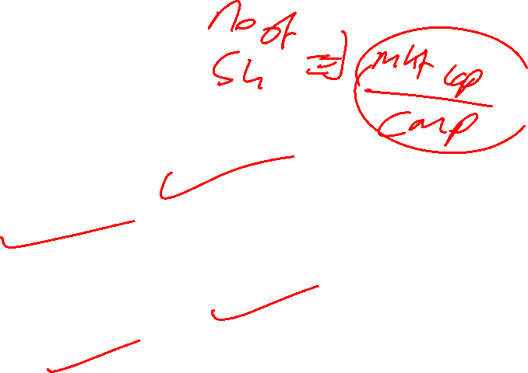
PS Ratio of NALCO
= 0.187 * [0.70 *(2.7887) * (1.0396)
-------------------------------------------------------
( 0.1320 – 0.0396) * (6.3272)
= 0.187 ( 2.0294/0. 5846 ) = 0.6492 times
Total PS ratio = 0.4905+ 0.6492 = 1.1397 times = 1.14 times
Predicted Mkt Cap = P/S * Sales 2025* (1+ 0.2026/360 * 270= 1.15) = 1.14* 16788*1.15 = INR 22009 Crores
Predicted price/share = 22009 / 183.66 cr shares = INR 119.84
Actual Mkt Cap = INR 58239 crores
Actual Price /share = INR 317.10 ( 30 Dec 2025)
52 w LH: INR 137.75 – INR 319.85 Highly Overvalued

Slide 503
Revised PS Ratio of NALCO ( 30 Dec 2025)
Particulars | 2025 | 2024 | 2023 | 2022 | 2021
DPS (in INR) | 8.00 | 5.00 | 4.50 | 6.50 | 3.50
EPS Basic ( In INR) | 28.68 | 10.83 | 7.81 | 16.07 | 6.97
Average DPR |  |  | 27.5/ 70.36 = 39.08% | Assume 40 % | St Ph DPR = 70%
ROE (in %) | 29.58 | 13.82 | 10.92 | 23.51 | 12.16
Average ROE(in %) |  |  | 18 %
Fundamental growth rate in % |  |  | 18 (1-0.40) = 10.80 % | 2 Stage Firm | St Ph G = 13.20 (0.30)= 3.96 %
NPM (IN %) | 31.71 | 15.66 | 10.83 | 20.81 | 14.51
5 Average NPM % | 18.70% | Let us take 20%
COE in % | Rf = 7.35% | Beta = 1.73 | MRP =7.46% | COE Hg = 20.26 % | St ph COE= 13.20 % (= 6 + 1.2*6)

Slide 504
Revised PS Ratio of NALCO in hg Phase
0.2000 [ 0.40*(1.1080) *( 1- [ {1.1080}^10/ {1.2026}^10])
= ------------------------------------------------------------ ]
0.2026 – 0.1080
= 0.2000 * 0.40* (1.1080) (1- {2.7887/ 6.3272}) / 0.0946 = 0.0496/0.0946
= 0.5243 times

Slide 505
Revised PS Ratio of NALCO –St. Phase
PS in Stable Phase
= NPM hg * [DPR st *(1+ g hg)^n * (1+g st)
-------------------------------------------------------
( COE st – g st) * (1+ COE hg)^n
NPM hg = 20 % ; DPR st = 70% ; g st = 3.96% ; g f hg = 2.7887
COE st = 6% + 1.2(6) = 13.20% ; length of HG phase = 10 years
COE f hg = 6.3272

Slide 506
Revised PS Ratio of NALCO
= 0.2000* [0.70 *(2.7887) * (1.0396)
-------------------------------------------------------
( 0.1320 – 0.0396) * (6.3272)
= 0.2000 ( 2.0294/0. 5846 ) = 0.6943 times
Total PS ratio = 0.5243+ 0.6943 = 1.2186 times = 1.22 times
Predicted Mkt Cap = P/S * Sales 2025* (1+ 0.2026/360 * 270= 1.15) = 1.22* 16788*1.15 = INR 23554 Crores
Predicted price/share = 23554/ 183.66 cr shares = INR 128.25 VS INR 119.84 ( Base Case)
Actual Mkt Cap = INR 58239 crores
Actual Price /share = INR 317.10 ( 30 Dec 2025)
52 w LH: INR 137.75 – INR 319.85 Highly Overvalued

Slide 507
PS Ratio for a 3-stage firm
Let us take TCS

Slide 508
PS Ratio for TCS ( 30 Dec 2025)
Particulars | 2025 | 2024 | 2023 | 2022 | 2021
DPS (in INR) | 126 | 73 | 115 | 43 | 38
EPS Basic (in INR) | 134.19 | 125.88 | 115.19 | 103.62 | 86.71
Avg DPR | 395/ 565.59 | 69.84% | Assume 60%
ROE (IN %) | 51.24 | 50.73 | 46.61 | 42.99 | 37.52
Avg.ROE | 45.82 %
Fundamental Growth rate (in %) | 45.82 (1-0.6) | =18.33 % Consider 18.30 %
COE hg Phase |  | 7.35+0.89*7.46 | = 13.99% | Assume 14 %
NPM (in %) | 19.11 | 19.13 | 18.76 | 20.05 | 19.83
Avg NPM % | 19.38% | Assume 19%

Slide 509
Assumptions in the computation of Fundamental PS for TCS-Trans.phase
Particulars | High Growth Phase | Transition Phase | Stable Phase
Length (in years ) | 20years | 5 years (i.e y21 to y25) | After year 25
DPR | 60% | (80-60)/5 = 4% p.year Y21: 60+4 = 64 % Y22: 68 % Y23: 72 % Y24: 76 % Y25: 80 % | 80 %
Growth Rate | 18.30 % | (18.30 -2.16 )/5 = 3.228 Y21: 15.072% ; Y22: 11.844% Y23: 8.616% ; Y24: 5.388 % Y25: 2.16% | 2.16% [ = 10.80 (1-0.80) ]
COE | 14 % | (14.00-10.80)/5 = 0.64% Y21: 13.36% ; Y22: 12.72% Y23: 12.08 % ; Y24: 11.44% Y25: 10.80 % | 6% + (0.8*6%) = 10.80%

Slide 510
PS Ratio for TCS in hg Phase (3 stage model)
0.1900 [ 0.60*(1.1830) *( 1- [ {1.1830}^20/ {1.1400}^20])
= ------------------------------------------------------------ ]
0.1400 – 0.1830
= 0.1900 * 0.60* (1.1830) (1- {28.8201/13.7435 )/ -0.0430 = 3.4405 times

Slide 511

TCS: Year 21 PS
= NPM hg *year 21 DPR * (1+G hg)^ hg period * (1+ G year 21)
-----------------------------------------------------------------------
(1+ COE hg) ^ hg period * (1+ COE year 21)
= 0.1900 *0.64 (28.8201) (1.1507) / (13.7435) (1.1336)
= 0.1900 *0.64 (33.1633) / 15.5796
= 4.0327/ 15.5796 = 0.2588 times

Slide 512

TCS : Year 22 PS
= NPM hg * year 22 DPR * (1+G hg)^ hg period * (1+ G year 21)*(1+G y22)
---------------------------------------------------------------------------------
(1+ COE hg) ^ hg period * (1+ COE year 21)*(1+COE y22)
=0.1900 *0.68 (33.1633) (1.1184) / (15.5796) (1.1272)
= 0.1900 *0.68 ( 37.0898) / 17.5613
= 4.7920 / 17.5613 = 0.2729 times

Slide 513
TCS : Year 23 PS
= NPM hg * year 23 DPR * (1+G hg)^ hg p * (1+ G y 21)*(1+G y22) (1+G y23)
--------------------------------------------------------------------------------------
(1+ COE hg) ^ hg p * (1+ COE y 21)*(1+COE y22)* (1+COE y23)
= 0.1900 *0.72 ( 37.0898) (1.0862))/ (17.5613) (1.1208)
= 0.1900 *0.72 (40.2869)/ 19.6827
= 5.5112/ 19.6827 = 0.2800 times

Slide 514
TCS : Year 24 PS
= NPM hg * year 24 DPR * (1+G hg)^ hg p * (1+ G y 21)*(1+G y22) (1+G y23) (1+Gy24)
--------------------------------------------------------------------------------------------------
(1+ COE hg) ^ hg p * (1+ COE y 21)*(1+COE y22)* (1+COE y23) (1+COE y24)
= 0.1900 *0.76 (40.2869) (1.0539) / (19.6827) (1.1144)
=0.1900 *0.76 ( 42.4584)/ 21.9344
=6.1310 / 21.9344 = 0.2795 times

Slide 515
TCS : Year 25 PS
NPM hg * year25DPR * (1+G hg)^ hg p * (1+ Gy21)*(1+Gy22) (1+Gy23) (1+Gy24)(1+G Y 25)
---------------------------------------------------------------------------------------------------
(1+ COE hg) ^ hg p * (1+ COE y 21)*(1+COE y22)* (1+COE y23) (1+COE y24) (1+COE y25)
= 0.1900 *0.80 (42.4584) (1.0216)/ (21.9344) (1.1080)
= 0.1900 *0.80 (43.3755)/ 24.3033
= 6.5931/ 24.3033= 0.2713 times

Slide 516
TCS: Year 21-25 PS
= 0.2588 + 0.2729+ 0.2800 +0.2795 +0.2713 = 1.3625 times

Slide 517

TCS : Stable Phase PS
NPM hg* St. Ph DPR * (1+G hg)^ hg p * (1+ Gy21)*(1+Gy22) (1+Gy23) (1+Gy24)(1+G Y 25)(1+G st.ph)
----------------------------------------------------------------------------------------------------
(COE st.ph – G st.ph) (1+ COE hg) ^ hg p * (1+ COE y 21)*(1+COE y22)* (1+COE y23) (1+COE y24) (1+COE y25)
= 0.1900 *0.80 (43.3755) (1.0216)/ (24.3033) (0.1080-0.0216)
= 6.7355/2.0998 = 3.2077 times

Slide 518
TCS : Total PS & Value
= PS HG phase + PS Transition phase + PS stable Phase
= 3.4405 + 1.3625+ 3.2077 = 8.0107 times= 8.01 times
Predicted Mkt Cap = 8.01* Sales 2025 at INR 255324 * (1 +0.1400/360 * 270= 1.11) = INR 2270111 crores
Predicted Price/share = 2270111/361.81 Crore shares = INR 6274/ Share
Actual Mket Cap @ INR 11,63,938 Crores on 30 Dec 2025; CMP = 3217
52 WLH : INR 3156 – INR 4431 Highly Undervalued

Slide 519

What Can be done????
We can assume Length of HG Phase as 10 years and Transition Phase as Y 11 to Y 15 and Stable Phase starting from Y 16
Keeping other things constant

Slide 520
Revised Assumptions in the computation of Fundamental PS for TCS-Trans.phase
Particulars | High Growth Phase | Transition Phase | Stable Phase
Length (in years ) | 10years | 5 years (i.e y11 to y15) | After year 15
DPR | 60% | (80-60)/5 = 4% p.year Y11: 60+4 = 64 % Y12: 68 % Y13: 72 % Y14: 76 % Y15: 80 % | 80 %
Growth Rate | 18.30 % | (18.30 -2.16 )/5 = 3.228 Y11: 15.072% ; Y12: 11.844% Y13: 8.616% ; Y14: 5.388 % Y15: 2.16% | 2.16% [ = 10.80 (1-0.80) ]
COE | 14 % | (14.00-10.80)/5 = 0.64% Y11: 13.36% ; Y12: 12.72% Y13: 12.08 % ; Y14: 11.44% Y15: 10.80 % | 6% + (0.8*6%) = 10.80%

Slide 521
Revised PS Ratio for TCS in hg Phase (3 stage model)
0.1900 [ 0.60*(1.1830) *( 1- [ {1.1830}^10/ {1.1400}^10])
= ------------------------------------------------------------ ]
0.1400 – 0.1830
= 0.1900 * 0.60* (1.1830) (1- {5.3684/ 3.7072 )/ -0.0430 = 1.4054 times

Slide 522
TCS: Revised Year 11 PS
= NPM hg *year 11 DPR * (1+G hg)^ hg period * (1+ G year 11)
-----------------------------------------------------------------------
(1+ COE hg) ^ hg period * (1+ COE year 11)
= 0.1900 *0.64 (5.3684) (1.1507) / (3.7072) (1.1336)
= 0.1900 *0.64 (6.1774) / 4.2025
= 0.7512/ 4.2025 = 0.1788 times

Slide 523
TCS : Revised Year 12 PS
= NPM hg * year 12 DPR * (1+G hg)^ hg period * (1+ G year 12)*(1+G y12)
---------------------------------------------------------------------------------
(1+ COE hg) ^ hg period * (1+ COE year 11)*(1+COE y12)
=0.1900 *0.68 (6.1774) (1.1184) / (4.2025) (1.1272)
= 0.1900 *0.68 ( 6.9088) / 4.7371
= 0.8926 / 4.7371 = 0.1884 times

Slide 524

TCS : Revised Year 13 PS
= NPM hg * year 13 DPR * (1+G hg)^ hg p * (1+ G y 11)*(1+G y12) (1+G y13)
--------------------------------------------------------------------------------------
(1+ COE hg) ^ hg p * (1+ COE y 11)*(1+COE y12)* (1+COE y13)
= 0.1900 *0.72 ( 6.9088) (1.0862))/ (4.7371) (1.1208)
= 0.1900 *0.72 (7.5043)/ 5.3093
= 1.0266/ 5.3093 = 0.1934 times

Slide 525

TCS : Revised Year 14 PS
= NPM hg * year 14 DPR * (1+G hg)^ hg p * (1+ G y 11)*(1+G y12) (1+G y13) (1+Gy14)
----------------------------------------------------------------------------------------------
(1+ COE hg) ^ hg p * (1+ COE y 11)*(1+COE y12)* (1+COE y13) (1+COE y14)
= 0.1900 *0.76 (7.5043) (1.0539) / (5.3093) (1.1144)
=0.1900 *0.76 ( 7.9088)/ 5.9167
=1.1420 / 5.9167 = 0.1930 times

Slide 526

TCS : Revised Year 15 PS
NPM hg * year15DPR * (1+G hg)^ hg p * (1+ Gy11)*(1+Gy12) (1+Gy13) (1+Gy14)(1+G Y 15)
----------------------------------------------------------------------------------------------
(1+ COE hg) ^ hg p * (1+ COE y 11)*(1+COE y12)* (1+COE y13) (1+COE y14) (1+COE y15)
= 0.1900 *0.80 (7.9088) (1.0216)/ (5.9167) (1.1080)
= 0.1900 *0.80 (8.0796)/ 6.5557
= 1.2281/ 6.5557= 0.1873 times

Slide 527

TCS: Revised Year 11-15 PS
= 0.1788 + 0.1884+ 0.1934 +0.1930 +0.1873 = 0.9409 times

Slide 528

TCS : Revised Stable Phase PS
NPM hg* St. Ph DPR * (1+G hg)^ hg p * (1+ Gy11)*(1+Gy12) (1+Gy13) (1+Gy14)(1+G Y 15)(1+G st.ph)
----------------------------------------------------------------------------------------------------
(COE st.ph – G st.ph) (1+ COE hg) ^ hg p * (1+ COE y 11)*(1+COE y12)* (1+COE y13) (1+COE y14) (1+COE y15)
= 0.1900 *0.80 (8.0796) (1.0216)/ (6.5557) (0.1080-0.0216)
= 1.2546/0.5664 = 2.2150 times

Slide 529

TCS : Revised Total PS & Value
= PS HG phase + PS Transition phase + PS stable Phase
= 1.4054 + 0.9409+ 2.2150 = 4.5613 times= 4.56 times
Predicted Mkt Cap = 4.56* Sales 2025 at INR 255324 * (1 +0.1400/360 * 270= 1.11) = INR 1292348 crores
Predicted Price/share = 1292348/361.81 Crore shares = INR 3572/ Share vs INR 6274/ share ( Base Case)
Actual Mket Cap @ INR 11,63,938 Crores on 30 Dec 2025; CMP = 3217
52 WLH : INR 3156 – INR 4431 Undervalued

Slide 530
FAL PGDF (24-26)
Session 13 10th Jan 2026

Slide 531
EV/EBITDA multiple
EV= MV of Equity + MV of Debt – Cash
MV of equity = market cap, MV of debt = BV of debt which is equal to short term borrowing and long term borrowing, cash and cash equivalent is cash and current investments.
EV is applicable for both equity and debt investor.
EBITDA- Earnings Before Interest Tax Depreciation and Amortization
When we values many companies using price based multiple why most of the companies are overvalues:
There are few types of company where DPS = EPS, DPS < EPS, DPS > EPS
If earning per share is higher then dividend per share then DPR is lower and P/E depends on DPR hence the valuation is higher.
One solution to solve it is to go for modified DPR which is FCFE/PAT where FCFE = PAT+D&A +/ delta Capex +- Delta NWC +- Net debt
Computed PAT removed non-recurring items & other incomes.

Slide 532
Suitability of EV/EBITDA multiple
Firms in businesses with longer gestation periods (invest today and payback takes time)
Firms reporting losses
Firms with differences in capital structure
In LBOs ( Leveraged Buyouts)

Slide 533
Determinants of EV/EBITDA
Value of firm as time 0 = FCFF1 / (WACC-g)
FCFF= EBIT(1-T)- Capex +D&A-Delta NWC
Could be expanded as
= (EBITDA-D&A) (1-T)- Capex + D&A- Delta NWC
= EBITDA (1-T)-D&A+ D&A T-Capex+D&A – Delta NWC
= EBITDA (1-T)+ D&A T-Capex- Delta NWC
EV/EBITDA = EBITDA (1-T)+ D&A T-Capex- Delta NWC/ EBITDA (WACC-g)
=( {1-T}/{WACC-g} ) + ( {D&A T/ EBITDA} / {WACC-g} ) -
( {capex / EBITDA} / {WACC-g} ) – ( {Delta NWC/EBITDA} / {WACC-g} )

Slide 534
Determinants of EV/EBITDA
=( {1-T}/{WACC-g} ) + ( {D&A T/ EBITDA} / {WACC-g} ) -
( {capex / EBITDA} / {WACC-g} ) – ( {Delta NWC/EBITDA} / {WACC-g} )
Tax Rate – lower the tax higher the EV/EBITDA
Depreciation/EBITDA – higher D&A, higher EV/EBITDA
Capex/EBITDA – lower the capex, higher EV/EBITDA
Delta NWC/ EBITDA - lower the delta NWC, higher EV/EBITDA
WACC or cost of capital - lower the WACC, higher EV/EBITDA
Growth Rate – higher growth, higher EV/EBITDA

Slide 535
EV/ EBITDA for PGDF (24-26) Ltd
Tax Rate = 50%
D&A/EBITDA= 5%
CAPEX/EBITDA= 15%
Delta NWC/EBITDA = 10%
Cost of Capital = 20%
Growth rate in operating income = 5%
EBITDA = INR 20000 Crores
EV/EBITDA= ??? & EV =?

Slide 536
EV/ EBITDA for PGDF (24-26) Ltd
=( {1-T}/{WACC-g} ) + ( {D&A T/ EBITDA} / {WACC-g} ) -
( {capex / EBITDA} / {WACC-g} ) – ( {Delta NWC/EBITDA} / {WACC-g} )
Tax Rate = 50% D&A/EBITDA= 5%
CAPEX/EBITDA= 15% Delta NWC/EBITDA = 10%
Cost of Capital = 20% Growth rate in operating income = 5%
EBITDA = INR 20000 Crores
EV/EBITDA= ??? & EV =?

Slide 537
EV/ EBITDA for PGDF (24-26) Ltd
=( {1-T}/{WACC-g} ) + ( {D&A T/ EBITDA} / {WACC-g} ) -
( {capex / EBITDA} / {WACC-g} ) – ( {Delta NWC/EBITDA} / {WACC-g} )
Tax Rate = 50% D&A/EBITDA= 5%
CAPEX/EBITDA= 15% Delta NWC/EBITDA = 10%
Cost of Capital = 20% Growth rate in operating income = 5%
EV/EBITDA= [(1-0.50)/0.15 ] + [0.05*0.5/0.15] –[0.15/0.15]-[0.10/0.15]
= 3.33+0.17-1.00-0.67 = 1.83 times
If EBITDA is INR 20000 crores, then its EV = 1.83*20000 = INR 36600 crores

Slide 538
EV/EBITDA for a Stable firm
V 0 = FCFF 0 (1+g) / {WACC-g)
V/EBITDA = FCFF0/EBITDA (1+g) / {WACC-g}

Slide 539
Let us consider HUL
Stable firm Test:
If the growth rate in operating income is less than the expected long run growth rate of the economy i.e 6 % for India
Growth rate in EBIT = Avg.reinvst rate * Avg ROC
We may consider last five years for our analysis

Slide 540
Five Year Average ROC for HUL
Particulars | 2025 | 2024 | 2023 | 2022 | 2021
ROC in % | 22.91 | 21.72 | 22.14 | 20.29 | 19.01
5 year avg ROC | = 21.21 | Last 3 years avg = 22.26 | Let us take 22 %

Slide 541
Reinvestment Amount – HUL (in Rs cr)
Particulars | 2025 | 2024 | 2023 | 2022 | 2021
Delta Net Capex (Tangible Fixed Asset + Cap WIP+ Intang.assets of CY minus PY) | 575 (37878-37303) | 959 (37303-36344) | 955 ( 36344 – 35389) | 598 (35389-34791) | 28832 (34791-5959)
NWC | ( 3081 ) | (3467) | ( 2244 ) | (2736) | (3465)
Delta NWC | Inc 386 | Dec 1223 | Inc 492 | Inc 729 | Inc 154
Net Reinvestment | 961 | -264 | 1447 | 1327 | 28986

Slide 542
Reinvestment Rate- HUL (amount in Rs cr)
Particulars | March 2025 | 2024 | 2023 | 2022 | 2021
EBIT | 12663 | 12517 | 11981 | 10868 | 9845
Total Tax expenses | 3744 | 3644 | 3201 | 2987 | 2606
PBT | 14423 | 13930 | 13346 | 11874 | 10606
Tax Rate | 0.2596 | 0.2616 | 0.2398 | 0.2516 | 0.2457
(1-t) | 0.7404 | 0.7384 | 0.7602 | 0.7484 | 0.7543
EBIT (1-t) | 9376 | 9243 | 9108 | 8134 | 7426
Reinvst amount | 961 | -264 | 1447 | 1327 | 28986
Reinvst rate | 10.25 | -2.86 | 15.89 | 16.31 | 390.33
5 year avg reinvest.rate | 85.98 | Let us take 20% | Median of 15.89 %

Slide 543
Inputs for EV/EBITDA for HUL
Avg.ROC = 22%
Assumed reinvestment rate = 20 %
Growth rate in EBIT = 22*0.20 = 4.4 % ( Stable firm)
FCFF/EBITDA =???
WACC = ???

Slide 544
FCFF/EBITDA - HUL
Particulars | 2025 | 2024 | 2023 | 2022 | 2021
EBIT | 12663 | 12517 | 11981 | 10868 | 9845
+ D&A | 1355 | 1216 | 1137 | 1091 | 1074
= EBITDA | 14018 | 13733 | 13118 | 11959 | 10919
EBIT(1-T) | 9376 | 9243 | 9108 | 8134 | 7426
- Reinvst | 961 | -264 | 1447 | 1327 | 28986
= FCFF | 8415 | 9507 | 7661 | 6807 | -21560
FCFF/EBITDA | 0.60 | 0.69 | 0.58 | 0.57 | -1.97
Avg FCFF/EBITDA | 9.40 % | Avg excluding 2021 = 61 % | we shall take 60% | Median = 58%

Slide 545
WACC for HUL
Stable phase WACC = 9 %

Slide 546
EV/EBITDA for HUL- 1 January 2026
FCFF/EBITDA = 0.60; g= 4.40%; WACC= 9%
EV/EBITDA = 0.60 (1.044) / (0.09-0.044) = 0.6264/0.046 = 13.62 times
Predicted EntV = 13.62 * EBITDA 2025* (1 + 0.09 / 360 * 271= 1.07)= 13.62*14018*1.07
= INR 204290 cr
Predicted Eq.value on 1 Jan 2026= EntV – Debt + Cash = 204290 -1+ 7554+3751 =
Rs 215594 Cr
Predicted Price/share = 215594 /234.96 = INR 917.58
CMP = INR 2323 on 1 January 2026
52 week LH : INR 2136.00 – INR 2750.00 Highly Overvalued

Slide 547
EV/EBITDA for a 2 stage firm

Slide 548

Let us consider
Hero Motocorp Ltd

Slide 549
Five Year Average ROC for Hero Motocorp
Particulars | 2025 | 2024 | 2023 | 2022 | 2021
ROC in % | 29.47 | 28.51 | 22.14 | 19.51 | 23.76
5 year avg ROC | 24.68 | Let us assume 25%

Slide 550

Reinvestment Amount – Hero Motocorp (in Rs cr)
Particulars | 2025 | 2024 | 2023 | 2022 | 2021
Delta Net Capex (Tangible Fixed Asset +Intang.assets + Cap WIP of CY minus PY) | 28 ( 6388-6360) | 78 ( 6360-6282) | -60 (6282-6342) | -274 ( 6342-6616) | -62 ( 6616-6678)
NWC | ( 306 ) | (1237) | (285) | (713) | (1200)
Delta NWC | Inc 931 | Dec 952 | Inc 428 | Inc 487 | Dec 866
Net Reinvestment | 959 | -874 | 368 | 213 | -928

Slide 551
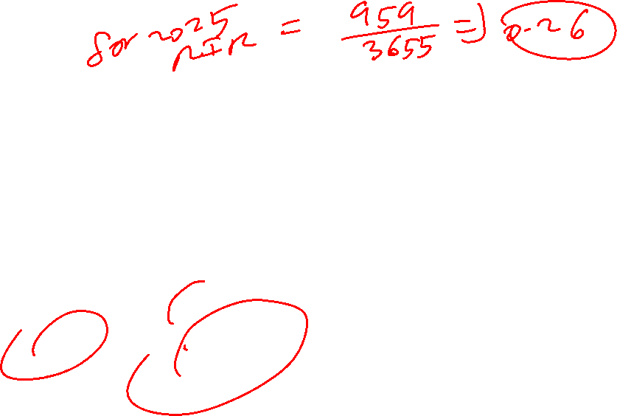
Reinvestment Rate- Hero Motocorp (amount in Rs cr)
Particulars | 2025 | 2024 | 2023 | 2022 | 2021
EBIT | 4910 | 4402 | 2976 | 2182 | 2877
Total Tax expenses | 1558 | 1348 | 1064 | 729 | 913
PBT | 6095 | 5210 | 3861 | 3257 | 3896
Tax Rate | 0.2556 | 0.2587 | 0.2756 | 0.2238 | 0.2343
(1-t) | 0.7444 | 0.7413 | 0.7244 | 0.7762 | 0.7657
EBIT (1-t) | 3655 | 3263 | 2156 | 1694 | 2203
Reinvst amount | 959 | -874 | 368 | 213 | -928
Reinvst rate | 0.26 | -0.27 | 0.17 | 0.13 | -0.42
5 year avg reinvest.rate | -3 % | Lets us assume 25% | 4 year avg reinvest rate (excluding 2021) 7% | Median 13%

Slide 552
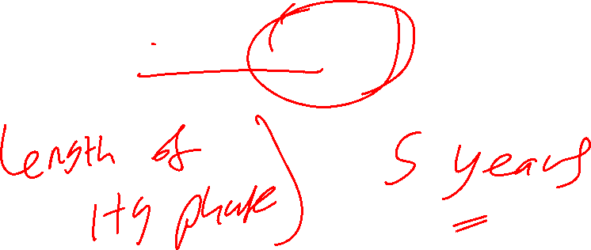
Inputs for EV/EBITDA for Hero Motocorp
Assumed ROC = 25%
Assumed reinvestment rate = 0.25
Growth rate in EBIT = = 25 *0.25 = 6.25% ( 2 stage growth firm)

Slide 553
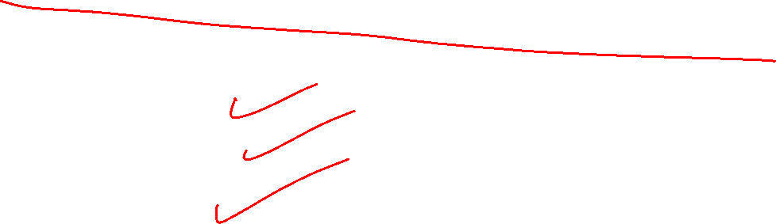
EV/EBITDA for the high growth phase
EV/EBITDA =
(FCFF/EBITDA) (1+g) { 1- (1+g) ^n/ (1+WACC)^n} / (WACC-g)
Here g= 6.25%
FCFF/EBITDA =???
WACC = ???

Slide 554
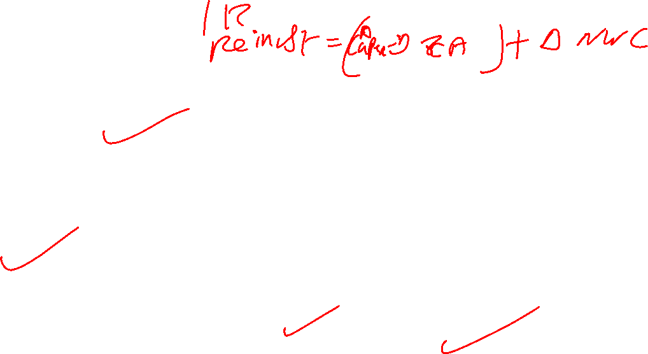
FCFF/EBITDA – Hero Motocorp
Particulars | 2025 | 2024 | 2023 | 2022 | 2021
EBIT | 4910 | 4402 | 2976 | 2182 | 2877
+ D&A | 825 | 757 | 697 | 690 | 715
= EBITDA | 5735 | 5159 | 3673 | 2872 | 3592
EBIT(1-T) | 3655 | 3263 | 2156 | 1694 | 2203
- Reinvst | 959 | -874 | 368 | 213 | -928
= FCFF | 2696 | 4137 | 1788 | 1481 | 3131
FCFF/EBITDA | 0.47 | 0.80 | 0.49 | 0.52 | 0.87
Avg FCFF/EBITDA | 0.63 | Median =0.52 | Let us take 60%

Slide 555
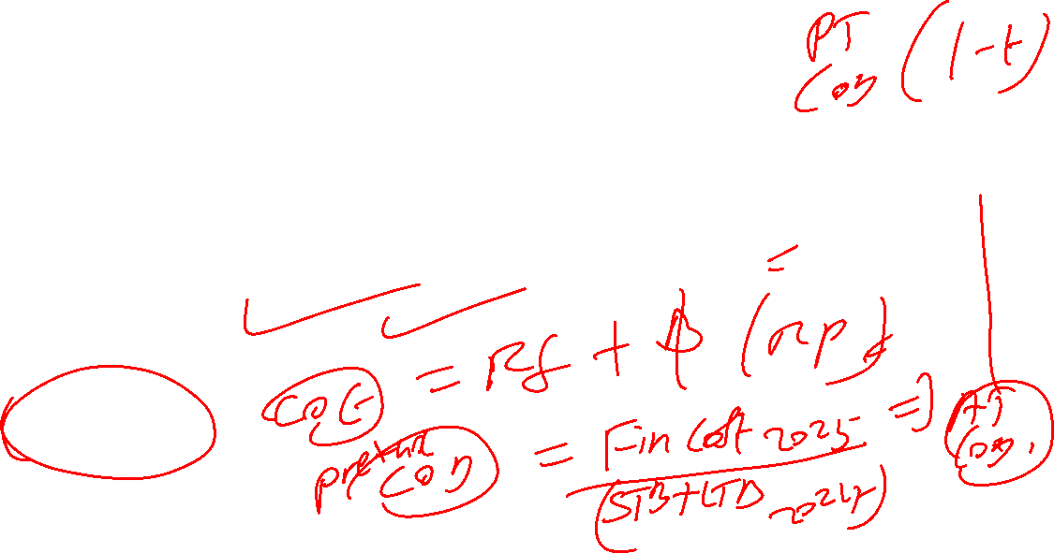
EV/EBITDA for the high growth phase
EV/EBITDA =
(FCFF/EBITDA) (1+g) { 1- (1+g) ^n/ (1+WACC)^n} / (WACC-g)
Here g= 6.25%
FCFF/EBITDA = 0.60
WACC = ???

Slide 556
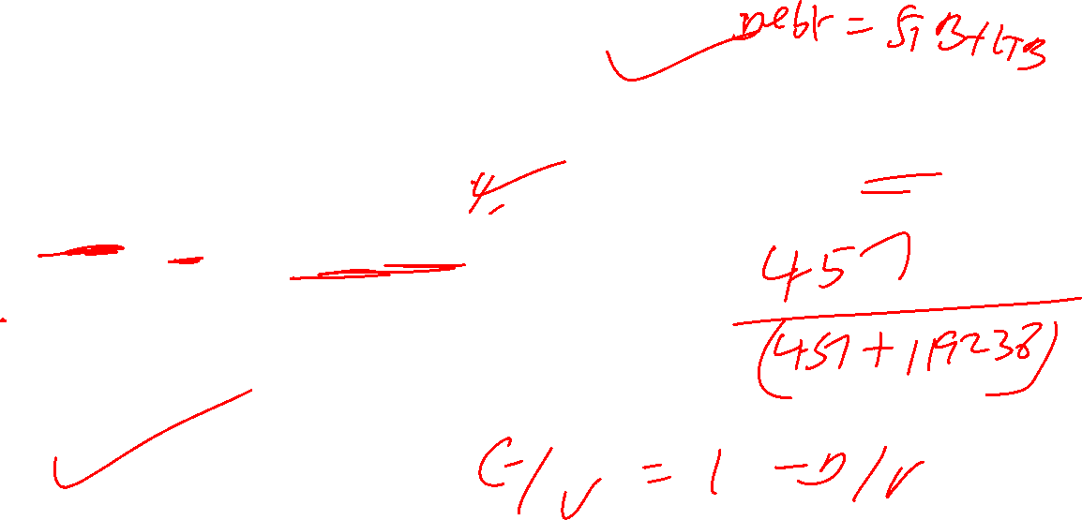
WACC for Hero Motocorp as on 1 January 2026
Cost of Equity = 7.35 + 1.07 (7.46) = 15.33 %
Cost of Debt = 2025 Fin cost/ 2024 Debt = 70.65 / 363.43 = 19.44 %
ATCOD = 19.44 * 0.7444 = 14.47
2025 Debt = 457 ; Mkt Cap = 119238
D/V = 457 /119695 = 0.004; E/V = 0.996
WACC = (0.004*14.47) + (0.996 * 15.33%)
= 0.06 +15.27 = 15.33 %

Slide 557
EV/EBITDA for the high growth phase- Hero Motocorp
EV/EBITDA =
(FCFF/EBITDA) (1+g) { 1- (1+g) ^n/ (1+WACC)^n} / (WACC-g)
Here g= 6.25%
FCFF/EBITDA = 0.60
WACC = 15.33% ; length of HG phase : 5 years

Slide 558

EV/EBITDA Hero Motocorp – High growth phase
EV/EBITDA =
(FCFF/EBITDA) (1+g) { 1- (1+g) ^n/ (1+WACC)^n} / (WACC-g)
= 0.60 (1.0625) { 1- (1.0625) ^5/ (1.1533)^5} / (0.1533-0.0625)
= 0.6375 {1- 1.3541/2.0404} /0.0908
= 0.2145/0.0908 = 2.3623 times

Slide 559
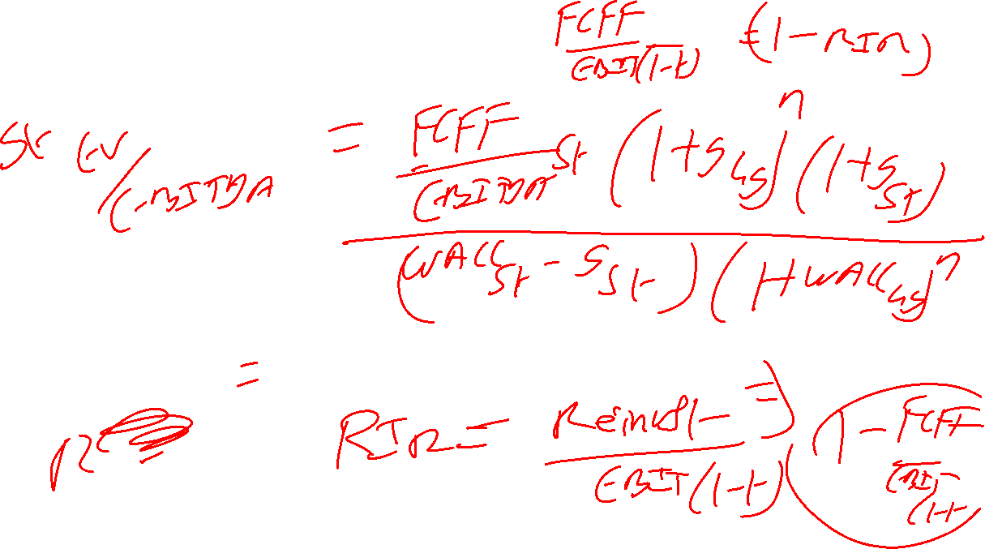

Slide 560
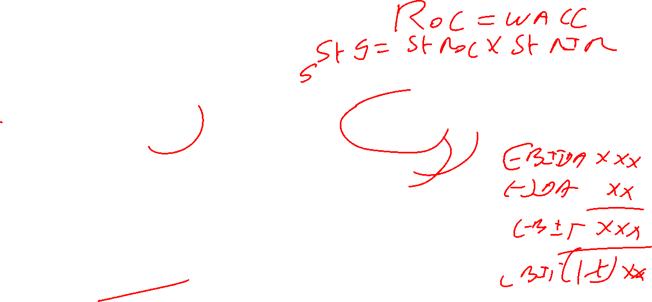
EV/EBITDA for Stable Phase
= (FCFF/EBITDA) st (1+g hg) ^n (1+g st) / (waac st-g st) (1+wacc hg)^n
Let us Assume
FCFF/EBITDA st = 0.80; g st =1 % ; WACC st = 10 %
= 0.80 (1.0625)^5 (1.01) / ( 0.10-0.01) ( 1.1533)^5
= 0.80(1.3541) (1.01)/ (0.09) (2.0404)
= 1.0941/0.1836 = 5.9592 times

Slide 561

EV/EBITDA for Hero Motocorp ON 1 January 2026
Total EV/EBITDA = 2.3623 + 5.9592 = 8.3215 times = 8.32 times
Predicted EntV = 8.32 * EBITDA 2025 * ( 1+0.1533/360 * 271= 1.12) = 8.32* 5735 *1.12=
INR 53441 cr
Predicted Eq.value = EntV – Debt + Cash =53441 -457 + 6636+574
= INR 60194 Cr
Predicted Price/share= 60194/20.01 = INR 3008.20
Actual Eq.value = Rs 119238 cr; CMP = INR 5958.50
52W LH : INR 3344.00-INR 6388.50
Highly Overvalued

Slide 562
EV/EBITDA of a 3-stage firm

Slide 563
Let us consider Adani Ports and Special Economic Zone Ltd
Stable firm Test:
If the growth rate in operating income is less than the expected long run growth rate of the economy i.e 6 % for India
Growth rate in EBIT = Avg.reivst rate * Avg ROC
We may consider last five years for our analysis

Slide 564

Five Year Average ROC for Adani Ports
Particulars | 2025 | 2024 | 2023 | 2022 | 2021 March
ROC in % | 13.94 | 13.15 | 8.90 | 9.90 | 12.54
5 year avg ROC | 11.69 % | Median 12.54 % | Let us consider 12.54%

Slide 565
Delta Capex in the past 5 years (Amount in INR Crores) – Adani Ports
Particulars | 2025 | 2024 | 2023 | 2022 | 2021 | 2020
Tangible assets | 70031 | 56958 | 54429 | 42321 | 38711 | 27488
+ Intangible assets | 12492 | 11283 | 11446 | 8572 | 5533 | 1940
+ Cap WIP | 11592 | 10936 | 6814 | 3986 | 3697 | 3216
Delta Net Capex | 14938 | 6488 | 17810 | 6938 | 15297

Slide 566
Reinvestment Amount –(Adani Ports ) (in Rs cr) (Consolidated B/S)
Particulars | 2025 | 2024 | 2023 | 2022 | 2021
Delta Net Capex | 14938 | 6488 | 17810 | 6938 | 15297
NWC( AR+Inv-AP) | 2233 | 1938 | 1866 | 1871 | 2904 ( 2761 for 2020)
Delta NWC | Inc 295 | Inc 72 | Dec 5 | Dec 1033 | Inc 143
Net Reinvestment | 15233 | 6560 | 17805 | 5905 | 15440

Slide 567

Reinvestment Rate- (Adani Ports) (amount in Rs cr)
Particulars | 2025 | 2024 | 2023 | 2022 | 2021
EBIT | 14042 | 11976 | 7290 | 6002 | 6467
Total Tax expenses | 1968 | 1990 | 96 | 746 | 1243
PBT | 12888 | 10255 | 5441 | 5348 | 6306
Tax Rate | 0.1527 | 0.1941 | 0.0176 | 0.1395 | 0.1971
(1-t) | 0.8473 | 0.8059 | 0.9824 | 0.8605 | 0.8029
EBIT (1-t) | 11898 | 9651 | 7162 | 5165 | 5192
Reinvst amount | 15233 | 6560 | 17805 | 5905 | 15440
Reinvst rate | 1.28 | 0.68 | 2.49 | 1.14 | 2.97
5 year avg reinvest.rate | 1.71 | Median 1.28 |  | Let us take 100 %

Slide 568
Inputs for EV/EBITDA for Adani Ports
5-year Median ROC = 12.54% ;
reinvestment rate =100 %
Growth rate in EBIT = 12.54* 1= 12.54% ( could be considered as a 3-stage firm)
FCFF/EBITDA =???
WACC = ???

Slide 569
FCFF/EBITDA – Adani Ports
Particulars | 2025 | 2024 | 2023 | 2022 | 2021
EBIT | 14042 | 11976 | 7290 | 6002 | 6467
+ D&A | 4379 | 3888 | 3423 | 2740 | 2107
= EBITDA | 18421 | 15864 | 10713 | 8742 | 8574
EBIT(1-T) | 11898 | 9651 | 7162 | 5165 | 5192
- Reinvst | 15233 | 6560 | 17805 | 5905 | 15440
= FCFF | -3335 | 3091 | - 10643 | -740 | -10248
FCFF/EBITDA | -0.18 | 0.19 | -0.99 | -0.08 | -1.20
Avg FCFF/EBITDA | -0.45 |  | Median 5 year -0.18 | Assume 10%

Slide 570
WACC for Adani Ports ( on 2 January 2026)
Cost of Equity = 7.35 + 1.30 (7.46) = 17.05 %
Cost of Debt = 2813 (Fin cost of 2025)/ 46142 (total borrowings of 2024) = 6.10%; post tax COD= 6.10 (0.8473) = 5.17 %
E/V = 321752 /(321752 + 45660) = 0.88 ; D/V = 0.12
WACC = 0.88( 17.05) + 0.12 ( 5.17)
= 15.00 +0.62 = 15.62 %
Assume : Stable Phase WACC of 10 %

Slide 571
What to do ???

Slide 572
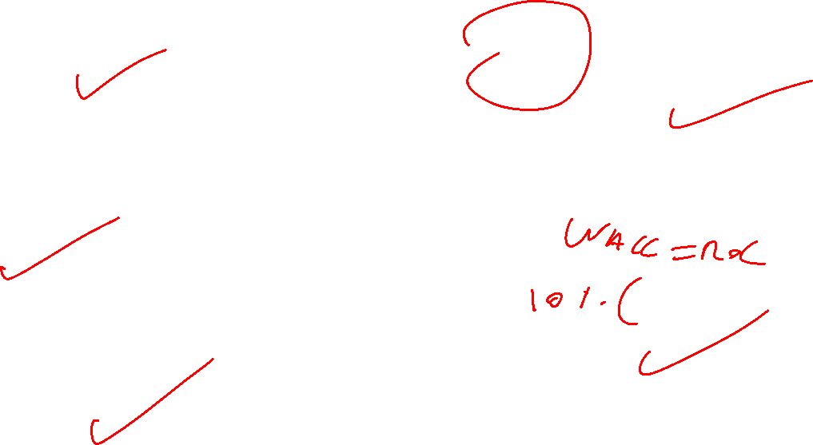
Assumptions in the computation of EV/EBITDA for Adani Ports- 3 stage model
Particulars | High Growth Phase | Transition Phase | Stable Phase
Length (in years ) | 10years | 5 years (i.e y11 to y15) | After year 15
FCFF/EBITDA | 10% | (70-10)/5 = 12% p.year Y11: 22 % Y12: 34 % Y13: 46 % Y14: 58 % Y15: 70 % | 70 %
Growth Rate | 12.54% | (12.54-2 )/5 = 2.108% p.year Y11: 10.432 % ; Y12: 8.324 % Y13: 6.216 % ; Y14: 4.108 % Y15: 2 % | 2% = 10 (0.2 )
COC (WACC) | 15.62 % | (15.62-12)/5 = 1.124 % p.year Y11: 14.496 % ; Y12: 13.372% Y13: 12.248% ; Y14: 11.124% Y15: 10% | 10%

Slide 573
EV/EBITDA for the high growth phase
EV/EBITDA =
(FCFF/EBITDA) (1+g) { 1- (1+g) ^n/ (1+WACC)^n} / (WACC-g)
Here g= 12.54 %
FCFF/EBITDA = 10%
WACC = 15.62%
length of HG phase : 10 years

Slide 574
EV/EBITDA Adani Ports – High growth phase
EV/EBITDA =
(FCFF/EBITDA) (1+g) { 1- (1+g) ^n/ (1+WACC)^n} / (WACC-g)
= 0.10 (1.1254) { 1- (1.1254) ^10/ (1.1562)^10} / (0.1562-0.1254)
= 0.1125 {1- 3.2589/4.2690} /0.0308
= 0.0266/0.0308 = 0.8636 times

Slide 575
Transition Phase EV/EBITDA for Adani Ports

Slide 576
Adani Ports : Year 11 EV/EBITDA
= year 11 FCFF/EBITDA * (1+G hg)^ hg period * (1+ G year 11)
-----------------------------------------------------------------------
(1+ COC hg) ^ hg period * (1+ COC year 11)
FCFF/EBITDA Y11 = 22 % ; gF hg = 3.2589 ; G Y11 = 10.432%;
COC F hg = 4.2690 ; COC Y 11=14.496%= 14.50 %
Length of HG phase = 10 years

Slide 577
Adani Ports : Year 11 EV/EBITDA
= year 11 FCFF/EBITDA * (1+G hg)^ hg period * (1+ G year 11)
-----------------------------------------------------------------------
(1+ COC hg) ^ hg period * (1+ COC year 11)
= 0.22(3.2589) (1.1043)/ (4.2690) (1.1450)
= 0.22 (3.5988)/ 4.8880 = 0.1620 times

Slide 578
Adani Ports : Year 12 EV/EBITDA
= year 12 FCFF/EBITDA * (1+G hg)^ hg period * (1+ G year 11)*(1+G y12)
---------------------------------------------------------------------------------
(1+ COC hg) ^ hg period * (1+ COC year 11)*(1+COC y12)
FCFF/EBITDA Y12 = 34 % ; g F y1-y 11 =3.5988 ; G Y12= 8.324%;
COC F y1-y11 = 4.8880 ; COC Y 12= 13.372%
Length of HG phase = 10 years

Slide 579
Adani Ports : Year 12 EV/EBITDA
= year 12 FCFF/EBITDA * (1+G hg)^ hg period * (1+ G year 11)*(1+G y12)
---------------------------------------------------------------------------------
(1+ COC hg) ^ hg period * (1+ COC year 11)*(1+COC y12)
= 0.34 (3.5988) (1.0832) / (4.8880) ( 1.1337)
= 0.34 (3.8982) / 5.5415 = 0.2392 times

Slide 580
Adani Ports : Year 13 EV/EBITDA
= year 13 FCFF/EBITDA * (1+G hg)^ hg period * (1+ G year 11)*(1+G y12) *(1+ g y 13)
-----------------------------------------------------------------------------------------
(1+ COC hg) ^ hg period * (1+ COC year 11)*(1+COC y12) (1+COC Y 13)
FCFF/EBITDA Y13 = 46 % ; g F y1-y12 =3.8982 ; G Y13 = 6.216%; COCF y1-y12 = 5.5415 ; COC Y 13= 12.248%; Length of HG phase = 10 years

Slide 581
Adani Ports : Year 13 EV/EBITDA
= year 13 FCFF/EBITDA * (1+G hg)^ hg period * (1+ G year 11)*(1+G y12) *(1+ g y 13)
---------------------------------------------------------------------------------
(1+ COC hg) ^ hg period * (1+ COC year 11)*(1+COC y12) (1+coc y13)
= 0.46 (3.8982) (1.0622) / (5.5415) (1.1225)
= 0.46 (4.1407) / 6.2203 = 0.3062 Times

Slide 582
Adani Ports : Year 14 EV/EBITDA
= year 14 FCFF/EBITDA * (1+G hg)^ hg period * (1+ G year 11)*(1+G y12) *(1+ g y 13) * (1+ g y 14)
-------------------------------------------------------------------------------------------
(1+ COC hg) ^ hg period * (1+ COC year 11)*(1+COC y12) (1+COC Y 13) (1+COC Y14)
FCFF/EBITDA Y14 = 58 % ; g F y1-y13= 4.1407 ; G Y14 = 4.108 %;
COC F Y 1-y 13= 6.2203 ; COC Y14= 11.124%
Length of HG phase = 10 years

Slide 583
Adani Ports : Year 14 EV/EBITDA
= year 14 FCFF/EBITDA * (1+G hg)^ hg period * (1+ G year 11)*(1+G y12) *(1+ g y 13) * (1+ g y 14)
-------------------------------------------------------------------------------------------
(1+ COC hg) ^ hg period * (1+ COC year 11)*(1+COC y12) (1+COC Y 13) (1+COC Y14)
= 0.58 * 4.1407* (1.0411)/ (6.2203) (1.1112)
= 0.58 (4.3109)/ 6.9120 = 0.3617 Times

Slide 584
Adani Ports : Year 15 EV/EBITDA
= year 15 FCFF/EBITDA * (1+G hg)^ hg period * (1+ G year 11)*(1+G y12) *(1+ g y 13) * (1+ g y 14) * (1+g y 15)
-------------------------------------------------------------------------------------------
(1+ COC hg) ^ hg period * (1+ COC year 11)*(1+COC y12) (1+COC Y 13) (1+COC Y14) (1+COC Y 15)
FCFF/EBITDA Y15 = 70 % ; g F y1-y14 =4.3109 ; G Y15 = 2 %;
COC F y1- y14 = 6.9120 ; COC Y 15= 10 %; Length of HG phase = 10 years

Slide 585
Adani Ports : Year 15 EV/EBITDA
= year 15 FCFF/EBITDA * (1+G hg)^ hg period * (1+ G year 11)*(1+G y12) *(1+ g y 13) * (1+ g y 14) * (1+g y 15)
-------------------------------------------------------------------------------------------
(1+ COC hg) ^ hg period * (1+ COC year 11)*(1+COC y12) (1+COC Y 13) (1+COC Y14) (1+COC Y 15)
= 0.70 (4.3109) (1.0200)/ (6.9120) (1.1000)
= 0.70 (4.3971)/ 7.6032 = 0.4048 Times

Slide 586
Adani Ports -EV/EBITDA Transition Phase
= 0.1620 +0.2392 +0.3062 +0.3617 +0.4048 = 1.4739 Times

Slide 587
Adani Ports : Stable Phase EV/EBITDA
St. Ph FCFF/EBITDA * (1+G hg)^ hg p * (1+ Gy11)*(1+Gy12) (1+Gy13) (1+Gy14)(1+G Y 15)(1+G st.ph)
----------------------------------------------------------------------------------------------------
(COC st.ph – G st.ph) (1+ COC hg) ^ hg p * (1+ COC y 11)*(1+COC y12)* (1+COC y13) (1+COC y14) (1+COC y15)
= 0.70 (4.3971)(1.0200) / (7.6032) (0.10-0.0200)
= 3.1395/ 0.6083 = 5.1611 times

Slide 588

EV/EBITDA for Adani Ports ON 2 January 2026
Total EV/EBITDA = 0.8636 + 1.4739+ 5.1611 = 7.4986 times = 7.50 times
Predicted EV = 7.50* EBITDA 2025 * ( 1 +0.1562/360 * 272= 1.12) =
7.50 * 18421*1.12= INR 154736 cr
Predicted Eq.value = EV – Debt + Cash =154736 -45660+ 6606 +752
=INR 116434 Cr
No.of shares : 216.01 crores : Predicted Price/Share = INR 539.02
Actual Eq.value = INR 321752 cr ; CMP 1489.50 on 2 Jan 2026
52 W LH : INR 1010.75 TO 1549.00
Highly Overvalued

Slide 589
Sensitivity for
WACC of Stable Phase : 9 %
Length of HG Phase = 15 years ; transition phase Y 16-Y20 ; St ph from Y 21
Other inputs remain the same

Slide 590
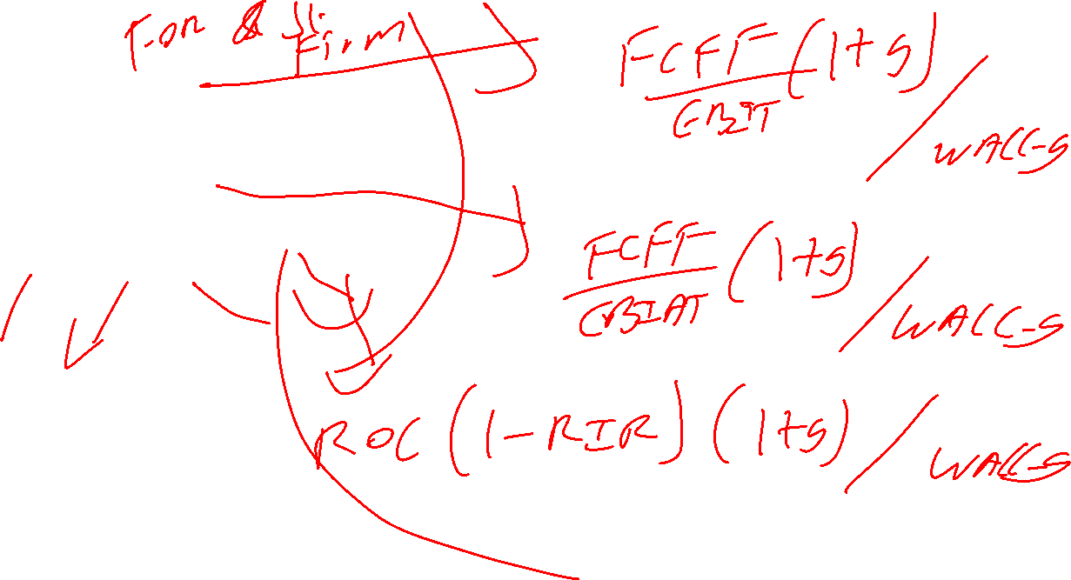
Other EV multiples
EV/EBIT
EV/EBIAT
EV/Invested Capital
EV/Sales

Slide 591
Need to do excel for EV/EBITDA stable/2 stage/ 3 stage
Need to do price based multiple excel 1/2/3 stage

